Slide 1
The National Conference
Wifi – free login once connected
Teas & Coffees next door
Take your agenda, bag, name badge
kirsty@TheCFN.org.uk
Chairman, The Corporate Finance Network

Slide 2
ACTION
POINTS
Notes:
Don’t waste today
Book meeting to share – leverage today

Slide 3
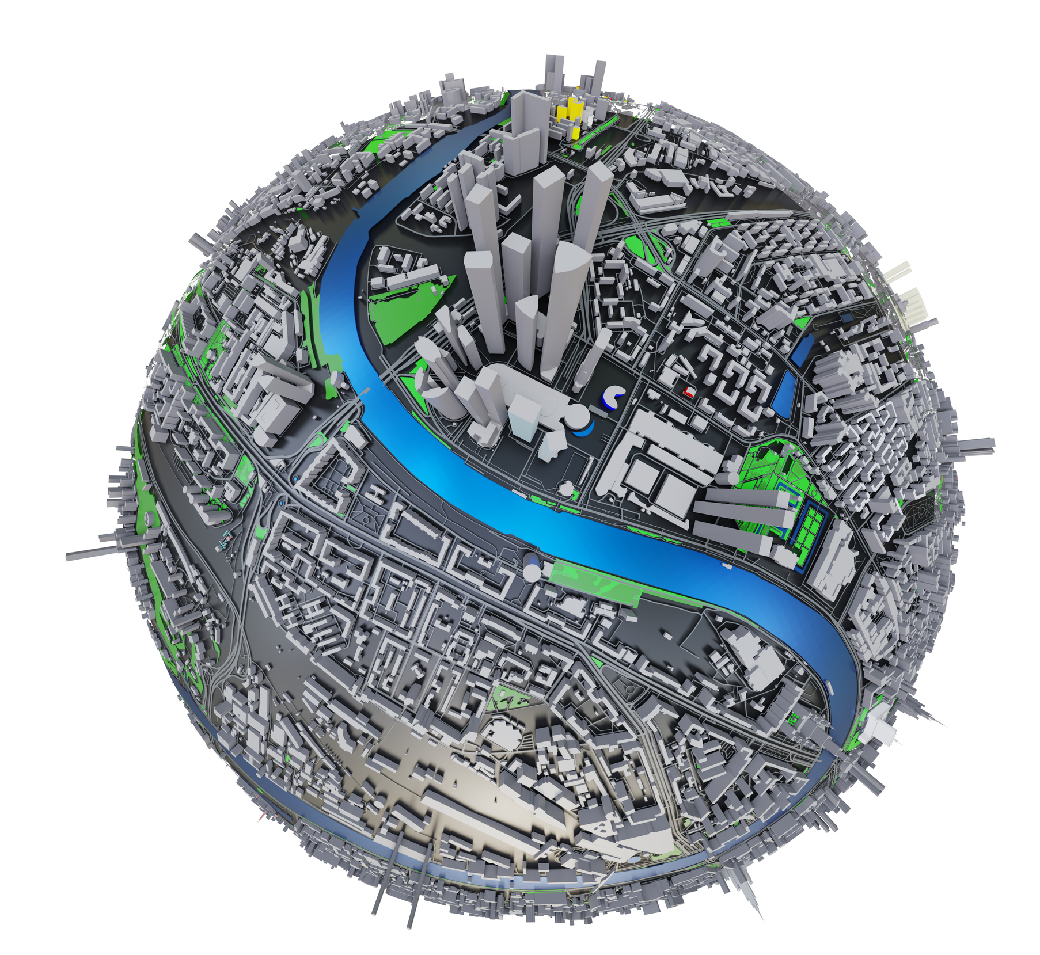
Global impacts on our doorstep
Notes:
These impacts will be affecting your clients – either they’ve not realised, or you haven’t (yet)
Risk of overtrading when seems like turnover is healthy – but margins aren’t, cashflow forecast is dire and real terms growth isn’t there
We are the support

Slide 4
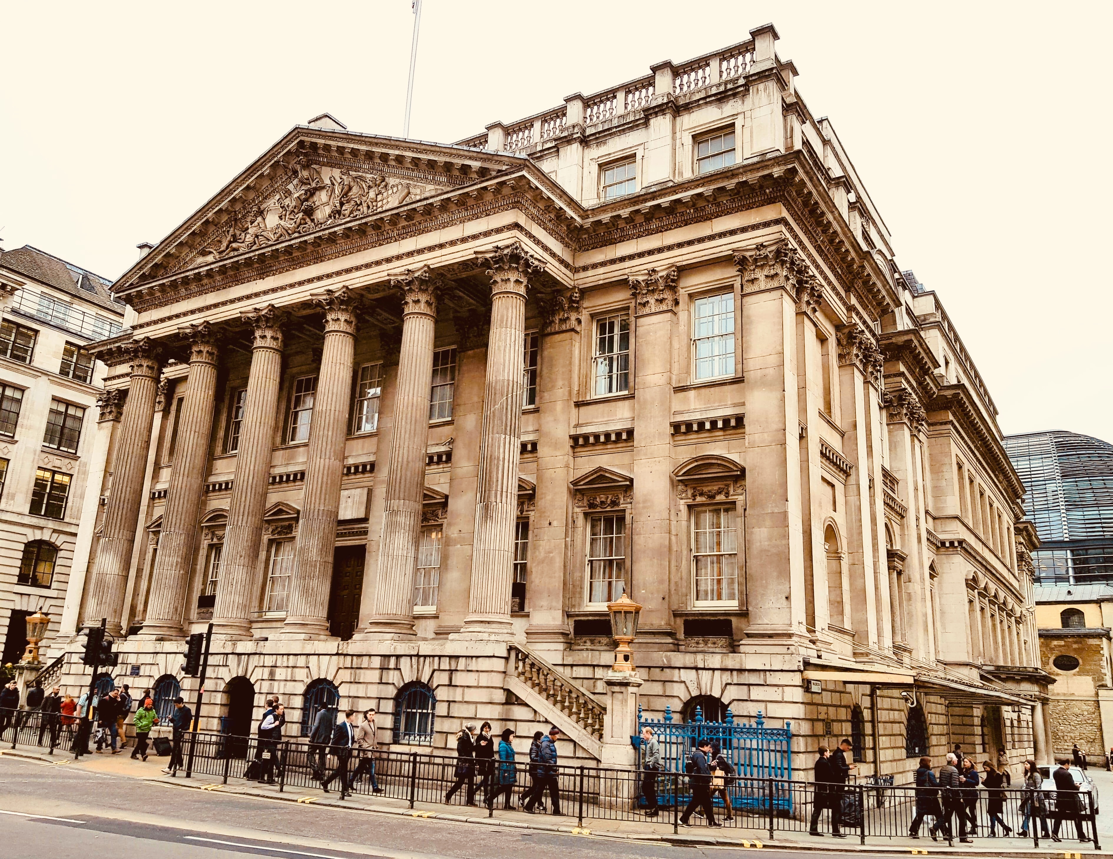
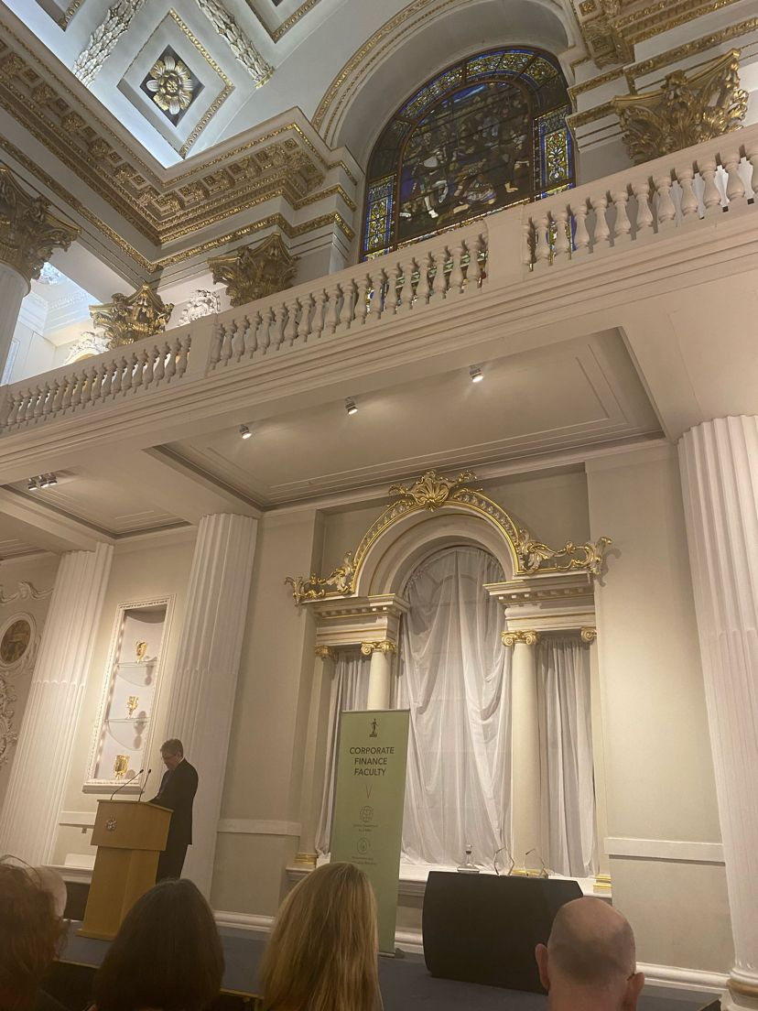
Notes:
ICAEW CF Faculty 25th Anniversary Reception
The great and the good
Chasing after the same deals £1m ebitda
Their experiences of smaller deals – SMEs are a nightmare!
Yes but what a difference we can make
We can keep employers in our community if we make the business sellable
We can give founders a retirement & their families a future with a healthy capital exit
We can give MBO teams the opportunity to control their destiny with co ownership
We can help clients grow by acquisition

Slide 5
Global impacts on our doorstep
Notes:
What about your impact?
How many clients have you made sellable?
How many have you turned onto the idea of acquisition?
How many have you helped build a growth strategy
And funded to achieve that growth

Slide 6
KNOW YOUR POWER!
LET’S GET $#IT DONE!

Slide 7

Notes:
We don’t have enough resource
Look at your recruitment & retention strategy
Do you tell employees:
They’ll work with the leading tech
They’ll have opportunity to work on exciting assignments
They can progress as fast as they want to
They’ll make a real difference to businesses & their local communities?
Or do you tell them they’ll get 20 days holiday and need to give you loads of THEIR experience and their commitment. What can you do for them? It’s not all about pay. It’s about job satisfaction and making a difference.

Slide 8
KNOW YOUR POWER!
LET’S GET $#IT DONE!
Notes:
We do have power.
We can make a massive impact.
What are accountants for nowadays? To report historical data or to support businesses and grow the economy?

Slide 9
The National Conference
kirsty@TheCFN.org.uk
Chairman, The Corporate Finance Network

