Slide 1

UK Restructuring Update
Overview
David Fleming, Mike Parsons and Sushil Patel
October 2022

Slide 2
Introduction to Kroll
UK Restructuring Market Update
HMRC Update
Supply Chain and Cost Inflation Challenges
Case Study – Project Print
Testimonial and Summary

Slide 3
01. Introduction To Kroll

Slide 4

UK Restructuring - SME Mid Market Practice
Total Staff: 149
15 Managing Directors
THE UK INSOLVENCY MARKET
London (30%)
Manchester (14%)
Birmingham (7%)
Manchester
7 MD’s
57 Staff
Overall UK market by number of administrations
Birmingham
2 MD’s
17 Staff
13%
6%
34%
London
6 MD’s
60 Staff

Slide 5


Core Service Overview
RESTRUCTURING
ADVISORY
(32 Staff)
Real Estate advisory
(11 STAFF)
100 cases per annum
Turnaround / Solvent Solutions
Options Reviews
Financial Forecast Modelling
Pre-Lend Reviews / Diligence
Stakeholder Management
HMRC Time to Pay
Debt Advisory
LPA Receiverships
RICS ‘Red Book’ Valuations
Property Asset Management
Strategic Value Advisory
Transaction Due Diligence
350 cases per annum
4
Core Services
Restructuring
(96 STAFF)
Personal insolvency
(4 STAFF)
55 cases per annum
Administrations
CVA’s / Restructuring Plans / Moratoriums
Liquidations
Contingency Planning
Accelerated M&A Processes
Contentious Insolvency
Corporate Structure Simplification
Individual Voluntary Arrangements (IVA’s)
Bankruptcies
Strategic Personal Advice
Pre-Action Asset Recovery Reports
85 cases per annum

Slide 6
02. UK Restructuring Market Update

Slide 7
MARKET UPDATE & HISTORIC UK ADMINISTRATION APPOINTMENTS
Post run-off of UK Government support initiatives has seen Administration appointments increase
FY21
(39%)
FY22
39%
Lowest level of administration appointments since 1989
Furlough
Ends
Winding Up Petition / Landlord Restrictions Lifted

Slide 8
MARKET OUTLOOK – CBILS vs ADMINISTRATIONS
Sector focus: CBILS lending vs. Administrations
CBILS / Administrations Analysis | CBILS Loans |  |  | Administrations (YTD 2022)
Sector | Loans (£'m) | No. Loans | % of Loan Values | Administrations | % of Administrations
Construction | 4,347 | 16,724 | 17% | 96 | 15%
Retail | 3,484 | 13,395 | 13% | 57 | 9%
Professional & Financial Services* | 2,282 | 8,284 | 9% | 52 | 8%
Real Estate | 1,879 | 5,547 | 7% | 72 | 12%
Manufacturing (excl. Fabricated Metal) | 1,863 | 6,952 | 7% | 66 | 11%
Leisure & Hospitality (excl. Accommodation) | 1,459 | 4,817 | 6% | 33 | 5%
Food & Drink | 1,344 | 5,535 | 5% | 21 | 3%
Office Administrative | 1,006 | 4,237 | 4% | 8 | 1%
Accommodation | 957 | 2,123 | 4% | 9 | 1%
Legal & Accounting Services | 873 | 3,188 | 3% | 7 | 1%
Media & Technology | 867 | 3,427 | 3% | 33 | 5%
Automotive | 810 | 3,837 | 3% | 14 | 2%
Land Transport & Transport via Pipelines | 762 | 4,166 | 3% | 15 | 2%
Manufacture of Fabricated Metal Products | 593 | 2,352 | 2% | 17 | 3%
Other | 493 | 2,417 | 2% | 9 | 1%
Energy, Industrials, & Utilities | 489 | 1,935 | 2% | 33 | 5%
Healthcare | 481 | 2,621 | 2% | 18 | 3%
Printing & Advertising | 465 | 1,922 | 2% | 14 | 2%
Recruitment | 460 | 1,900 | 2% | 10 | 2%
Education | 434 | 1,293 | 2% | 5 | 1%
Transportation & Logistics | 332 | 1,250 | 1% | 14 | 2%
Agriculture, Forestry, & Fishing | 196 | 1,017 | 1% | 5 | 1%
Telecoms | 133 | 450 | 1% | 8 | 1%
Mining | 58 | 266 | 0.2% | 1 | 0.2%
Aerospace & Defense | 10 | 40 | 0.04% | 3 | 0.5%
TOTAL | 26,080 | 99,695 |  | 620
64% of Loans Values
&
63% of Admins
*Professional & Financial Services excludes ‘Legal & Accounting Services’ and ‘Office Administrative’

Slide 9





SECTOR MARKET OUTLOOK
KEY DISTRESSED SECTORS
CONSTRUCTION
CONSUMER
(RETAIL + LEISURE & HOSPITALITY)
FINANCIAL SERVICES
REAL ESTATE
MANUFACTURING
(INC F&B)
£4.4bn CBILS
15% Administrations YTD
Inflation pressures
Supply chain disruption
Energy intensive sectors like steel, cement and concrete face surging costs.
Operational inefficiencies (safety regulation, labour shortages and pandemic)
£5bn CBILS
14% Administrations YTD
Reducing demand
Change in spending habits
Inflationary pressures
Interest rate rises
£2.3bn CBILS
8% Administrations YTD
Borrowing costs
Risk appetite
Funding restrictions
Bad debts & provisions
£1.9bn CBILS
12% Administrations YTD
Increased development costs
Supply chain / delivery protraction
Prime & Secondary divergence
Retail – declining
£3.2bn CBILS
14% Administrations YTD
Access to raw materials
Change in consumer habits
Inflationary pressures
Energy costs
Competition
Staff costs / shortages
Supermarket dictating prices

Slide 10
MARKET UPDATE AND HISTORIC UK CREDITORS’ VOLUNTARY LIQUIDATIONS (CVLs)
In line with the phasing out of Government support measures, the number of CVL’s has increased significantly since mid 2021 and are now 65% higher than pre-COVID levels
FY21
33%
FY22
49%
Furlough phased out
Furlough
Ends
Winding Up Petition / Landlord Restrictions Lifted

Slide 11
SECTOR ANALYSIS – TOTAL INSOLVENCIES
Sector focus: Total Number of Insolvencies Per Sector
27%
8%
10%
21%
10%
6%
7%
12%
73%
11%
72%
14%
12%
12%
19%
18%

Slide 12
03. HMRC Update

Slide 13
Selected Case Study
HMRC Time To Pay Proposal – Project Viking
Sponsor-backed £27m turnover polymer manufacturer
Operational turnaround plan in progress
Very poor compliance record
Strong resistance from senior HMRC leaders
Cessation of enforcement action from HMRC
16 month Time To Pay Agreed
Company Overview
Challenges
Outcome
£3.5m of arrears
Aggressive approach taken by director / sponsor
Prior pre-pack Admin with £4m HMRC loss
Bond demand of £2.5m expected
500 jobs saved
Bond demand dropped

Slide 14
Selected Case Study
HMRC Time To Pay Proposal – Project Amber
£13m turnover events business with 150 staff
Lost key contract worth £3m p.a.
Poor compliance record
Initial management TTP rejected
Forecasts constructed inc sensitivities
18 month Time To Pay Agreed
Company Overview
Challenges
Outcome
Staff shortages and cost inflation
Tax arrears of £800k
Exhausted stakeholder support
No reliable financial forecasts
TTP included s455 tax
Director loan repayment plan agreed as part of proposal

Slide 15
04. The Impacts on Value of Leverage

Slide 16
CASE STUDY - LEVERAGED BUYOUTS
Project Coniston – Leveraged MBO of Forklift Truck Hire and Servicing Business
BACKGROUND
WHAT IF THE TRANSACTION OCCURED IN 2023?
£3.9m
£600k
£1.55m
BOE Base Rate is expected to increase to 6% in 2023.
This would increase DSC to £550k per annum with EBITDA providing less than 1.1 times cover.
To achieve EBITDA cover of 1.35 cover, the debt structure would need to decrease by £150k.
This could potentially see a reduction in enterprise value of £150k for the vendor.
Turnover
EBITDA
Debt Structure
TRANSACTION STRUCTURE - 2020
EBITDA:DSC = 1.35 times

Slide 17
CASE STUDY - LEVERAGED BALANCE SHEETS
Project Cake – Disposal Options Pre and Post COVID-19
TRADING PERFORMANCE (PRE-COVID)
UPDATED PERFORMANCE (POST-COVID)
£27.5m
£2m
£3.77m
£21.8m
£700k
£5.8m
Turnover
EBITDA
Debt Structure
Turnover
EBITDA
Debt Structure
BALANCE SHEET – JAN-20
BALANCE SHEET – JUN-22
ENTERPRISE VALUE = £12m
ENTERPRISE VALUE = £0.6m

Slide 18
05. Summary

Slide 19
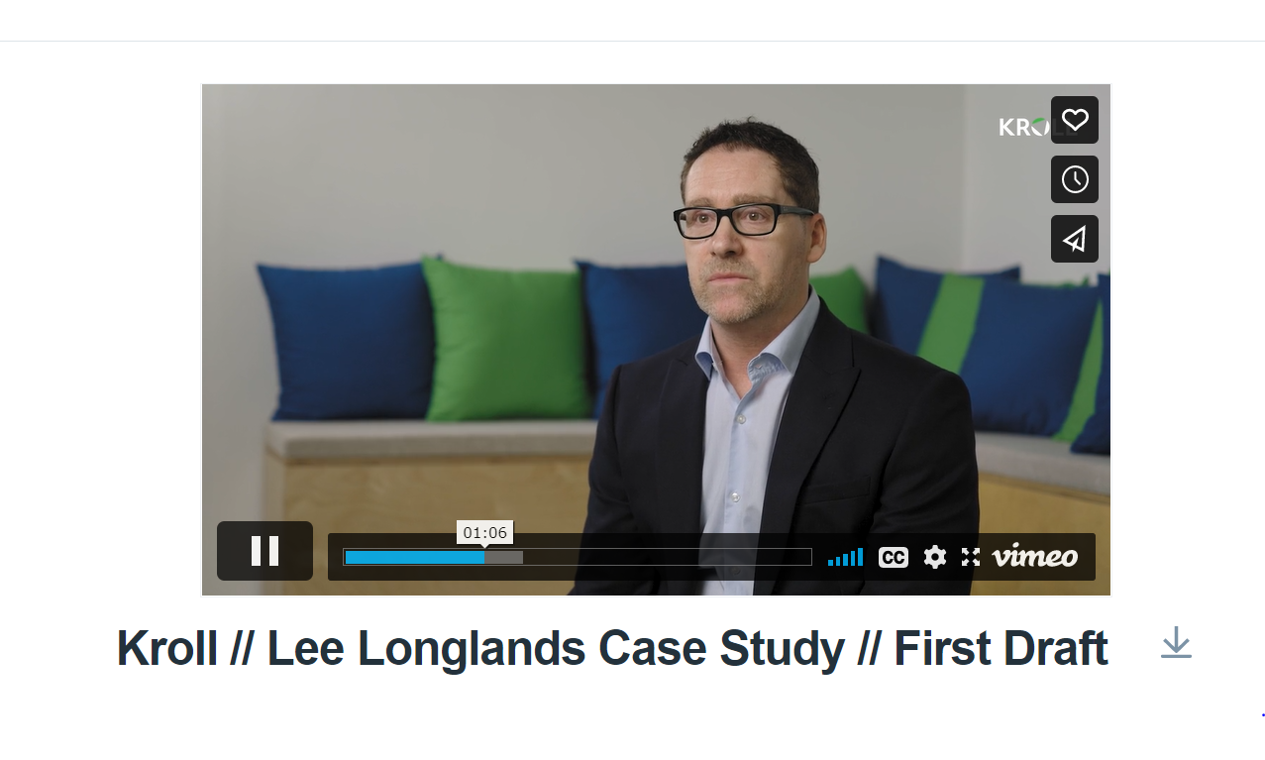
TESTIMONIAL
Lee Longlands Furniture
https://vimeo.com/756739790/e4b05f99ab

Slide 20
SUMMARY
Rising Administration and Liquidations indicating increased levels of distress even prior to recent economic developments
Construction, retail, hospitality, financial services and manufacturing continue to be the sectors with the most insolvencies
HMRC pressure is increasing but we continue to get long term TTP’s agreed, even for companies with poor compliance records
Leveraged buy-outs will become more challenging with increasing interest rates and more risk averse lender approaches due to market uncertainty.
COVID-19 has left many previously high performing businesses with materially depleted enterprise values which will compromise available exit options.
Rising interest rates, increasing inflation, currency devaluation and market volatility could lead to a deep and protracted recession.

Slide 21
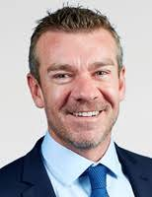
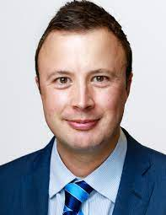

David Fleming
UK Head
Restructuring Advisory
T: +44 0161 827 9155
M: +44 7833 451 848
E: David.Fleming@kroll.com
Mike Parsons
Senior Director
Advisory - North
T: +44 161 827 9013
M: +44 7989 343 372
E: Mike Parsons@kroll.com
Sushil Patel
Director
Advisory – Tax Arrears Solutions
T: +44 207 029 5467
M: +44 7810 155 748
E: Sushil.Patel@kroll.com

