Slide 1

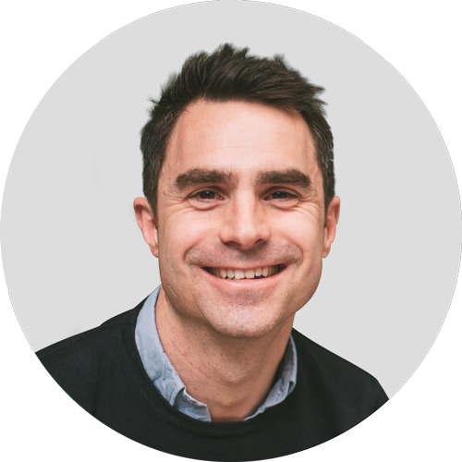

CFN
Breaking the Mould / Cracking advisory
PAUL SURTEES
CEO and Co-founder, Capitalise

Slide 2
Talking points
STATE OF THE ECONOMY
01
04
Why are we here?
Your data
02
05
Capitalise Advisory Board
Lending Data
03
06
Macro Opportunity
Starting a movement …

Slide 3


Slide 4

Why?
Notes:
Why - a pretty big existential question.
Lets apply it …
Why are you here?
What is that you want to hear? What do you want to learn? How will you apply it?
Why did your clients start their business?
Why is Capitalise here …

Slide 5
What is your clients why?
Notes:
Why - a pretty big existential question.
Lets apply it …
Why are you here?
What is that you want to hear? What do you want to learn? How will you apply it?
Why did your clients start their business?
Why is Capitalise here …

Slide 6

Financial
freedom

Slide 7

BRISTOL
Buy a home in
the countryside

Slide 8

BRISTOL
Explore
the world

Slide 9

BRISTOL
Pay for
university

Slide 10
Why are you here?
Notes:
Why - a pretty big existential question.
Lets apply it …
Why are you here?
What is that you want to hear? What do you want to learn? How will you apply it?
Why did your clients start their business?
Why is Capitalise here …

Slide 11
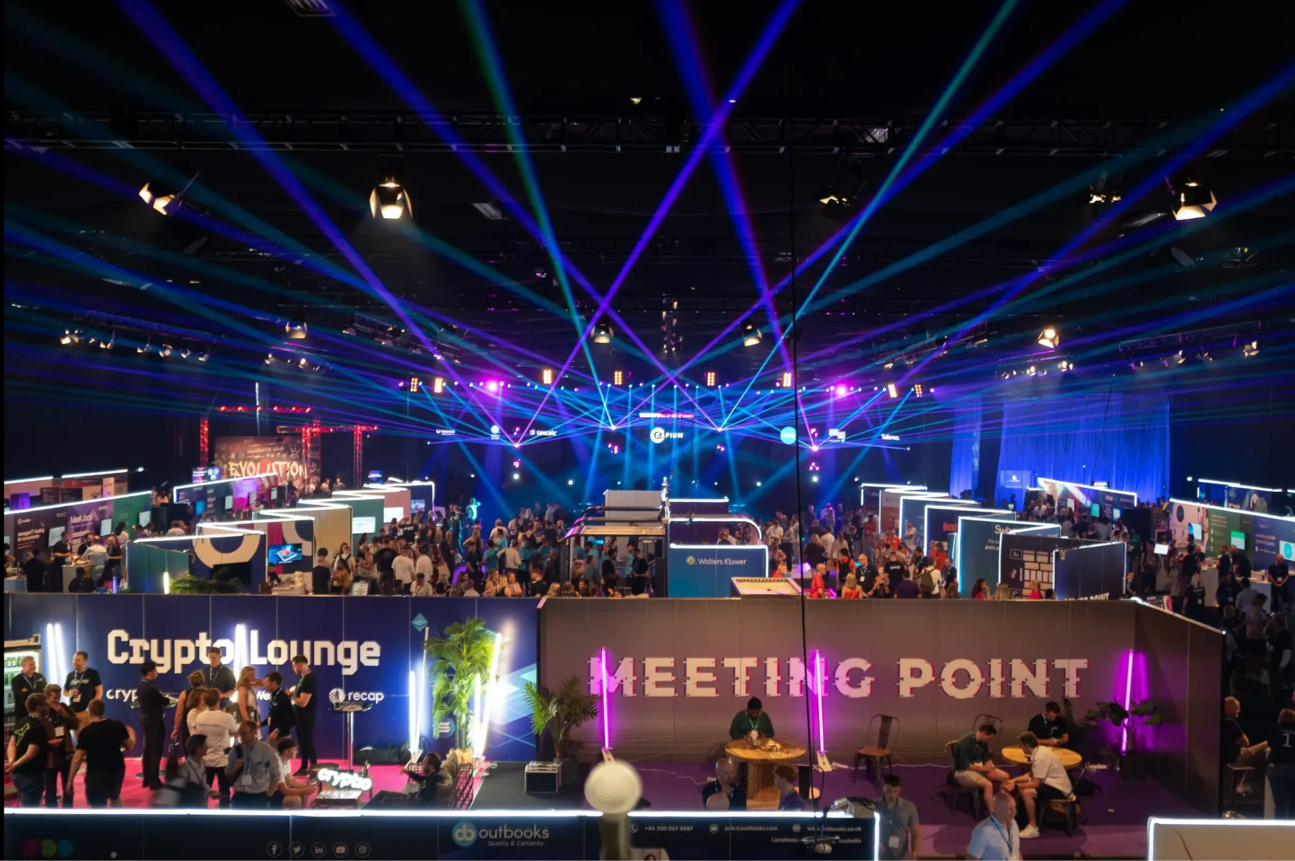
CAB

Slide 12
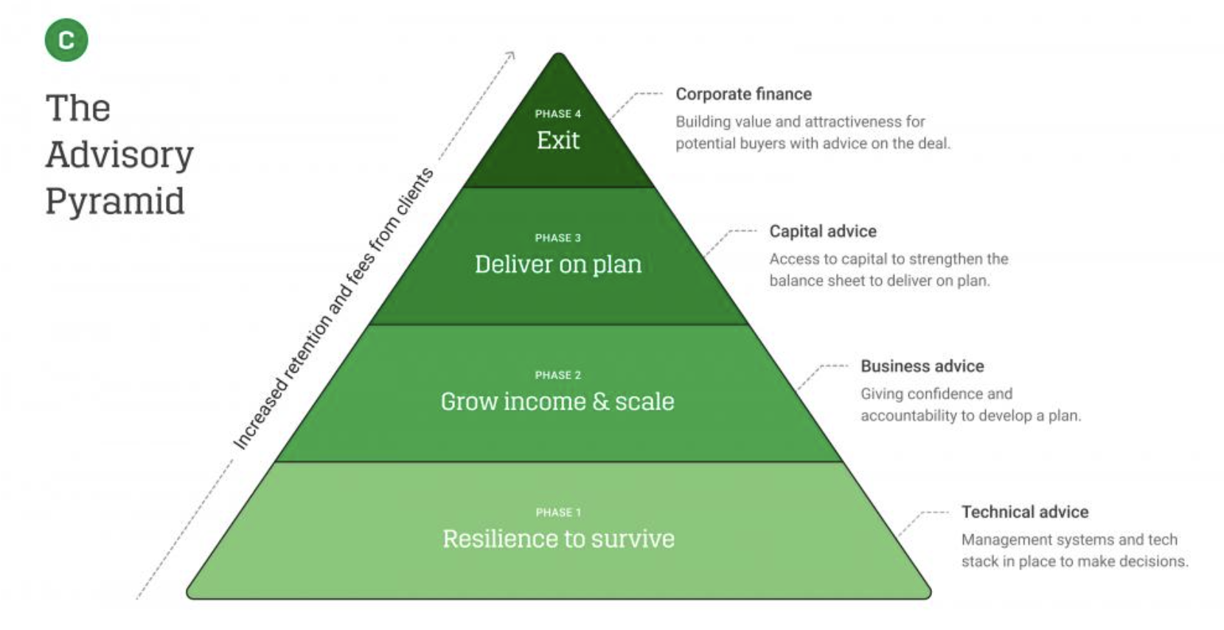

Slide 13
MY CONVERSATIONS
Economy
Speed of Transformation
2024
Private Equity
AI
2
Project Roadblocks
Talent & Capacity
3
Revenue Expansion

Slide 14
PLANS FOR 25
Speed of Transformation
2025
2
3
🚀 Revenue Expansion 🚀

Slide 15
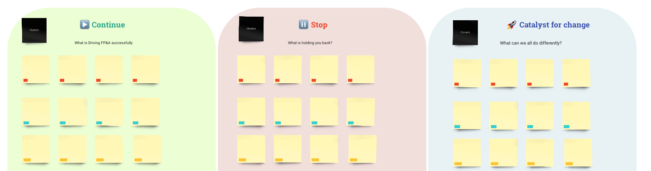
LAND & EXPAND
Why rolling out FP&A is so hard?
What are the barriers and why?
What works well and how?
Why do “large” project roll outs hit so many barriers
Why do “mini pilots” rarely get buy-in for new projects?
Do you need to create a non-billable head space for delivery?
Where do advisory services sit in the prioritisation of the firm?
When projects are delivered well, who typically is involved? Does it create bottlenecks?
How big is the opportunity?
What multiple of book revenue growth is realistic to aim for?

Slide 16
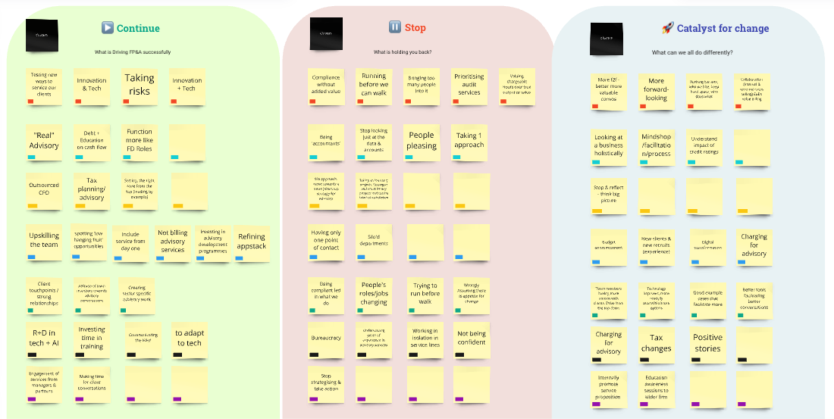
CAB
2
3

Slide 17
ADVISORY BOARD NEXT STEPS
Continue
- Lead by example
- Communicate the why
- Create moments of delight
- Holistic client approach
Stop
- Being siloed
- Single client touch points
- Being compliance led
Catalyst 🚀
- Segment clients
- Hire right for the future
- Story telling
- Advisory KPIs
- Be forward looking
- Digital transformation
Notes:
CAB TAKEAWAYS +

Slide 18


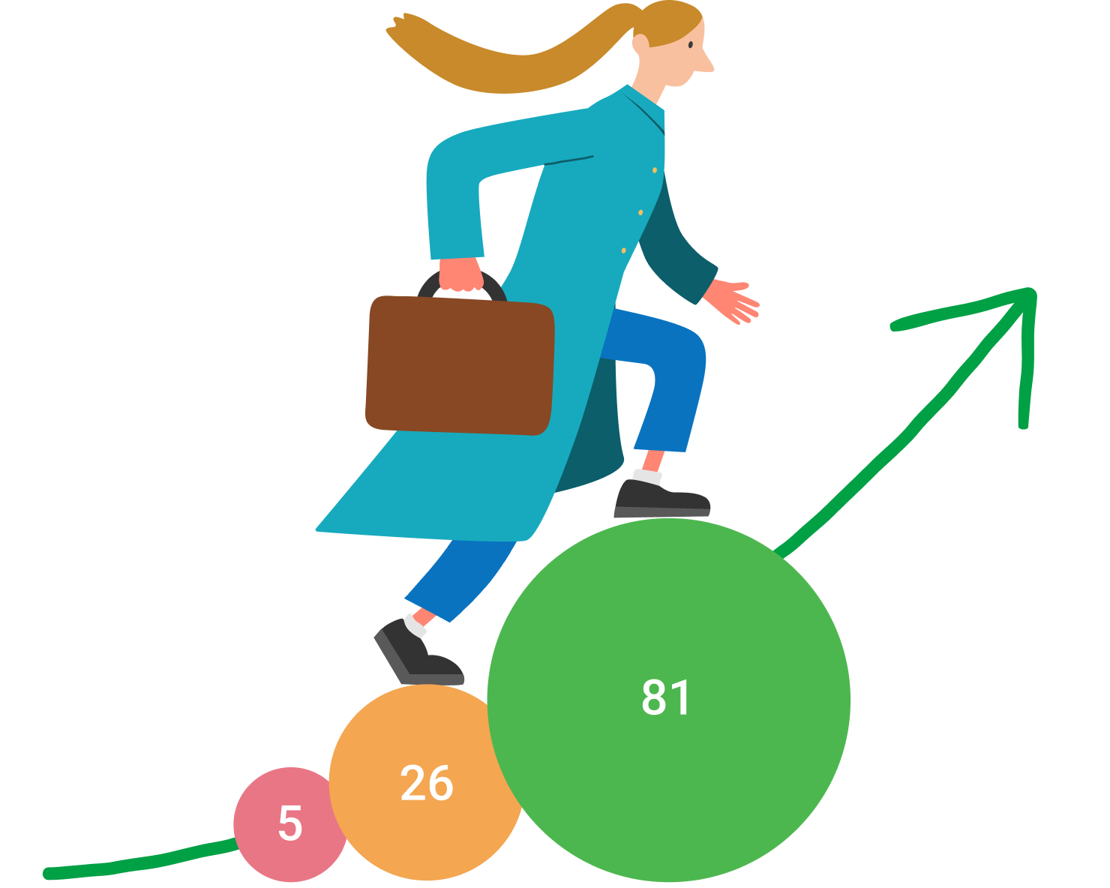

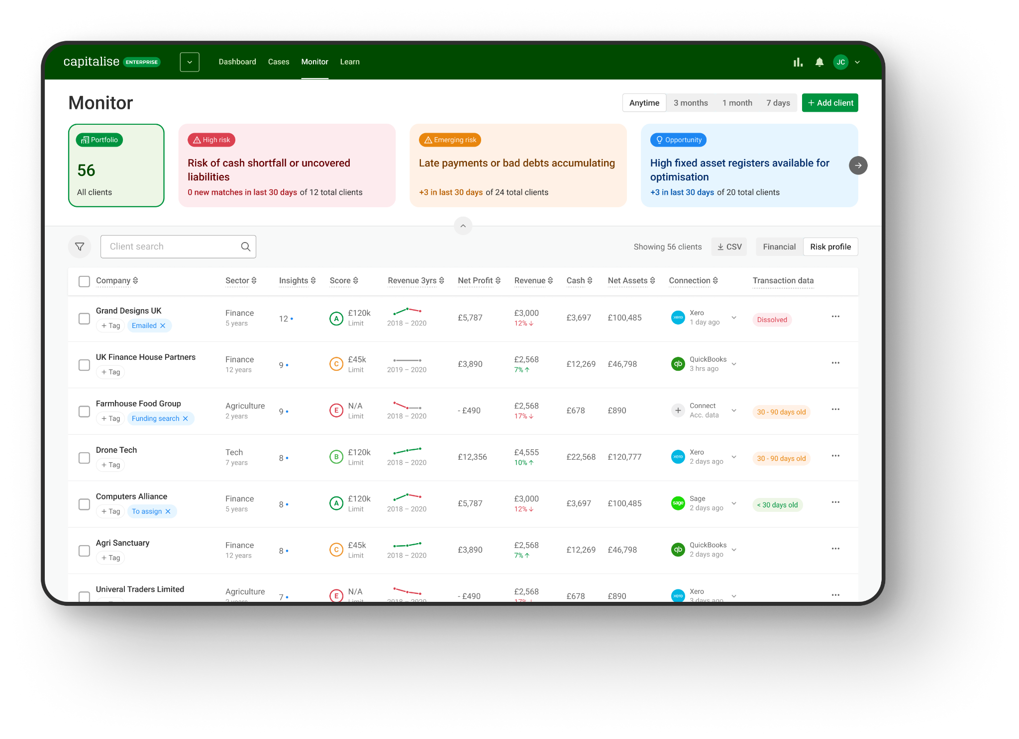
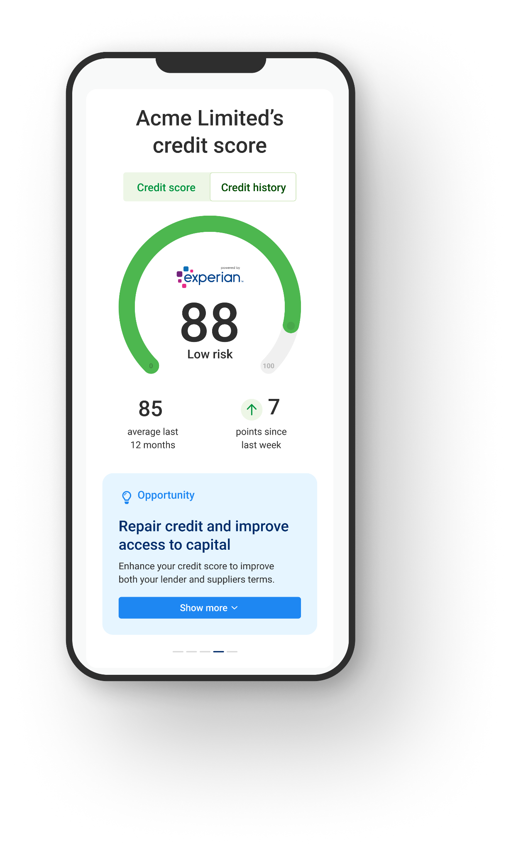
Why is Capitalise here?
WHY
2,200
Accounting firms
150,000
Small businesses
Improve Credit Scores 96%
£2,000,000,000 approved capital
Give small businesses and their advisers transparency and control over business finance, in one place.

Slide 19


Slide 20
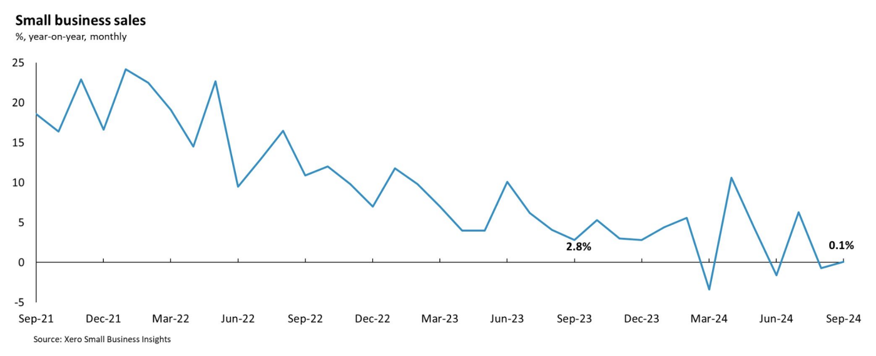
INTRODUCTION

Slide 21
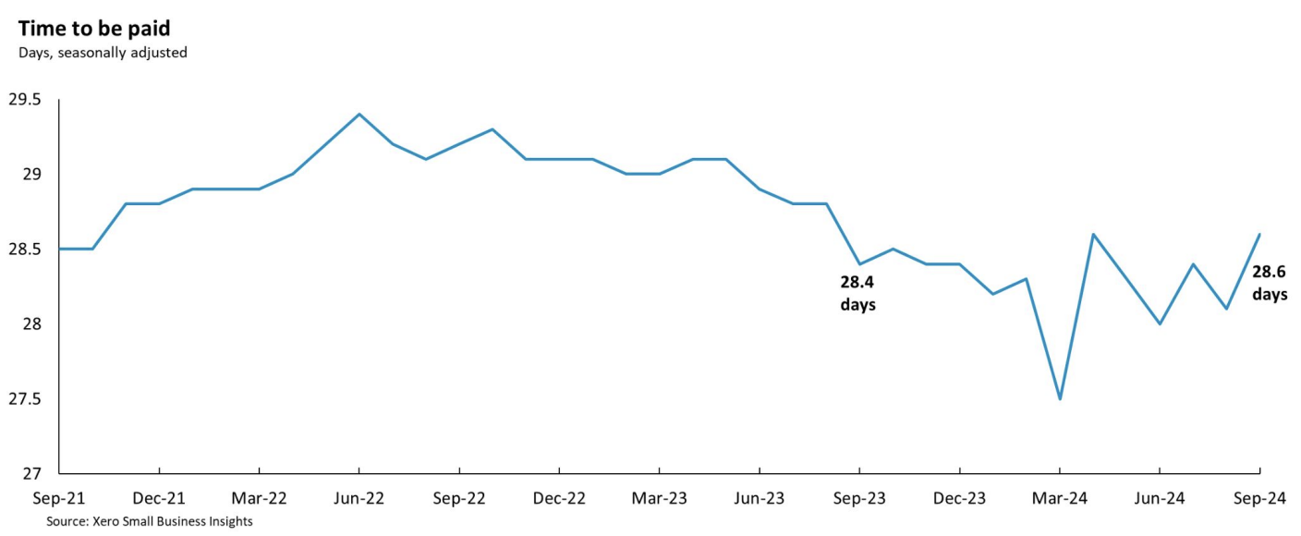
INTRODUCTION

Slide 22
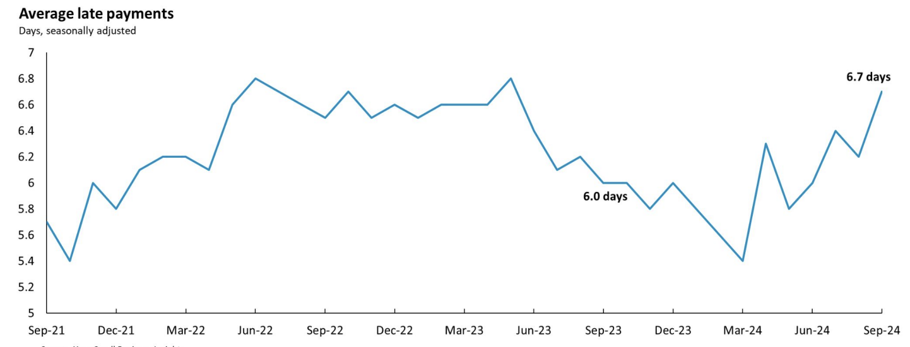
INTRODUCTION

Slide 23
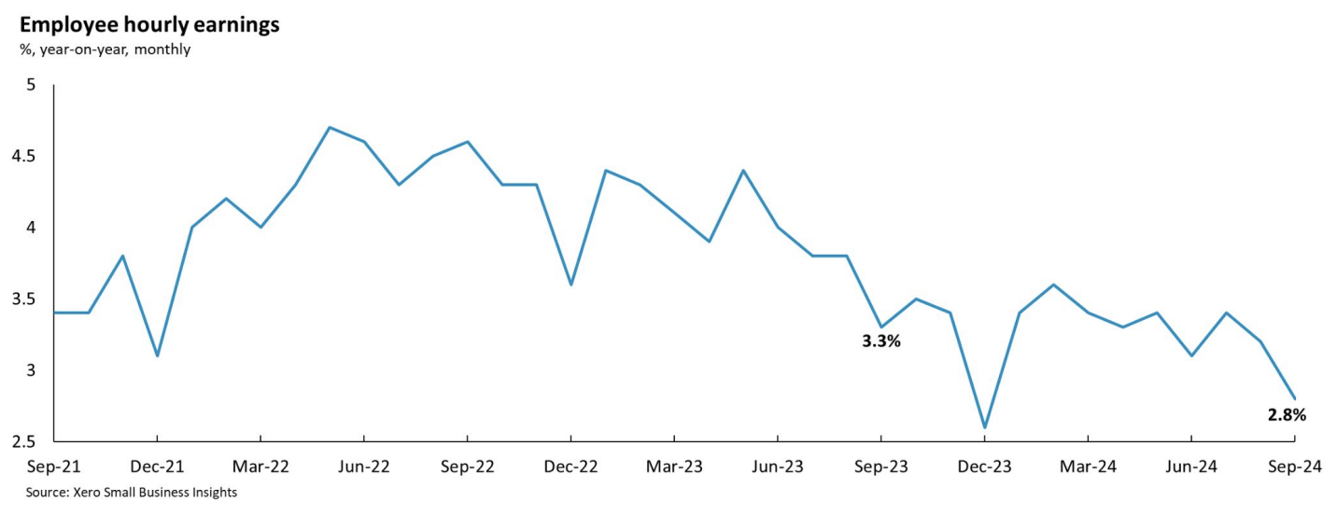
INTRODUCTION

Slide 24

MY PERSONAL LEADING INDICATOR ……
Notes:
Energy prices, services and cofre inflation

Slide 25
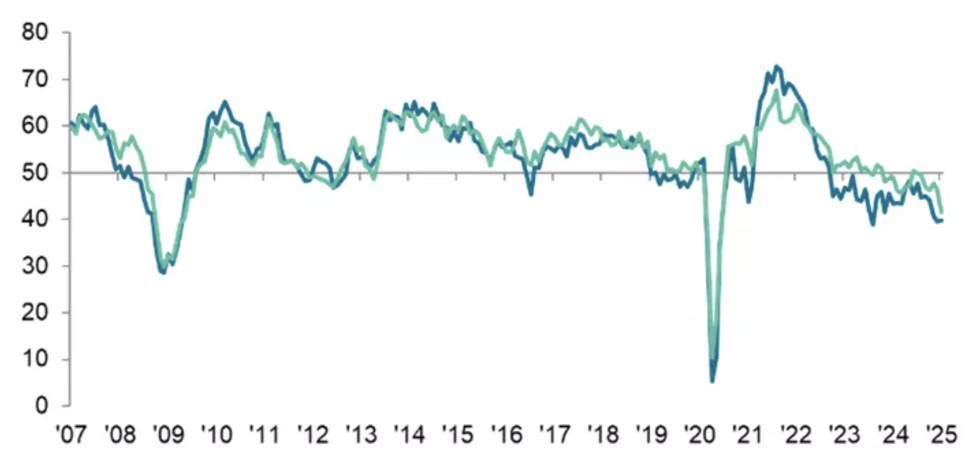
KPMG RECRUITER SURVEY - TEMP BILLINGS / PERMANENT PLACEMENTS
Pandemic
Global financial crisis

Slide 26
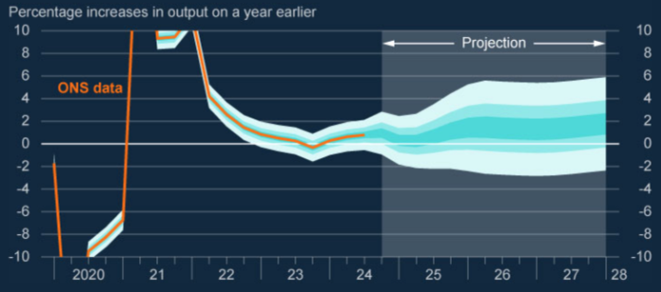
GDP

Slide 27
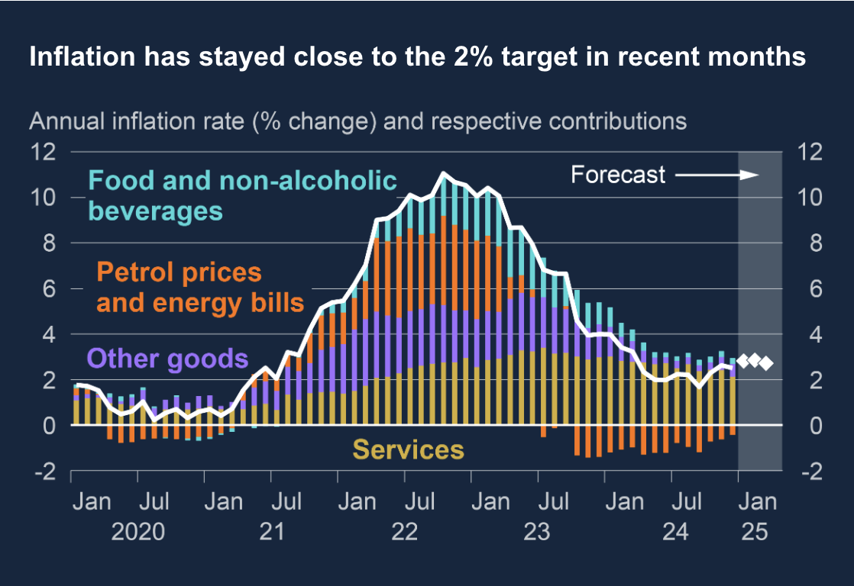
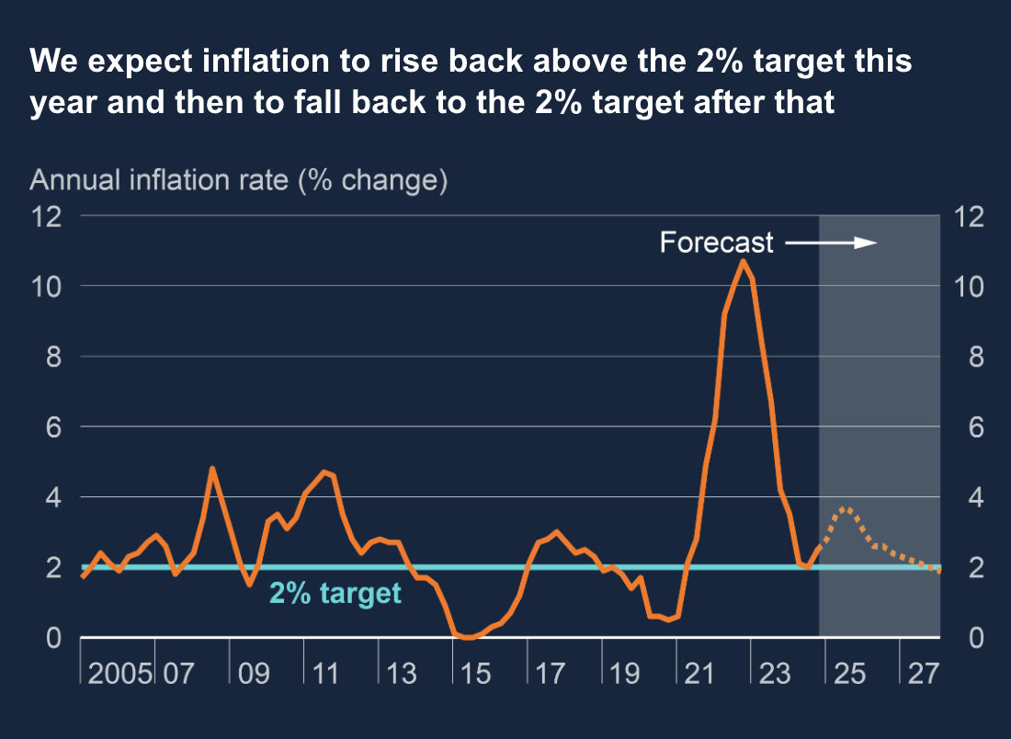
INFLATION

Slide 28
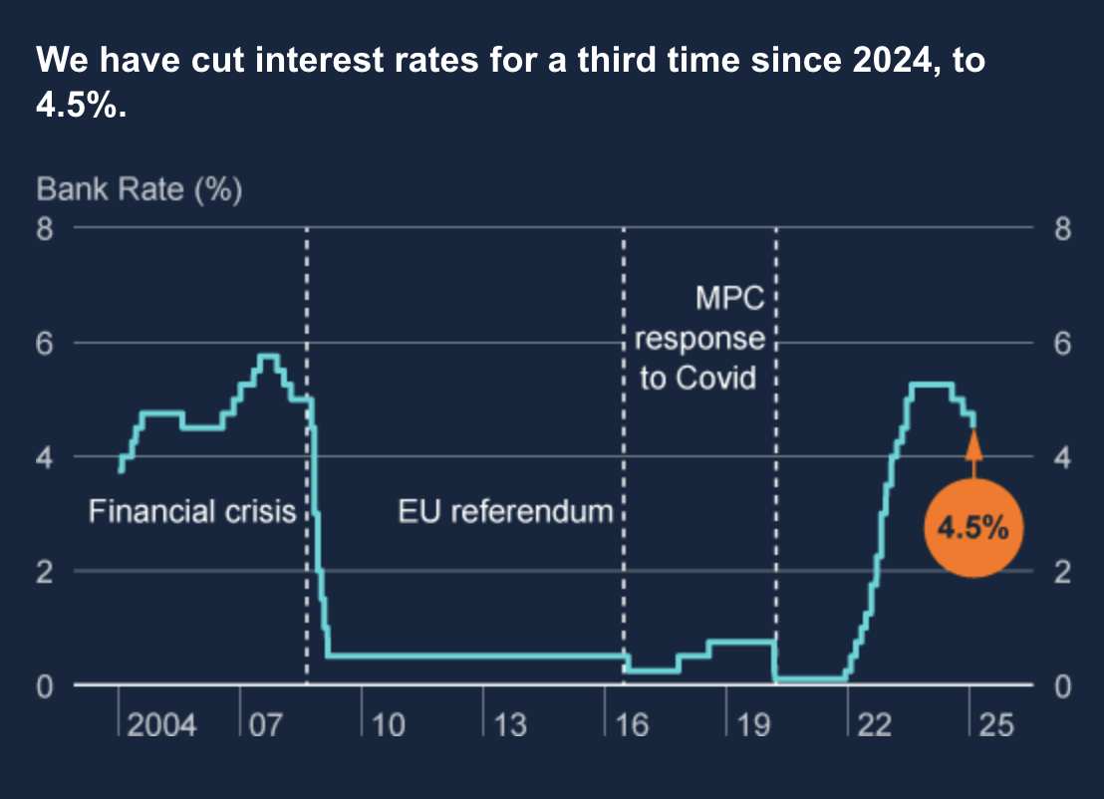
RATE CYCLE

Slide 29
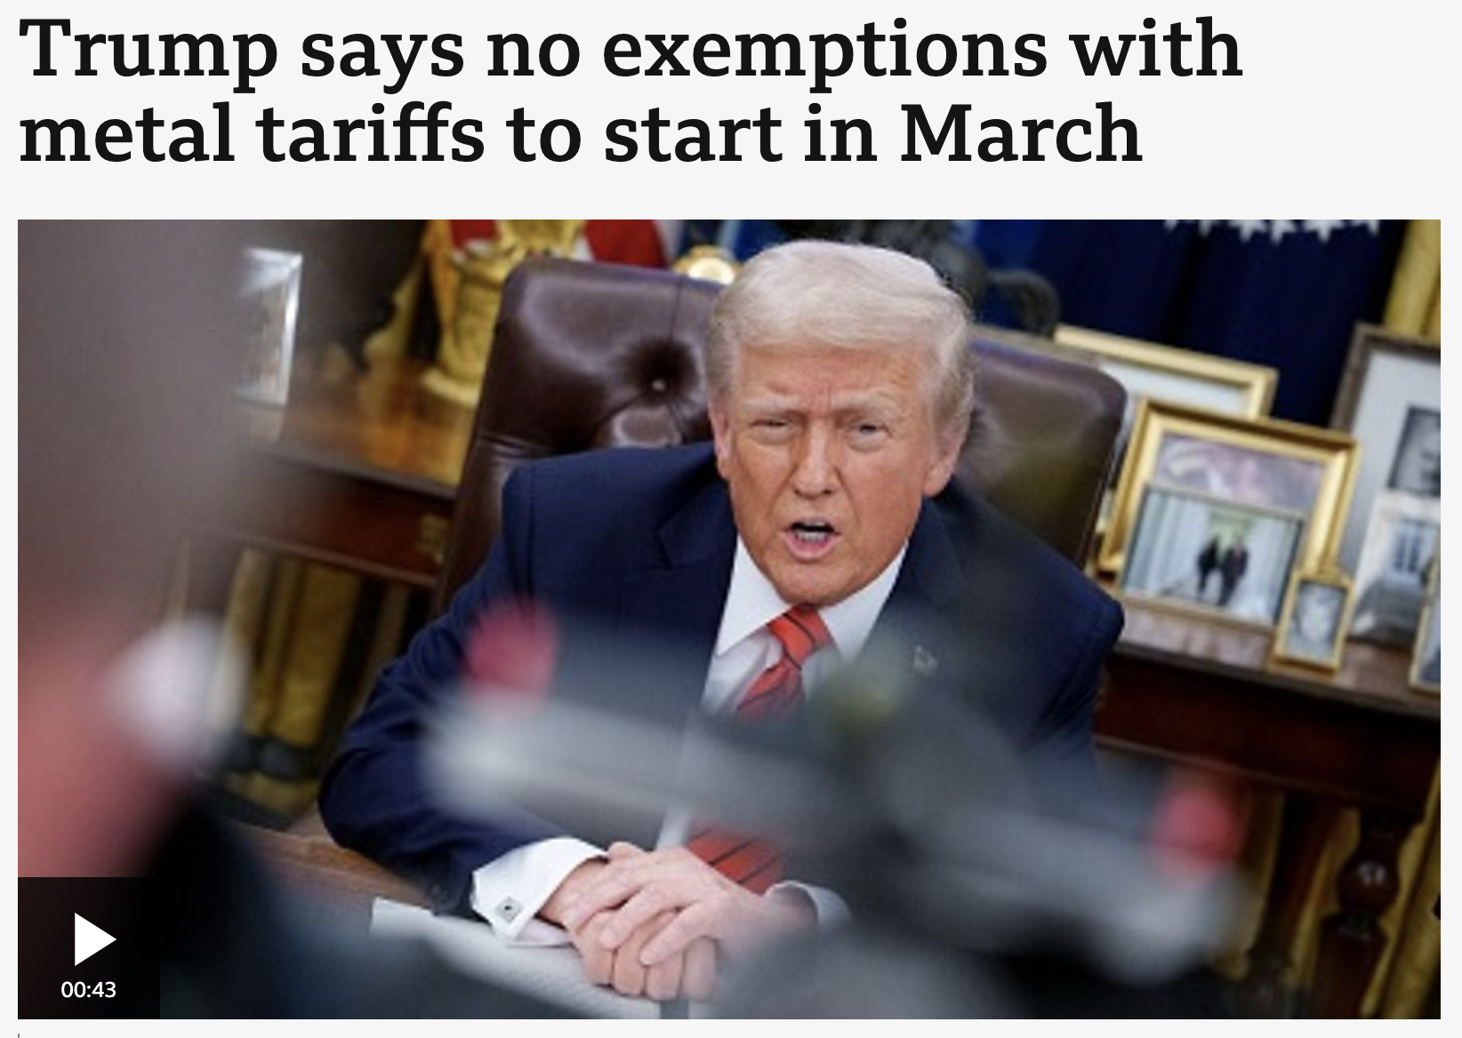
TARIFFS

Slide 30
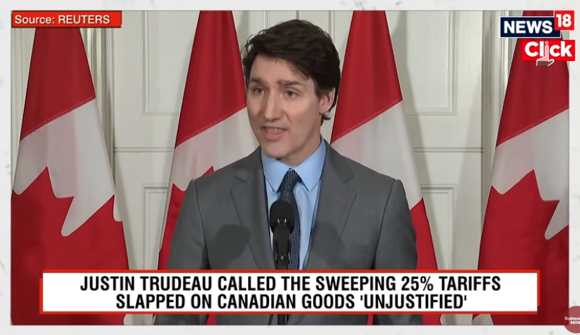
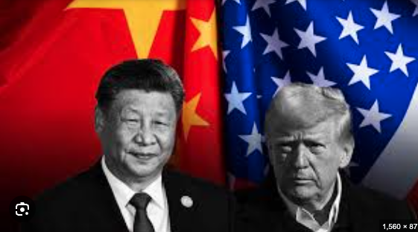
TARIFFS
Notes:
Tariffs ALWAYS increase inflation and slow growth - the more widespread - the greater the impact.
They can be very useful if targetted
China Protectionism 1980-2000 no foreign imports, subsidised local industry - built a manufacturing superpower.
US Steel Tarrifs 2002 30% - George Bush - Stopped US Steel going bankrupt - lasted 1yr.
South Korea Tariffs on Foreign Trade 1960-80s - Made Samsung, LG and Hyundai.
US Tariffs on Japanese cars in 70s / 80s.
But they must be targetted and time specific.
None of trumps are currently.

Slide 31
CRACKING FP&A
STARTING A MOVEMENT
Financial Planning & “Advisory”

Slide 32

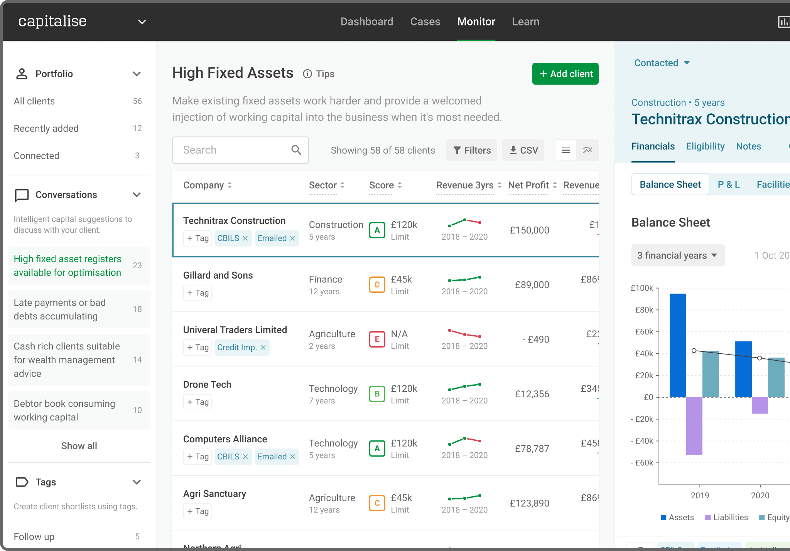

Monitor and identify opportunities in your portfolio
MONITOR
Notes:
PS

Slide 33


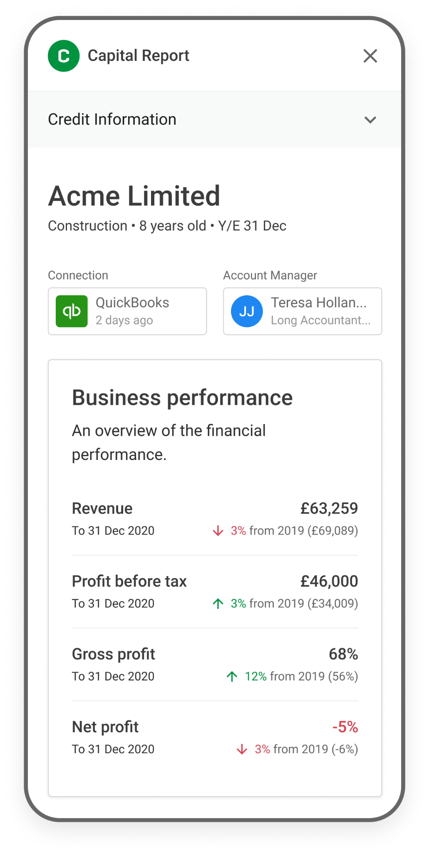
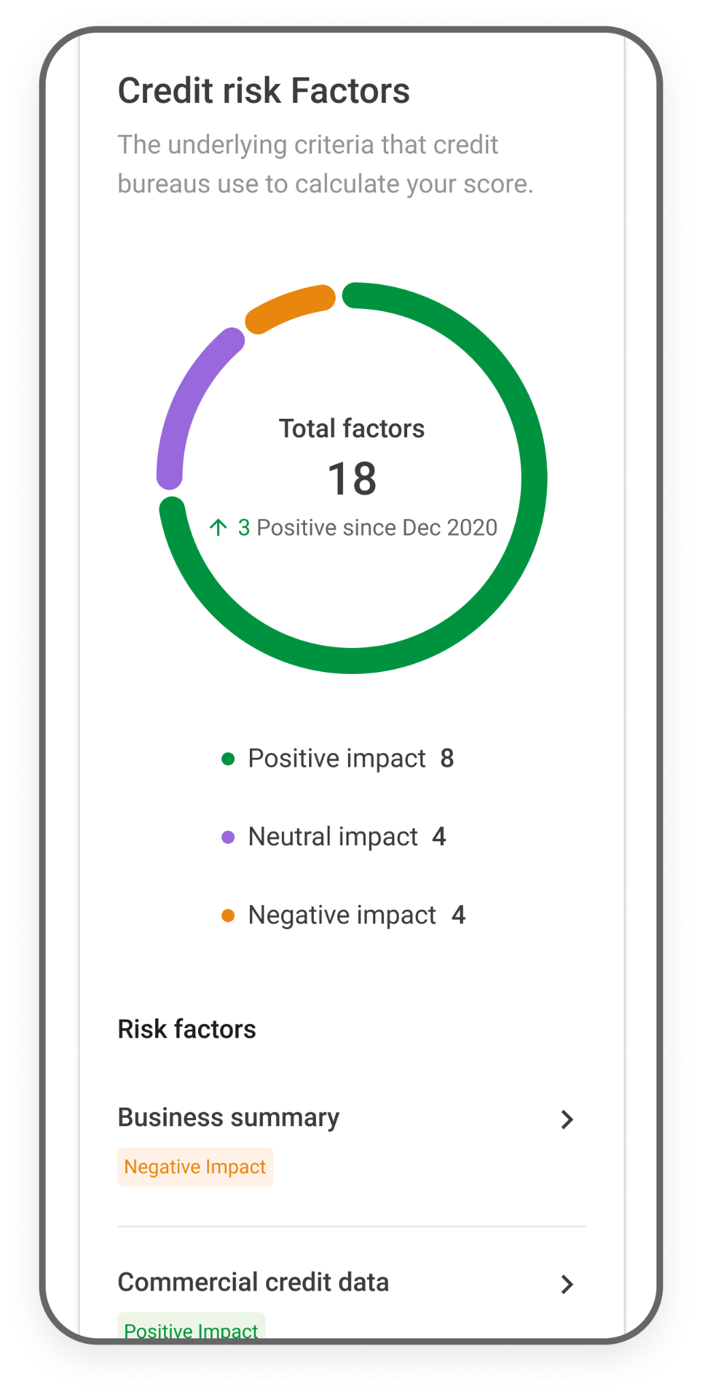
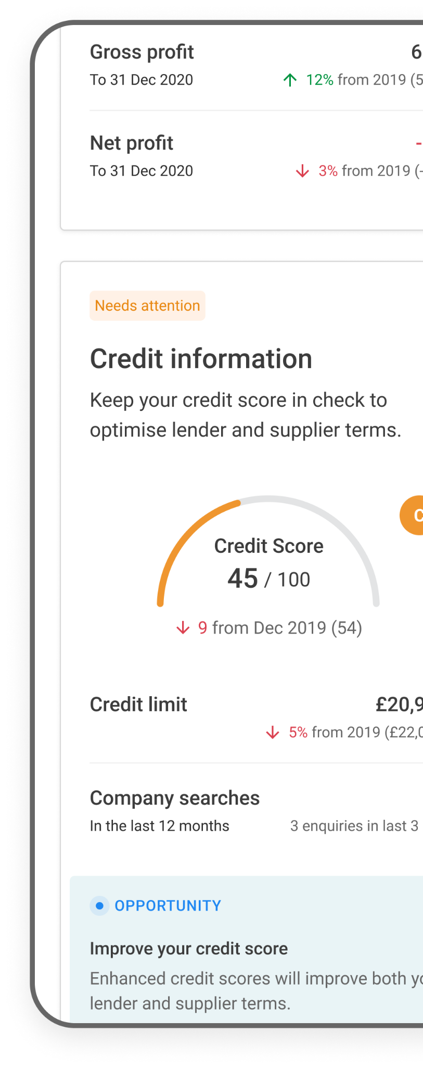
Create customer engagement & action with the Capital Report
INSIGHTS-DRIVEN
Notes:
PS

Slide 34
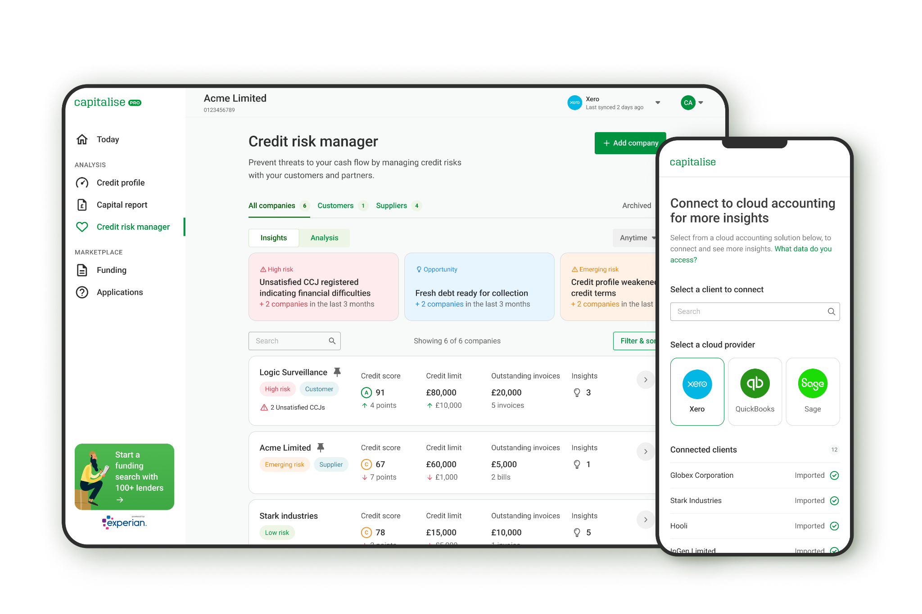
Credit Risk Manager allows clients to better self serve
RISK
Notes:
PS

Slide 35




Construction company increases their trade credit by £63,000
ATM build and fitter increases their trade credit by £58,000
Home Improvements company increases their trade credit by £7,700
Ground works company increases their trade credit by £530,000
BEFORE
AFTER
BEFORE
AFTER
BEFORE
AFTER
BEFORE
AFTER
CREDIT LIMIT £27K | CREDIT LIMIT £90K
CREDIT SCORE 71/100 | CREDIT SCORE 100/100
CREDIT LIMIT £16K | CREDIT LIMIT £74K
CREDIT SCORE 39/100 | CREDIT SCORE 74/100
CREDIT LIMIT £3.3K | CREDIT LIMIT £11K
CREDIT SCORE 52/100 | CREDIT SCORE 58/100
CREDIT LIMIT £0K | CREDIT LIMIT £530K
CREDIT SCORE 0/100 | CREDIT SCORE 100/100

Slide 36
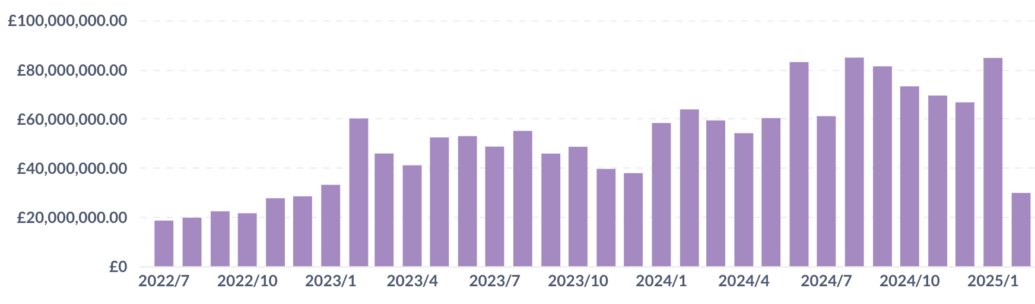
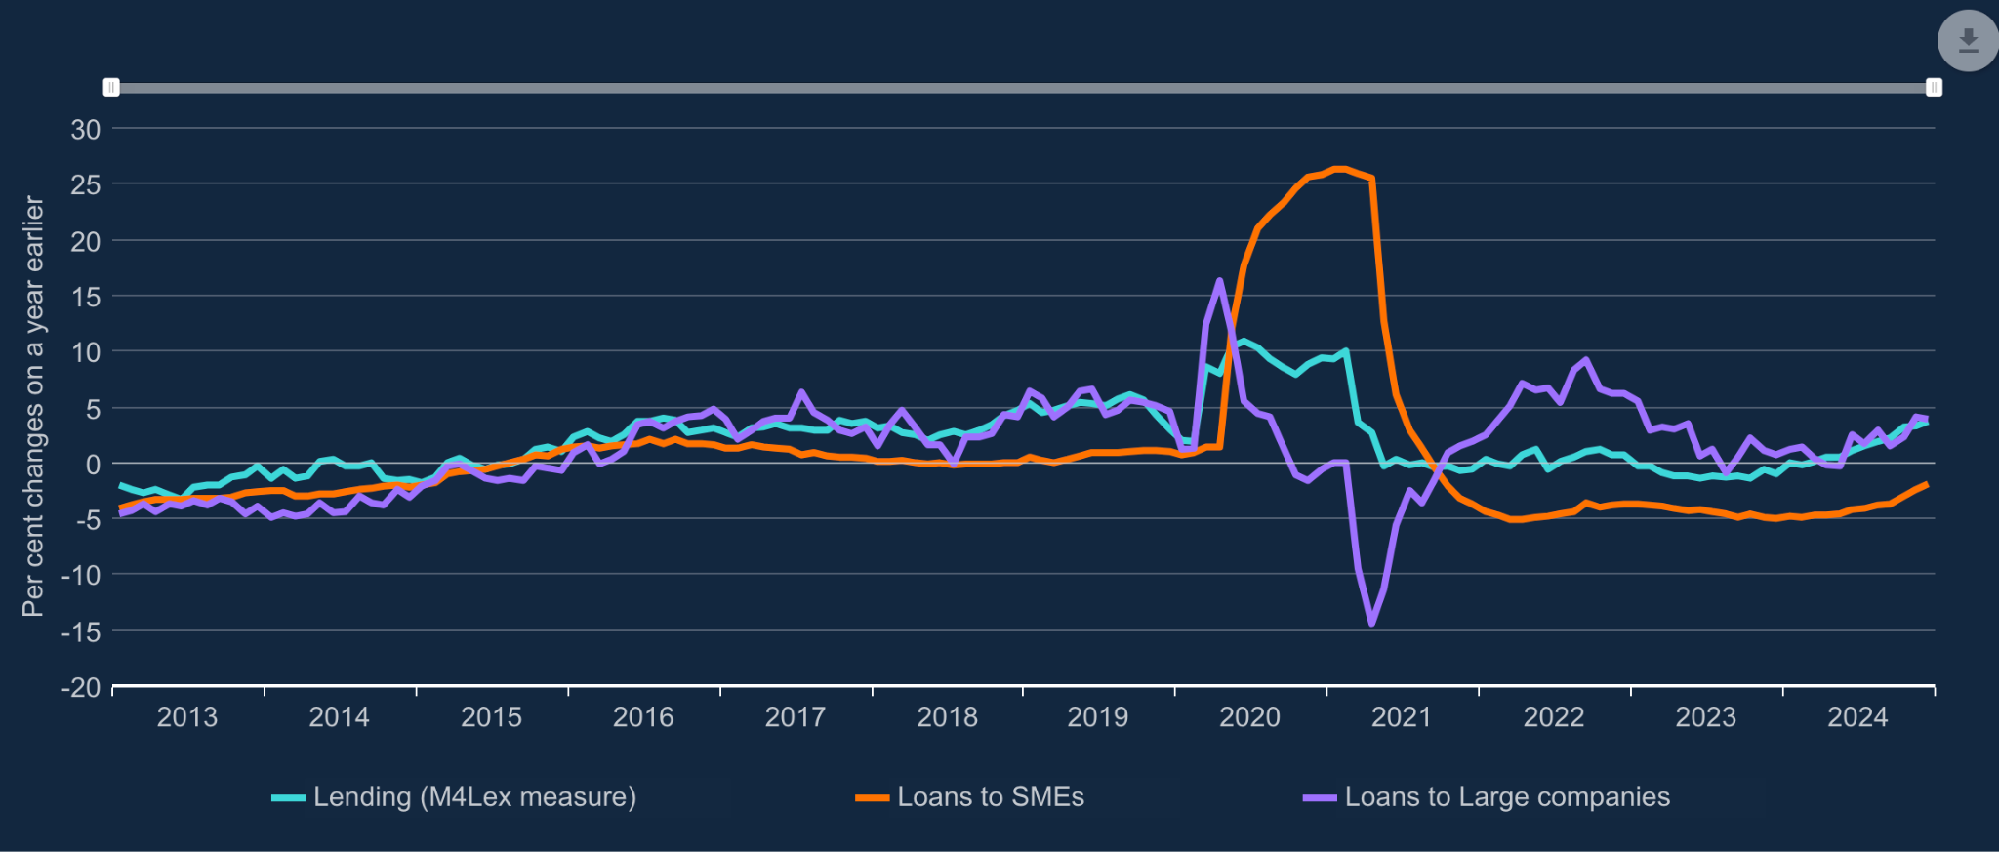
FUNDING VOLUME
4x Funding Volume
Loan books shrinking

Slide 37


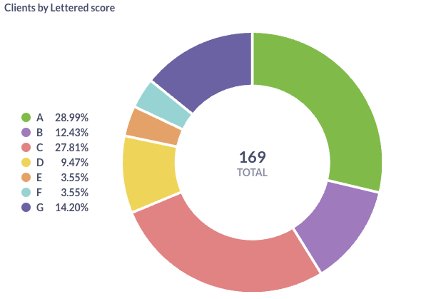

Jacobs Allen 🚀
Data as at 28/2/25
Insights
0
10
10
6
0
232
2
Recent CCJs Registered
Recent Credit Searches
Credit Profile Improved
Credit Profile Worsened
Funding Eligibility Improved
Number of clients
Connected clients
0
0
0
0
Winding up petition registered
Payment Performance Worsening
Late Paying Customers
Qualified Bad Debt
Credit scores
Funding
20
1
1
0
0
12
Total searches
N° of
active searches
N° of searches
not released
N° of searches
released
N° of searches
at offer
N° of searches
paid out
7
2
2
85%
65%
60%
Total searches
(Last 12M)
Total searches
(Last 6M)
Total searches
(Last 3M)
Release
conversion %
(15 cases)
Offered
conversion %
(12 = 80% of released)
Paid
conversion %
(11 = 73% of released)
Notes
Number of Clients and Connected clients (to cloud accounting) are those on the Capitalise platform.
Released cases are where we have had all the documentation which the lenders need - i.e. we go to market at that point
Offered Conversion are cases which have received at least one offer
Paid Conversion are cases which the client has drawn down
Number of CRS’ = 0

Slide 38
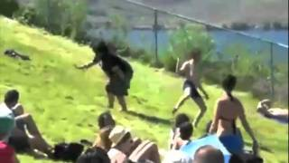

Slide 39

Now - how do you feel
about why you are here?

Slide 40


