Slide 1
The National Conference
Wifi –
Teas & Coffees
Take your bag, name badge
Built to Sell books @ £12 each – take books today & complete order form so I can invoice you next week
kirsty@TheCFN.org.uk
Chairman, The Corporate Finance Network

Slide 2
ACTION
POINTS
Notes:
Don’t waste today
Book meeting to share – leverage today
Loads of ideas, tips, motivation – use it to take you through the next 6mths
Look at Action Points from previous conferences, are they still on your list or have you progressed? Don’t take all this on your own shoulders – share the ideas, delegate the actions

Slide 3

“The secret of getting ahead is getting started”
Notes:
Think back to pre-Covid.
To the CF work and the conversations you were having then.
That was 5 years ago. Do you think you/your firm are having more conversations now? Or not?

Slide 4
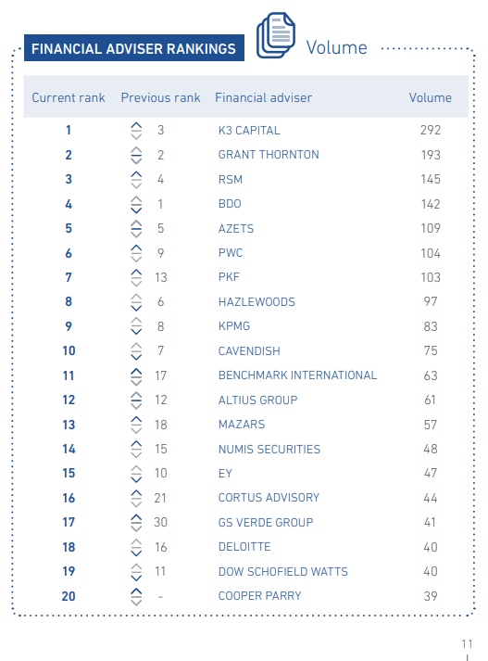

Last year to 31/12/23
2023 Cases 200
Full lead advisory 74
Ref: Experian MarketIQ UK&ROI M&A Review 2023
Notes:
CFN y/e Sept 2023:
- completed cases (funding, buy-side, sell-side, transaction support/DD) = 200
- full lead advisory buy-side or sell-side = 74
Well within Top 20 of Financial Advisers as per Experian 2023 M&A Review (nearer Top 10)

Slide 5
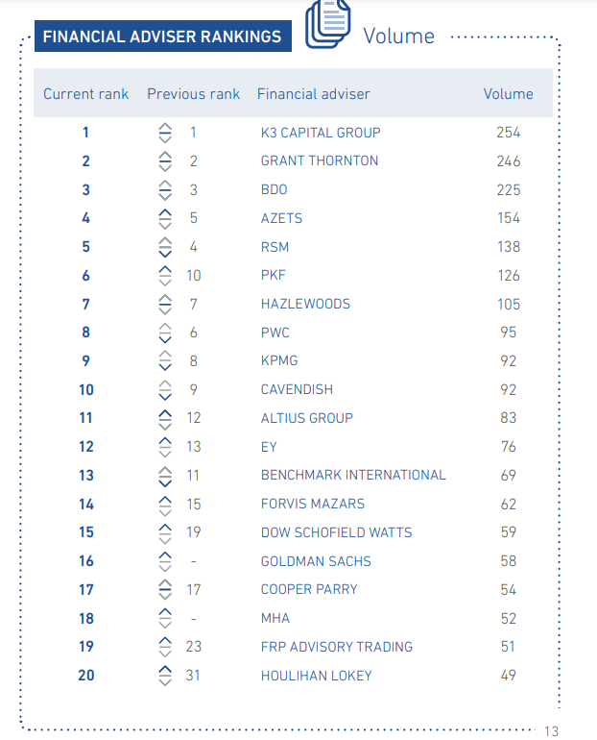
This year to 31/12/24
2024 Cases 181
Full lead advisory 79
Ref: Experian MarketIQ UK&ROI M&A Review 2024

Slide 6
Notes:
What happens if we just increase to 0.52%?

Slide 7
2024 Cases 181
Full lead advisory 79
Ref: Experian MarketIQ UK&ROI M&A Review 2024
Notes:
What do the firms in red have in common?

Slide 8
Your advantages:
Long-standing relationships with clients
Opportunities to speak to them multiple times per year
Deal origination & M&A products – unique for the OMB market
Research & market intelligence
Highly skilled and experienced
Notes:
What are your advantages – esp over those firms in red?

Slide 9
Age of directors…..in 2015 vs 2025
Source: Experian Market IQ, 12/10/2015 & Mark to Market 26/3/24, 30/9/24 & 5/3/25 Active companies UK & ROI
Has the tipping point been reached?
Notes:
Brand new data – have we reached the tipping point?
What does this mean for us/our firms?

Slide 10
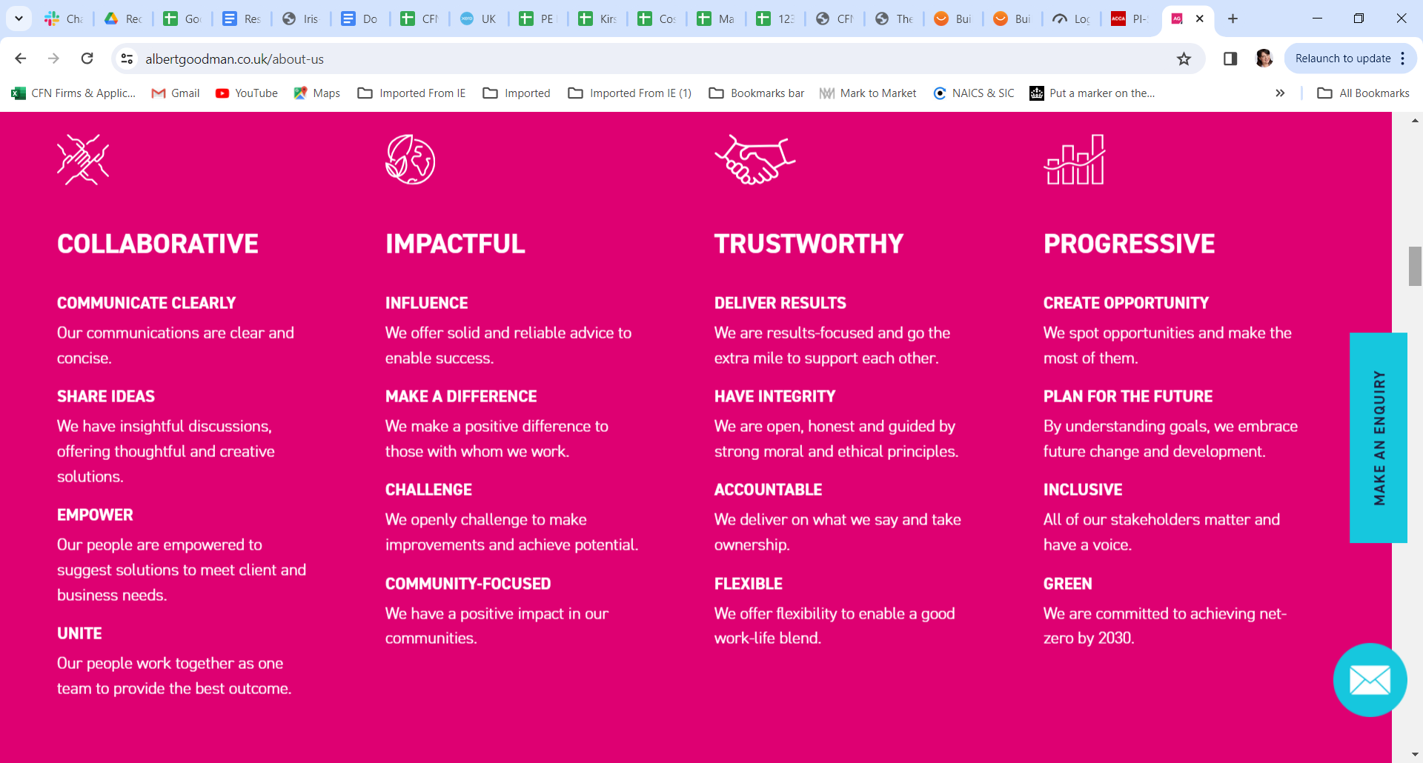
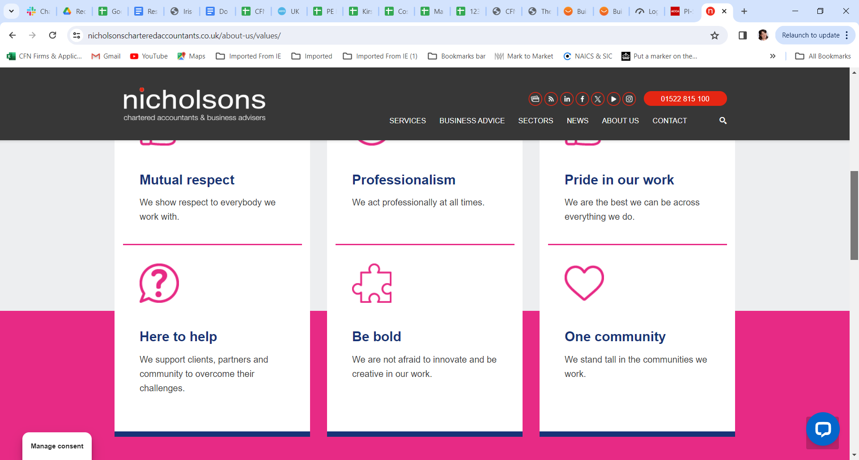
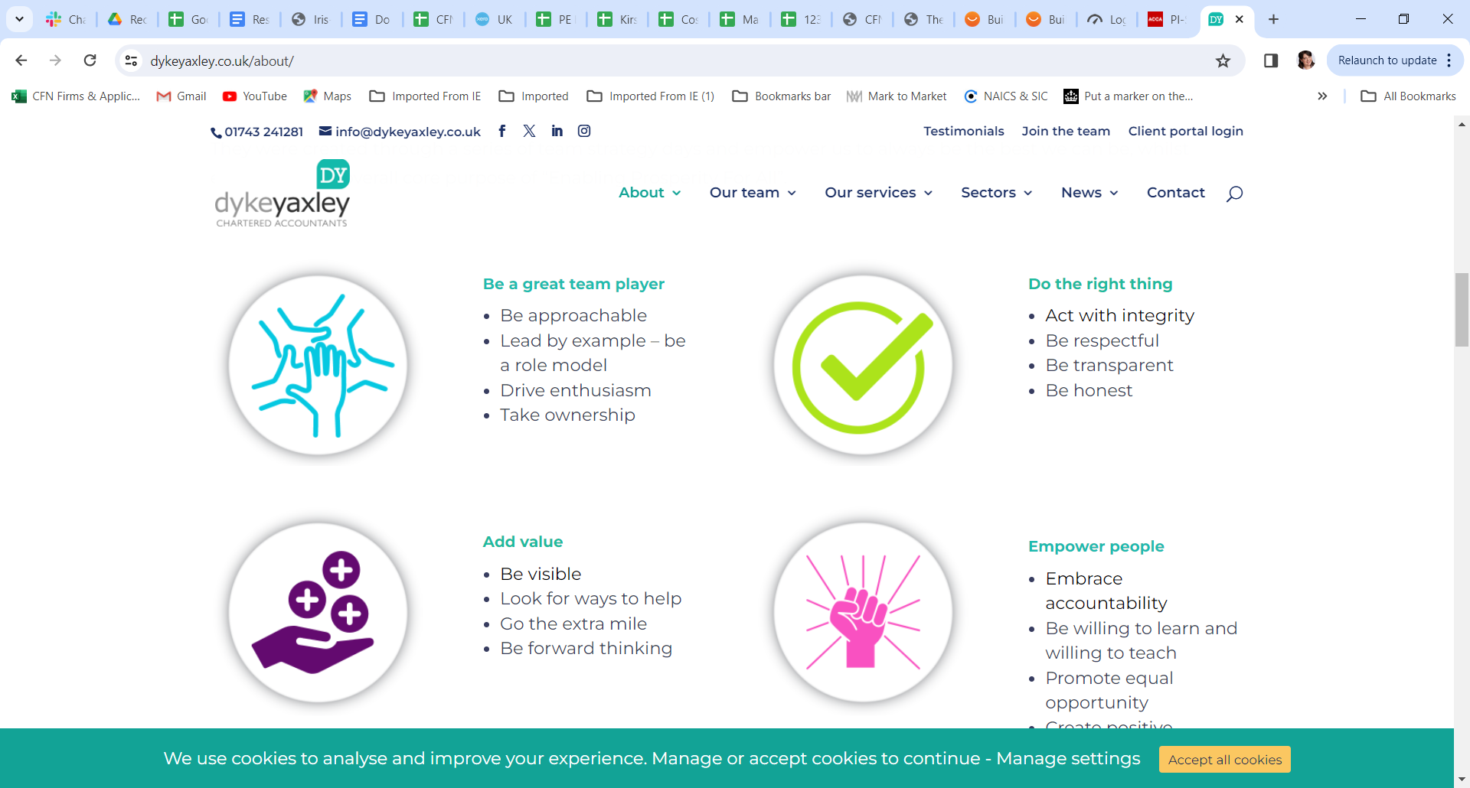
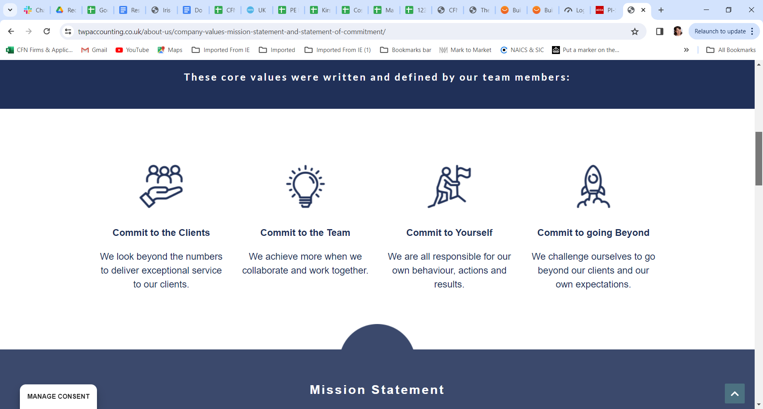
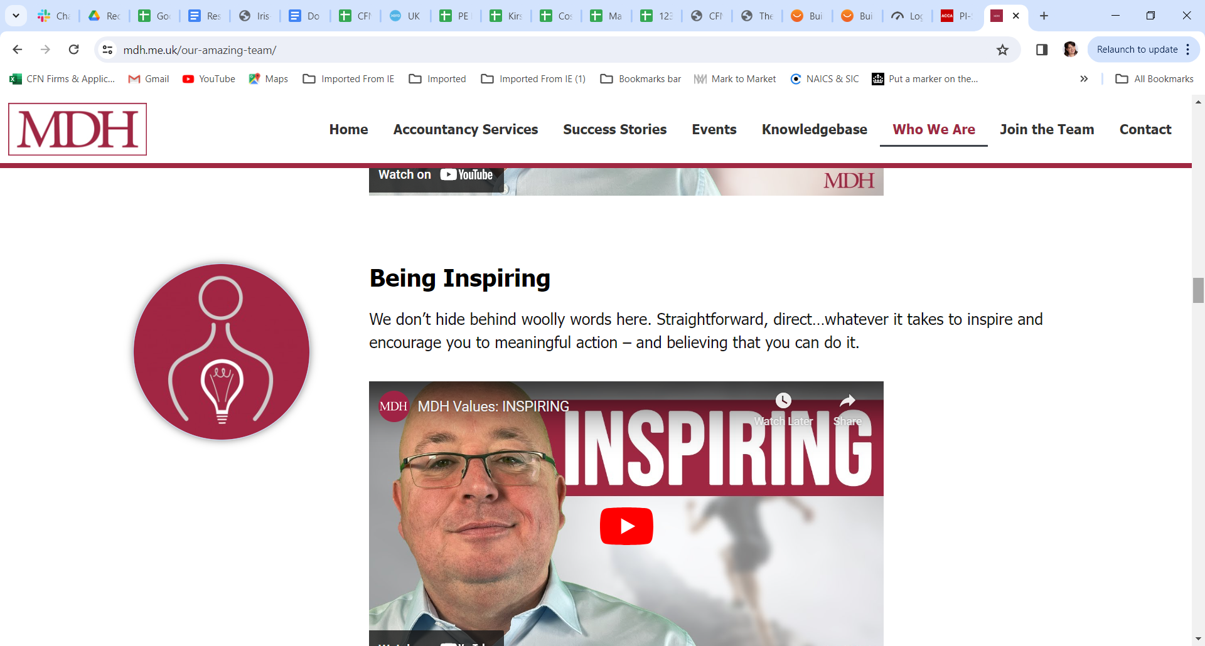
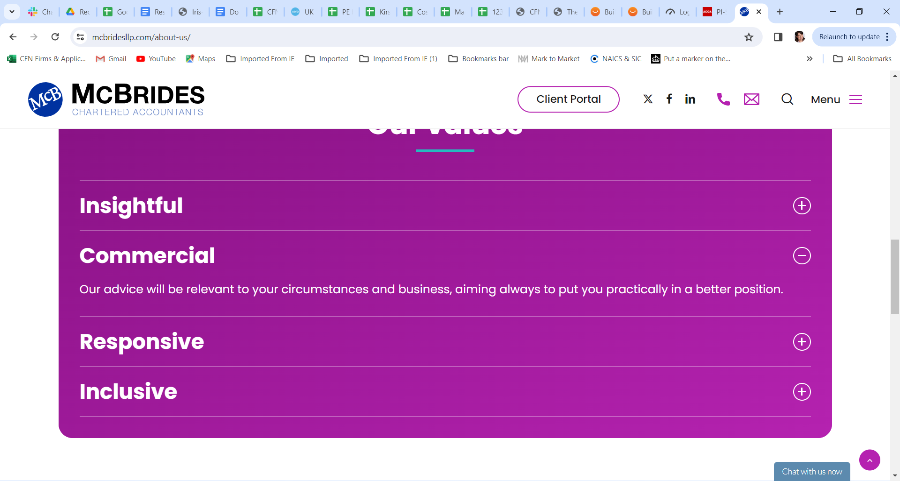
We know you want to make a difference to your clients – your core values say you do
Notes:
You say you want to make a difference to business owners
HTGM fast growing businesses
What would your clients say?

Slide 11
Are you using your advantages in the market?
How many clients have you or a colleague spoken to about exit planning, disposals or acquisitions in the past 6 months?
What is your full opportunity?
How far have you come?
Notes:
Show of hands – more than 50?
More than 20?
More than 5?
Share the opps spreadsheet – rework it

Slide 12

It’s taken 18 years….
Kirsty is coming in to work with the whole firm!
New products
Across the whole firm
Working with your partners/directors/SLT
Notes:
This is after years of watching firms trying to implement advisory

Slide 13
New Product 1
Business Development Nurture Project
Notes:
Stand alone training isn’t enough
There has to be data
There has to be resources to support – what to say, who to, when
Some will want to do more than others – okay let’s work with that, but everyone has to do something
There has to be accountability
SLT have to step up to this new world – we need to advise more, we need to upsell to other services. This isn’t optional for our firms.
Grant Thornton, Azets, they’re coming for your clients

Slide 14


Why aren’t high quality, commercial conversations happening with all your clients in the firm?
Notes:
I know you’re doing all this
But you need help
Has to be leveraged across the whole firm

Slide 15
Why aren’t high quality, commercial conversations happening with all your clients in the firm?
Time/ priority
Not expected in role
No account-ability
Lacking confidence
Lacking knowledge
Who to speak to?
What to focus on?

Slide 16
Introduction – a wraparound of 3 parts over 6 months
Data Capture
Training & Rollout
Content nurture
Build CRM capability
Identify Segment of Client Needs
Identify Sector
Optional - Integrate with Practice Management system (CCH, Iris etc)
Optional - Integrate with other advisory apps (Capitalise, Fathom etc)
Identify who will be having advisory conversations
Provide training about commercial skills
Provide supporting resources & content
Provide conversation starters & structures
Set out a clear approach and expectation
Review progress & hold accountable
Supply regular blogs, guides, videos, case study successes, quizzes etc targeted at different client-need segments & different sectors
Train on updating CRM
Optional - organise webinars or seminars
Optional - direct marketing by telephone or post
Optional - website news updates and social media posts
Integrate with existing mailing software (mailchimp, hubspot)
Notes:
A CRM on its own won’t work.
This is after years of watching firms trying to implement advisory.
There needs to be a wraparound solution to nurture the rest of the team (identified into different roles) including training, content supply & someone just doing all the legwork – me!

Slide 17
By sector ….and by client-need segment

Slide 18
By sector ….and by client-need segment
Provide sector-specific content eg care homes, recruitment, estate agents, manufacturing etc
Provide segment-specific targeted content eg exit planning, acquisitive, tax planning, wealth management, payroll etc
Provide “Conversation Starters” or Agenda Points, and resources for client leads
Record next actions & follow up – what, by who, by when

Slide 20
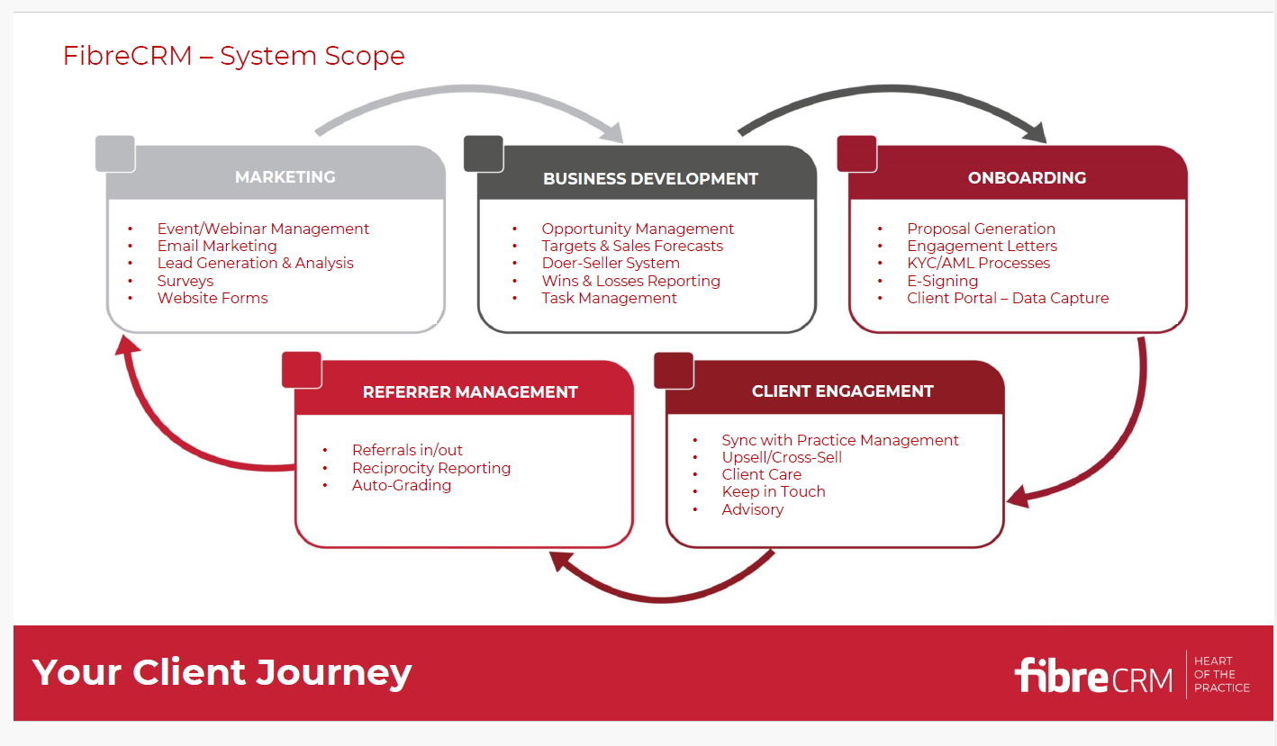
Notes:
Fibre does a lot – this is the full system. It can be a bit overwhelming, so I have asked them to instead create a base product just for us, taking the elements which I think are essential to start with – the rest is optional & you can add on at any time when you’re ready.

Slide 21
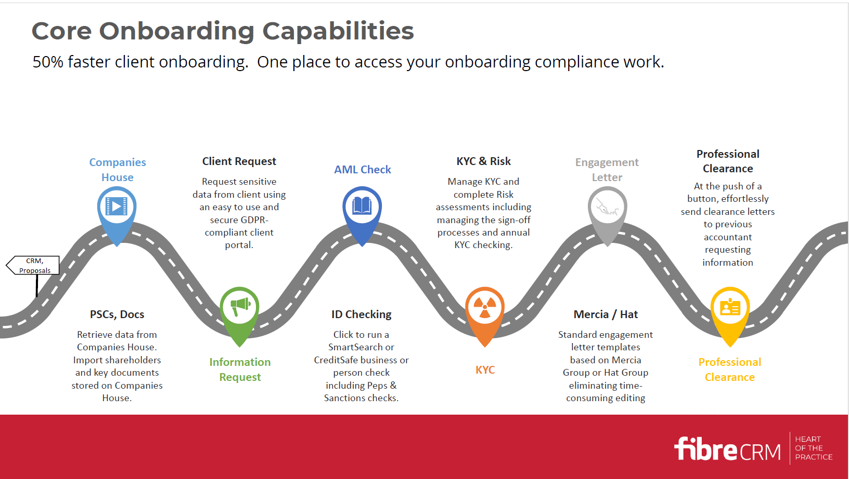
Notes:
Supported onboarding through all the requirements – not all of this is included, see shortly. But all available.

Slide 22
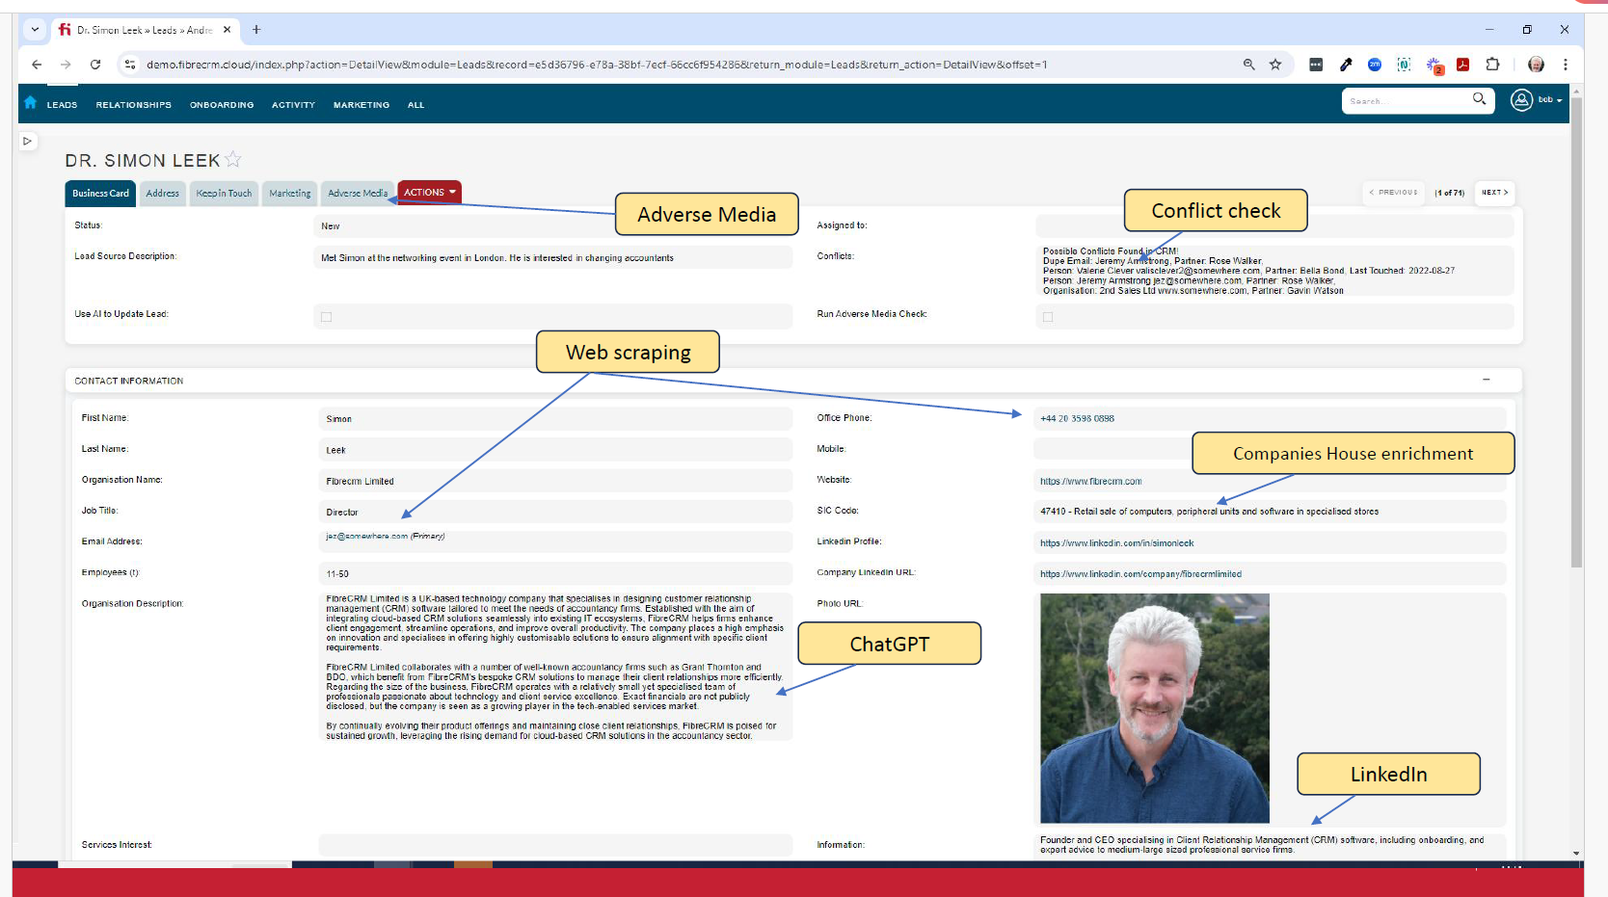
Notes:
Individual contact screen pulls information from various sources to give an overview of an individual/company

Slide 23
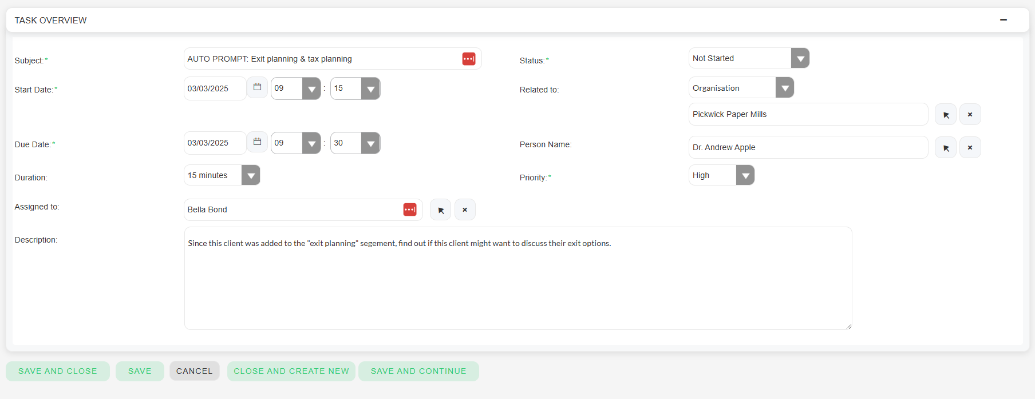
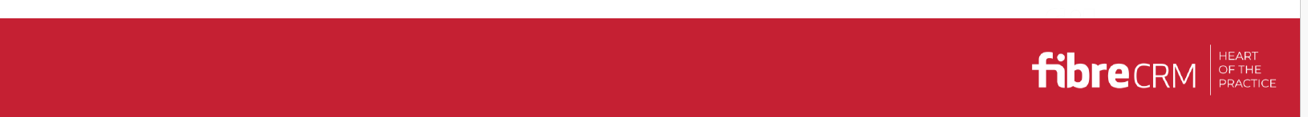

Slide 24
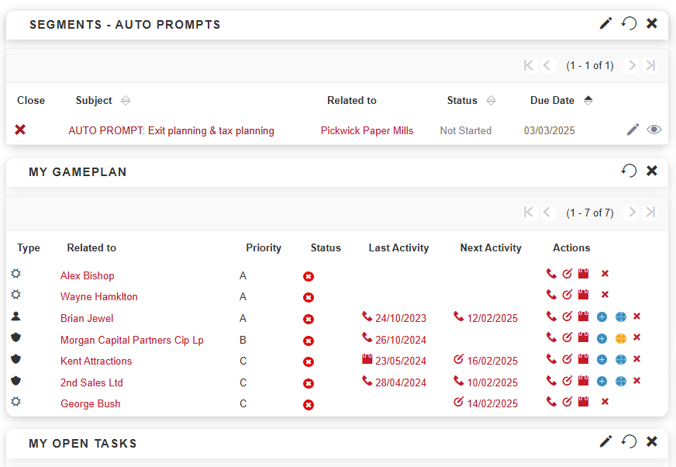

Slide 25
Base FibreCRM product to start:
Lead management for new clients - with enrichment via ChatGPT, Companies House and Perplexity AI
Sales Opportunity / pipeline management for existing clients - including upsell conversation starters & notes
Communication tools (tasks, calls, meetings, surveys)
Email marketing integration – your own (Mailchimp, Hubspot etc) or firm to be provided with Campaign Monitor
Basic Onboarding capabilities to include:
  Client Portal for requesting data (e.g. tax ref no, previous accountant details, ID docs)
  KYC compliance management and sign off processes
  Risk assessment forms with option to use Mercia AML package (requires separate subscription to Mercia)
  Professional Clearance generation
Client enrichment via a live feed from Companies House (e.g. filing dates, new/resigned involvements)
All hosted in SaaS on AWS with a workflow designer and reporting capability
Optionally to include:
Sync with a Practice Management system
Sync with MS Outlook
Proposal generation
Engagement letter generation with optional embedded Mercia-based templates
AML integration to SmartSearch or CreditSafe

Slide 26
Costs payable to FibreCRM
Setup and installation of 1-7 - £1,500
Import of a CSV/Excel file containing the data to be imported (e.g. existing clients, prospects, introducers) - £600 per file
£150/hr for any adhoc work (e.g. linking a website form to CRM, help building reports)
Items 1-7 would be £750 per month for up to 20 users then £30 per month for each additional user
Optional add-ons will be quoted on case by case basis
Note re integration with PMS (Iris, CCH, Xero, QB) – ideal eventually, so both systems always in sync (for new email address for example), but with extra cost for integration work.
Support – KM to be liaison between FibreCRM/your team. Additionally, all the team would have free access to FibreCRM’s user community and help guides plus helpdesk phone and email support.

Slide 27
Project costs for implementation support, training, ongoing content
£2,500/month for 6 months to include:
  Confirmation of which systems already used & which to be integrated
  Liaison with FibreCRM to implement & upload data
  SLT discussion to
    confirm which team members will use & to what degree – onboarding, marketing & managers/SLT
    how each group will be held accountable to use after training
    marketing strategy & content required to be supplied
  Meetings with each client portfolio holder to allocate sectors & client-need segments for each client
  Book & deliver training sessions – grouped into need, for FibreCRM & commercial training
  Provide conversation starters & structures by client-need segments
  Support with team during rollout, review progress and report back to SLT for next actions
  Share best practice & success stories from other firms’ experiences
Thereafter, optional ongoing supply of content by sector & by segment, likely £500/month – tbc
Notes:
Led by KM

Slide 28
Reminder – a wraparound of 3 parts over 6 months
Data Capture
Training & Rollout
Content nurture
Build CRM
Identify Segment of Client Needs
Identify Sector
Optional - Integrate with Practice Management system (CCH, Iris etc)
Optional - Integrate with other advisory apps (Capitalise, Fathom etc)
Identify who will be having advisory conversations
Provide training about commercial skills
Provide supporting resources & content
Provide conversation starters & structures
Set out a clear approach and expectation
Review progress & hold accountable
Supply regular blogs, guides, videos, case study successes, quizzes etc targeted at different client-need segments & different sectors
Train on updating CRM
Optional - organise webinars or seminars
Optional - direct marketing by telephone or post
Optional - website news updates and social media posts
Integrate with existing mailing software (mailchimp, hubspot)

Slide 29

Workflow management

Slide 30
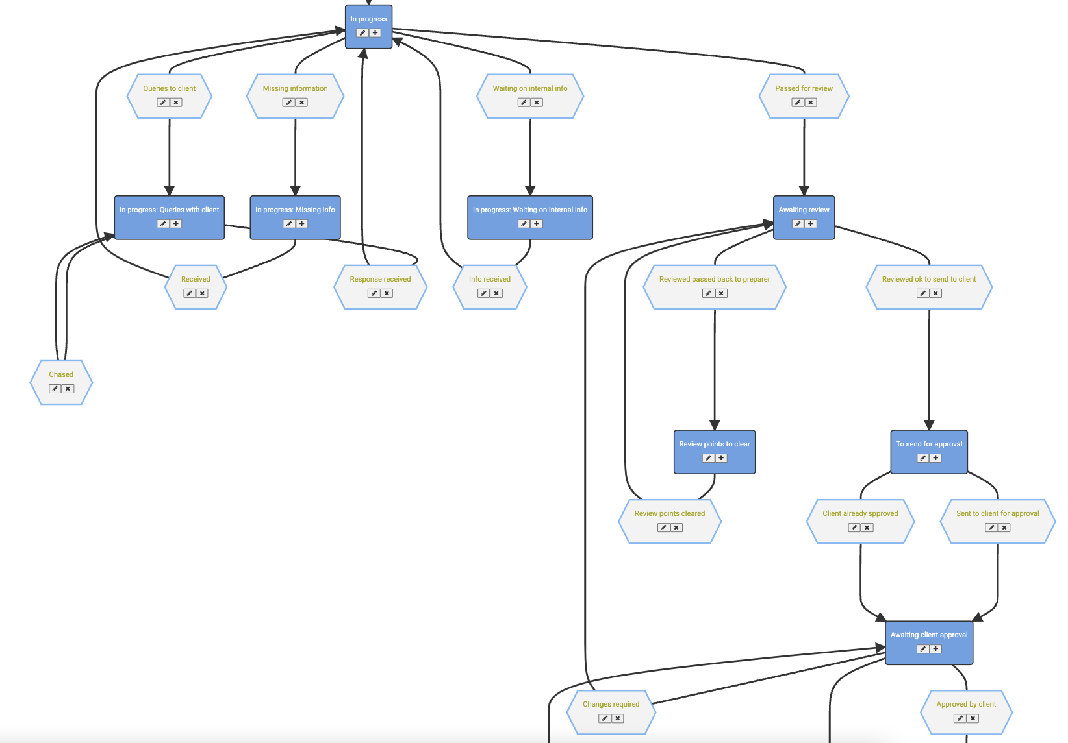
Step 1 – Configure flows
Glide has c. 100 templates or start from scratch.
  Compliance.
  Advisory.
  Back office (e.g. onboarding)
Extremely configurable.
The ‘process map’ approach brings simplicity (the real world is matched in the diagram) - but also detail.
This comprehensive approach eliminates spreadsheets.
Use sub-jobs (e.g. Accounts and CT separated).
Use parent-child jobs, which are popular in onboarding scenarios e.g. AML.

Slide 31
Step1 – Configure actions on steps
All steps (i.e. progress from A to B) can have automations, e.g.
  Auto-update the current job holder to the correct user/team. Makes the job jump to the correct dashboard/list, with notification if desired.
  Auto-generate next target date(s) – e.g. “When info is booked in, draft tax return out in 60 days” or (more granular) “When info is in, start job in 5 working days.”
  Create other linked jobs (e.g. AML job creates PSC check job).
  Block progress (e.g. mandatory data capture).
  Send email/SMS/webhook.
Ensures work is accurately allocated and moves quickly through the office, to contribute to improved turnaround times.

Slide 32
Step 1 – Configure flows (CRM / CF work)
Relevance to lightweight CRM functionality:
  Trigger flow (either manual or from prospect web form).
  Internal reminders (email or Teams) to follow up periodically.
  External reminders if desired.
  Ultimate auto or manual progression to:
    Did not convert (store reason).
    Converted – would auto-create the onboarding workflow.
Relevance to CF CRM work:
  Compliance flows and/or client data auto-trigger on opportunity.
  Process to contact client and offer services
Relevance to CF work:
  Flows to track progress of work such as valuations.
    Formally ensure AML / Els in place, etc.
    Track internal review processes.
    Maintain visibility on work.

Slide 33
Step 2 – Import clients
Glide can link to PM systems (e.g. CCH, Digita, Practice Engine).
  Sync clients, users and responsibilities.
Or bulk import from Excel.
Prospects can be brought in via web form integrations (we have a full API with Zapier and Make support).
A full prospect/client database is available in Glide, e.g. store data and custom fields, alongside knowledge of which workflows are active and all staff responsibilities.

Slide 34
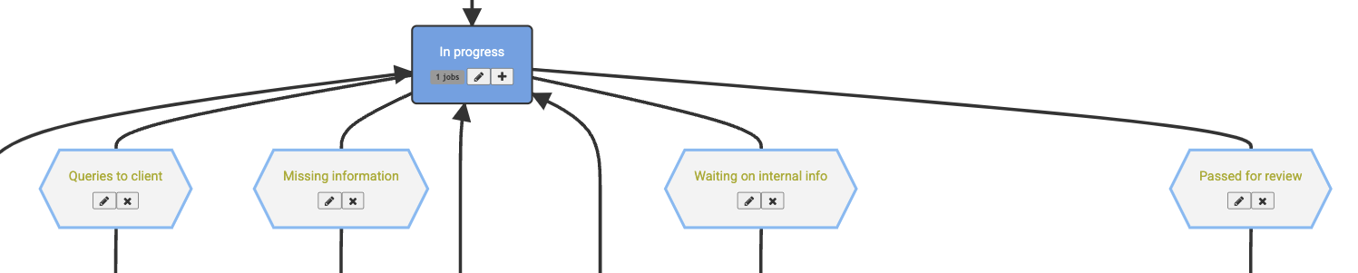
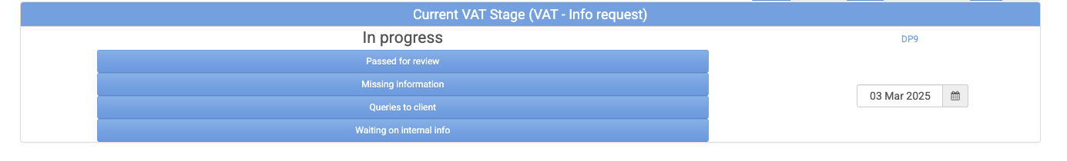
Step 3 – The team progress jobs (we make this bit easy).
A combination of our focus on simplicity (i.e. one click) along with the shared/transparent nature of the system achieves vastly better team buy-in than typically enjoyed by this software category.
Each line on the process map is one blue button – it creates the required detail in data/dashboards without making the system any harder to use.

Slide 35
Step 4 – Automate routine comms
The highly controlled and accurate nature of the data facilitates much more automation or routine communications (both internal and external) – via email, SMS or webhook integrations (Teams, etc).
Request info (generic or client-specific) - e.g. on tax returns, accounts, VAT, payroll, etc.
Chase info automatically whilst it remains outstanding.
  Escalate template.
  Eventually escalate to team member for phone call.
Automate tax payment reminders (VAT, CT, IT, POAs).
Internal automation via email on events or relative to actual or target dates.

Slide 36
Step 5 – Dashboard oversight for all
Create dashboards to monitor practice-wide or service-specific.
Filter to see the entire business, an office, a team, your portfolio or the work you have on your desk.
View other users' dashboards to monitor team progress.
Exceptionally simply – whilst remaining reliable and as detailed as required.

Slide 37
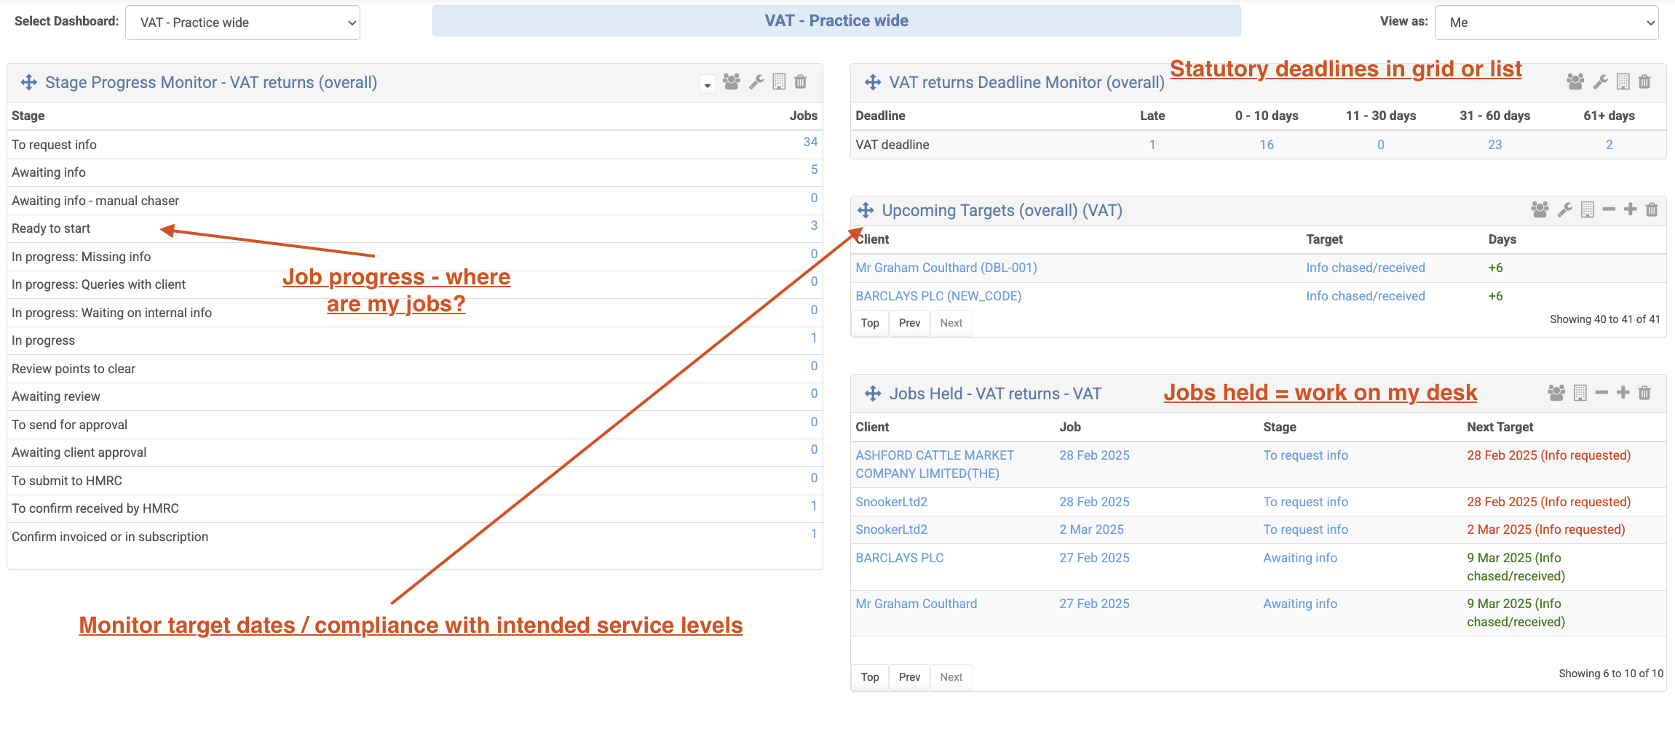
Dashboards (highly configurable, just an example)

Slide 38
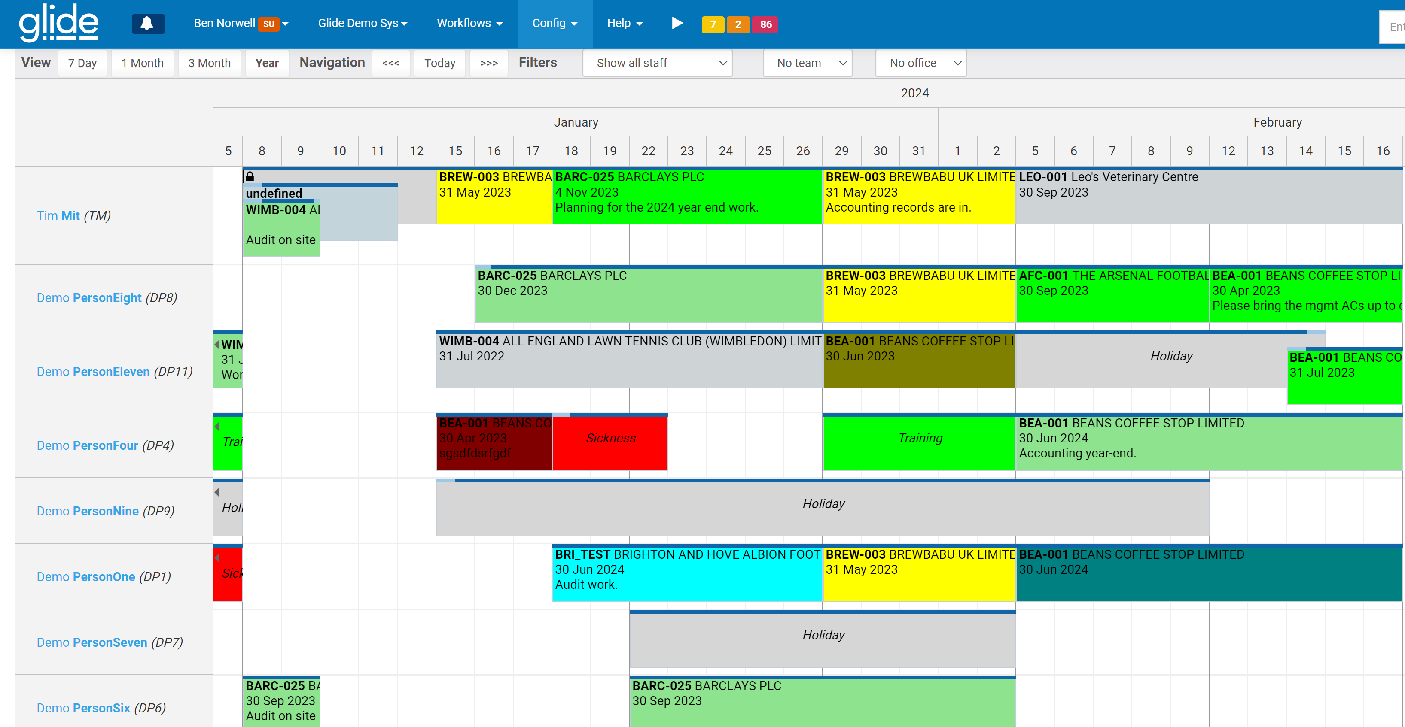
Other functionality – Scheduler / Staff planner

Slide 39
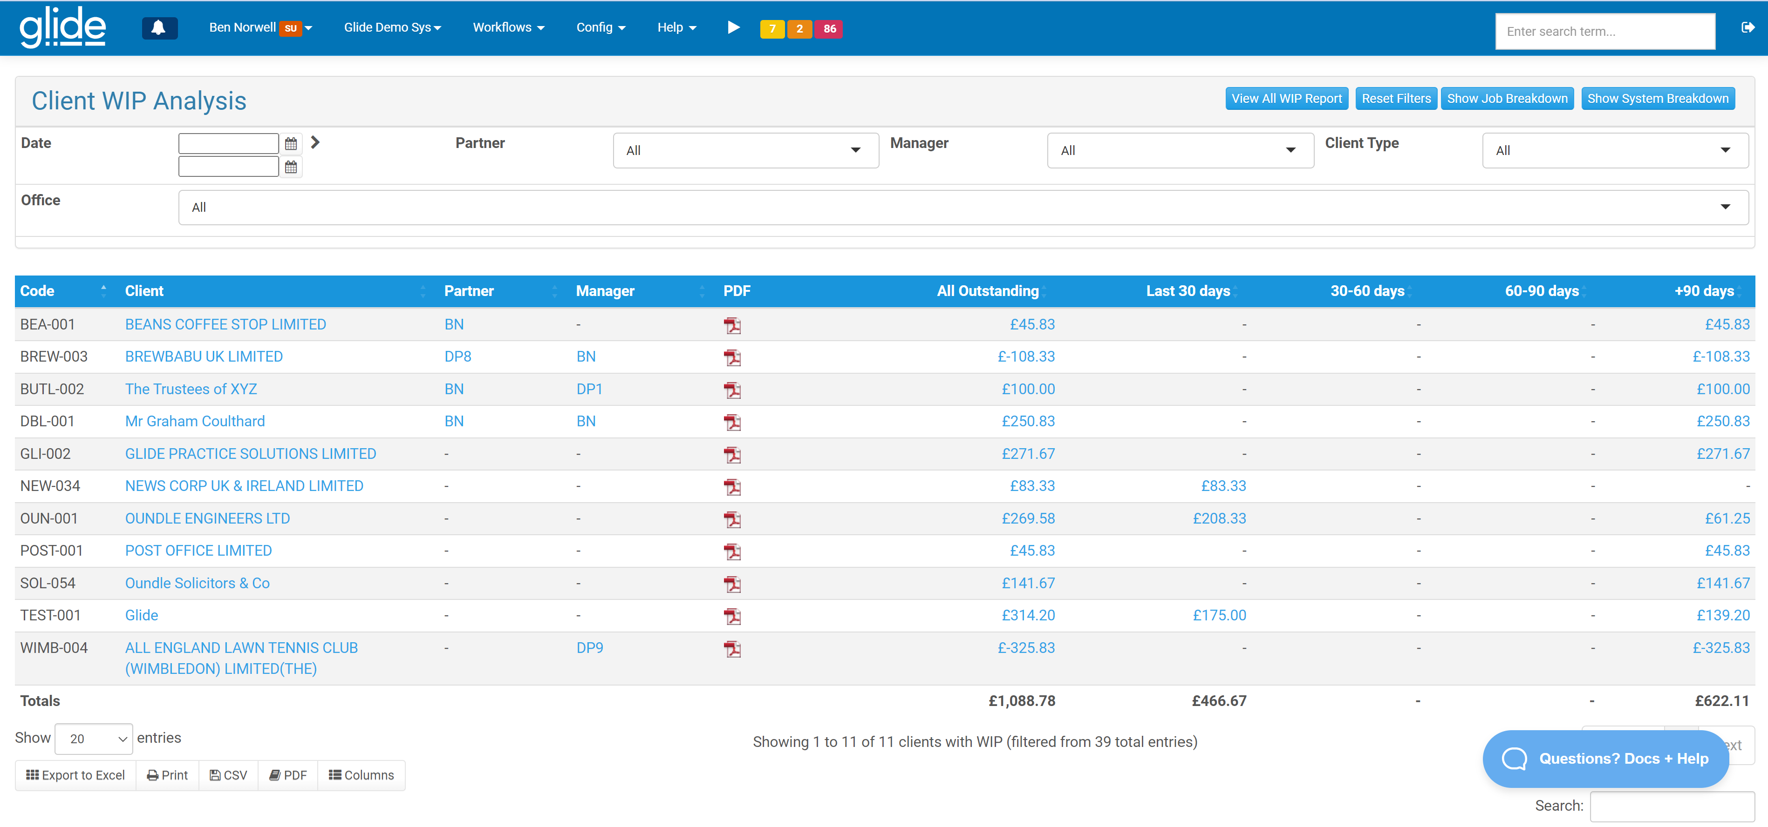
Add-on module – Glide Time
Timesheets/billing (Xero partner, others via Make/API).
Comprehensive WIP management.
Recovery reporting by client, portfolio, service, user, office, etc.
Bulk timesheet entry system.

Slide 40
Integrations
MS Entra ID (SSO / AAD).
Comprehensive/open API.
(New) Snapshot APIs for consumption in PowerBI reporting.
Webhooks for all key events (e.g. job progresses down step 12).
Connectors to popular PM (CCH, Digita, Practice Engine).
VC integrates into Glide.
Integration fully built for: Workiro, MyDocSafe, Google Drive, Xero, Summa Tech, and Companies House (ongoing monitoring of dates).
Extensive possibilities via our Zapier and Make apps.

Slide 41
Costs payable to Glide
Pricing is per user with gradually increasing volume discounts.
A 5% annual discount is available on top of this.
Onboarding, billed separately (fixed once scope known), rarely in excess of c. £2,500.
Ongoing:
  At 10 users, the total price is £245.86 per month (£24.58 per user per month).
  At 25 users, the total price is £564.10 per month (£22.56....).
  At 50 users, the total price is £994.66 per month (£19.89....).
  At 100 users, the total price is £1,681.06 per month (£16.81....).
  At 500 users £11.47 per user per month.

Slide 42
Project costs for implementation support, training, ongoing content
£2,500/month for 6 months to include:
  Confirmation of which systems already used & which to be integrated
  Liaison with Glide to implement & upload data
  SLT discussion to
    confirm which team members will use & to what degree – onboarding, marketing & managers/SLT
    how each group will be held accountable to use after training
    marketing strategy & content required to be supplied
  Meetings with each client portfolio holder to allocate sectors & client-need segments for each client
  Book & deliver training sessions – grouped into need, for Glide & commercial training
  Provide conversation starters & structures by client-need segments
  Support with team during rollout, review progress and report back to SLT for next actions
  Share best practice & success stories from other firms’ experiences
Thereafter, optional ongoing supply of content by sector & by segment, likely £500/month – tbc
Notes:
Led by KM

Slide 43
Making the decision
Look at the 2 solutions – CRM or workflow?
Look at the costs & look at the opportunity – ROI?
Make the decision & do something!

Slide 44
Or we can use any other CRM you want to use
LET’S JUST GET SOMETHING GOING, SO WE CAN SUPPORT MORE CLIENTS!

Slide 45
Also - maybe
Fee Reset Consultancy Project
  Mid-tier firms are not charging enough, especially for audits, but are nervous about increasing the fees. With data & supporting resources, they will have more confidence to do so.
  Benchmarking competitors’ charge-out rates & audit fees in region
  Communications with partner/director/manager teams for buy-in and draft communications with clients to ensure new fee structure is rolled out effectively
Fast-growing Client Specialism
  Targeting younger & innovative businesses
  This will alleviate some of the stress on the firm in respect of the lifetime value of its existing client base, which is predominantly aged over 50.
  Developing strategy
  Technical training for team members on high growth finance, innovation grants, crowdfunding, private equity market, valuations, IP considerations etc which are areas which younger, fast growing clients would expect their accountant to understand and to be able to advise on
  Marketing – website, content creation, networking events
Trainee Recruitment Strategy
  Identify need and associated trainee recruitment plan for the next 3 years
  Website development with resources for recruitment – Q&As, team member videos, day in the life etc
  Identify appropriate avenues for trainees – colleges or universities and build awareness amongst those student populations
  Refine assessment, interviewing and offer processes
  Onboarding and orientation procedures

Slide 46
And then - maybe
International connections
  Are you using your international association to fullest extent?
  Identifying strategy, best new connections, making contact
Create a new term in the market “Legacy disposals”
  Lowest value sales
  To protect the employment
MBO Training Programme
  Identifying suitable clients for an online introduction to MBOs
  Identifying suitable customers of banks
  Invites then follow up post event
MBI Headhunters
  Website development with resources for recruitment – Q&As, team member videos, day in the life etc
  Identify appropriate avenues for trainees – colleges or universities and build awareness amongst those student populations
Create consolidators
  Identify sectoral groups
  Find acquirers

Slide 47
But first – lay the foundations in the next 6 months
Data Capture
Training & Rollout
Content nurture
Build CRM capability
Identify Segment of Client Needs
Identify Sector
Optional - Integrate with Practice Management system (CCH, Iris etc)
Optional - Integrate with other advisory apps (Capitalise, Fathom etc)
Identify who will be having advisory conversations
Provide training about commercial skills
Provide supporting resources & content
Provide conversation starters & structures
Set out a clear approach and expectation
Review progress & hold accountable
Supply regular blogs, guides, videos, case study successes, quizzes etc targeted at different client-need segments & different sectors
Train on updating CRM
Optional - organise webinars or seminars
Optional - direct marketing by telephone or post
Optional - website news updates and social media posts
Integrate with existing mailing software (mailchimp, hubspot)
Notes:
A CRM on its own won’t work.
This is after years of watching firms trying to implement advisory.
There needs to be a wraparound solution to nurture the rest of the team (identified into different roles) including training, content supply & someone just doing all the legwork – me!
Email me please

Slide 48
Email me – let’s get this moving

