Slide 1
Insurance in M&A: Best Practice
Emily Chamberlain
W&I Broker

Slide 2

Transactional Risk Insurance
1. | Overview of warranty & indemnity insurance
2. | Strategic use of W&I
3. | SME market conditions
4. | Scope of cover & cost
5. | Other deal-related insurances
6. | Questions

Slide 3
The Mechanics of Liability in an Uninsured Transaction
Consideration
Business/Assets
+
Warranties
Seller(s)
Buyer
Warranty Claim
Damages

Slide 4
Strategy - Why a buy-side policy is better
Benefits for buyer
Benefits for seller
Increased protection including limit of liability, period of cover and warranty coverage
Differentiates a bid in
an auction process
Faster transaction negotiations
Clean exit from deal
Mitigation against
price-chips
Maximizes the return
to investors
Greater covenant strength from an insurer and a dedicated claims service
Broader set of contractual protections
Removes warranty burden of management team transferring
Sellers no longer need to have any involvement in the day-to-day business
Provides comfort to lenders, investors and shareholders
Allows the buyer to recover against an insurer for sellers' fraud
Comfort provided to warrantors with insurer taking on risk rather than seller or management warrantors
Enables sellers to use
the proceeds of the
sale immediately
Gives direct recourse to the Buyer from an insurer, particularly useful in jurisdictions where there is limited appetite for recourse against the Seller through traditional methods, such as the courts
Minimizes execution risk
Mutual benefits
Facilitates negotiation and completion of the transaction - deal certainty
Ability to insure known issues e.g. tax, litigation, contingent risks via standalone policies
Introduction to W&I

Slide 5
Sell-side W&I
→ It’s a solution for the sellers if the buy-side refuses to obtain the W&I in their name
Don’t tell the buy-side!

Slide 6
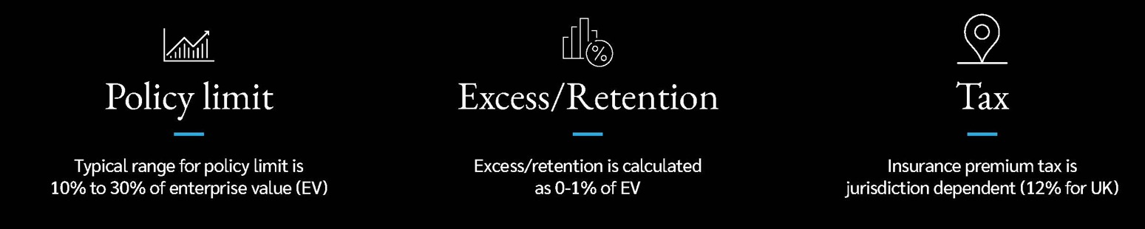
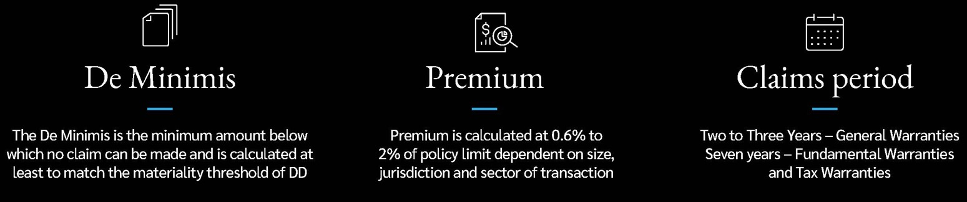
A W&I Policy in Numbers
Typical range for policy limit is 10% to 30% of enterprise value (EV) – higher for lower value deals
Excess / retention is calculated as 0.25% - 0.5% of EV (sometimes nil)
The de minimis is the minimum amount below which no claim can be made and is calculated at least to match the materiality threshold of the DD reports
0.5%/0.035% of EV?
3 years for General Warranties
7 years for Tax and Fundamental Warranties
Introduction to W&I

Slide 7

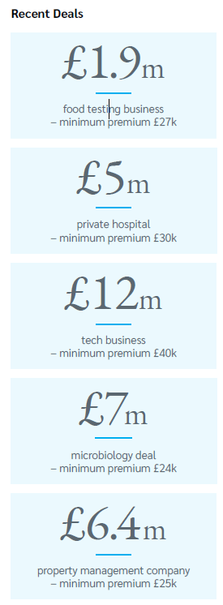
W&I on SME Deals
“Deals in the £1m-£15m range are now very much within appetite for a growing number of insurers”
W&I Insurance in the SME Space
• Usual standard coverage and exclusions apply (no difference from larger deals)
• Proportionately higher levels of cover compared to larger deals
(30-100% of EV as opposed to the traditional 10-30%)
• Tip-to-nil retentions normally available
• Sensible de minimis in line with materiality in DD reports
TRANSACTIONAL RISKS
Notes:
DE

Slide 8




Do insurers accept internal DD?
YES, as long as:
The individuals doing the DD are suitably qualified/experienced
The scope is written down and is appropriate for the transaction
→ otherwise matters not covered in DD might be excluded
The findings explain how reviewer got there
→ i.e. don’t just state conclusions with no explanation

Slide 9


What does W&I cover?
 | Fundamental warranties
 | General (operational) warranties
 | Tax warranties
 | Tax covenant
 | Specific indemnities

Slide 10
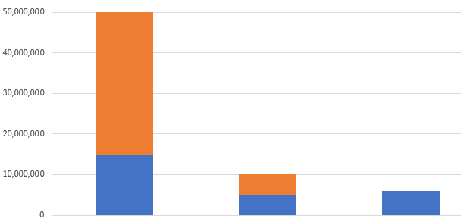
How much is a W&I policy, and who pays for it?
Premiums are charged as a % of the cover limit
e.g. 0.5-1% of limit
Subject to minimum premiums of c.£25k
EV
Total cost:
- Premium
- IPT @12%
- Broker fee: £30k less 20% of premium
- Underwriting fee: 0-£7.5k on an SME deal
Coverage
EV
Coverage
EV/Coverage

Slide 11
Rough Quote vs Report on Terms
For a rough quote, we would need:
EV (or anticipated/estimated EV)
What the target does
Where the target does it (country/ies)
For a full W&I report, we would need:
NDA (if required)
EV (or anticipated/estimated EV)
Name of target
Information Memorandum or management presentation describing the target company (if either is available – if not then a bit of commentary on the target’s operations/revenue by division/jurisdiction/number of employees)
Draft SPA (if there is one – or heads of terms if not)
Details of anything unusual about the transaction e.g. dragging shareholders, re-organisation
How much of the DD will be internal
Introduction to W&I

Slide 12

Typical Underwriting Timeline - W&I
Days 1-2
Days 4-5
Days 7-10
~20 - 35business days
from completion
Review information; provide initial advice on coverage and appropriate insurers; submit information to chosen insurers for non-binding terms
Engage with preferred insurer; facilitate flow of information / due diligence (DD) for insurer review
Continue iterative negotiation of policy in conjunction with DD report review; responses to underwriting questions; obtain coverage position
Payment of the premium
Days 3-4
Days 5-7
Days 10-12
Advise on initial terms; flag initial concerns and potential issues
Negotiate front-end / pre-underwriting policy draft; address insurer’s early concerns / issues
Agree and incept policy
Introduction to W&I

Slide 13
Step/Action | Comment
Lockton engagement letter | To be entered into with the company which will be the policyholder
Insurer expense agreement | If applicable (i.e. if the insurer is charging an underwriting fee), again to be entered into with the policyholder
Due diligence | Please provide all DD reports that will be available to the insurer
Hold harmless letters | To the extent required before DD reports can be shared
Transaction documents | SPA/tax deed/warranty schedule/disclosure letter
Data room access | For broker & insurer teams
Underwriting questions | Shortly after instruction, the insurer will issue a set of “tranche 1” underwriting questions. These are fairly generic. After reviewing the DD reports and the VDR, they will issue a set of “tranche 2” underwriting questions, more specific to issues raised in the DD.
Policy | At the same time as underwriting is in process, the insurer will issue a draft policy based on a well-negotiated one we have agreed with them recently. We will review this and include our comments before sending it to you for further review.

Slide 14
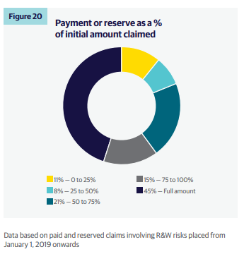
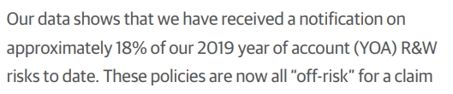
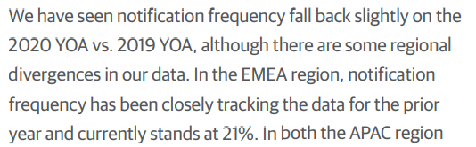
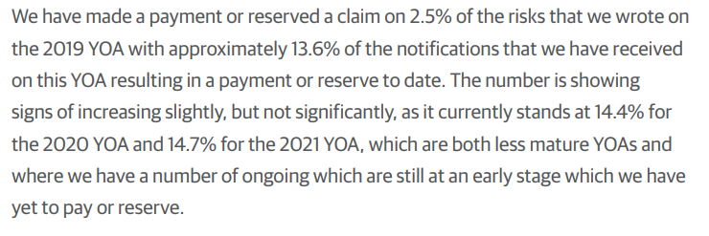
Claims Data Extracted from Liberty’s 2024 Claims Briefing
TRANSACTIONAL RISKS
Notes:
DE

Slide 15

Example – Real Estate – Hotels PE Acquisition
Acquisition of an operational hotel business in the Caribbean.
Years prior to completion, the fire authorities had requested that the sellers install a sprinkler/fire alarm system to comply with the applicable fire safety standards. The fire authorities wrote to the sellers to advise that the hotel’s fire safety certificate would only be issued for one year, with renewal conditional upon a suitable system being installed.
Post-Completion the fire authorities informed the buyer that implementing the modifications could take 3-5 years and result in disruption to the hotel including various residences needing to be closed. Failure to implement such modifications will result in having to close the hotel and would risk losing tour operators essential to the business.
The cost quoted to undertake the remediation works was c.$450k
The insurer agreed to settle at this amount
However, the buyer was unable to recover under the policy for any indirect (consequential) loss, namely profits lost as a result of needing to close parts of the hotel whilst works were to be undertaken.

Slide 16
Other deal-related insurances

Slide 17
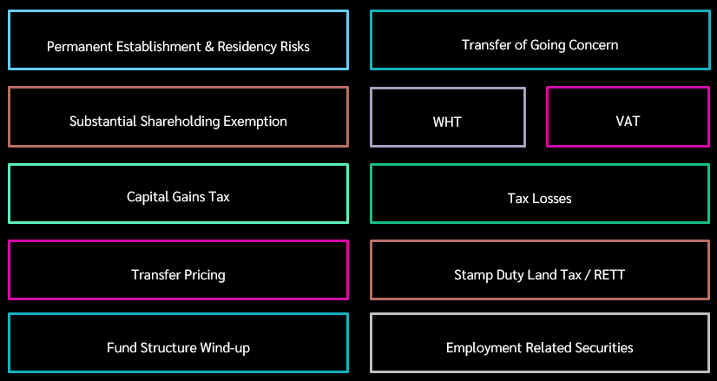
Insurable Tax Risks

Slide 18

Contingent Risk Insurance
Protects against identified risks
Can be in the context of M&A (but not always)
It tends to cover uncertainty relating to identified legal risks, e.g.:
Prospective or ongoing court or arbitral proceedings
Contractual interpretation issues
Identified contingent balance sheet liabilities
Ownership and title risks
Regulatory decisions
Think low probability, high-cost events
→ Potential deal-stoppers
TRANSACTIONAL RISKS
LOCKTON COMPANIES |
18

Slide 19



IP: Transaction examples
Sector | Issue | Solution
 | Deep tech business (uni spin out) with VC exit and trade buyer Trade buyer identified title and infringement risk and requested a material price chip in addition to specific indemnities which exiting VC would not agree to | We facilitated a top up DD exercise and created specific insurance solutions for the areas of concern within the W&I The seller agreed to pay for the additional coverage instead of the price chip and specific indemnities
 | SaaS business with unregistered TM position Buyer’s DD identified registered third party TMs which were substantially similar to Target’s unregistered TM position £1m indemnity and holdback requested and sellers’ disagreed on risk | We facilitated a top up DD exercise Put in place a specific risk policy that replaced the specific indemnity in the SPA

Slide 20
Any questions?

