Slide 1

What ever you make,
make it smarter

Slide 2
What is Made Smarter?
Knowledge & Funding Support
to adopt Digital Technology
Expanded in 2025 to all of England
Extension to Scotland, Wales and Northern Ireland in 2026

Slide 3
Workshops & Training
Digital Champion, Work Force Development
and Leadership & Management
- Road Map - Digital Technology & focus business areas
Selection of Digital Technology to adopt
Tools to succeed - Project & Change Management

Slide 4
Grant Support
- Revenue £3.5k fully funded
- Capital £20k 50% funded
To Support the Road Map Adoption

Slide 5
Participating Businesses MUST be;
^{-Trading}
^{-Manufacturing a product}
^{-Based in England}
-Small to Medium Enterprise (meet 2 of the following, under 250 staff, £36M T/O, £18M BS)
^{Why consider Made Smarter;}
-To benefit from fully-funded advice from specialist technology experts.
-Who will help identify the right digital tools and technology to make everyday improvements to the business.
-Develop a business road map to a Smarter Factory
^{But don’t take my word for it…}

Slide 6
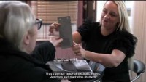
Deal Direct Blinds Case Study

Slide 7
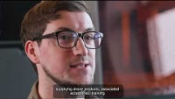
Heliguy Case Study

Slide 8
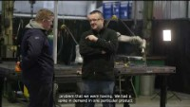
Expanded Metal Company Case Study

Slide 9
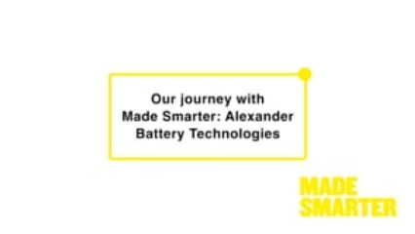
Alexander Battery Technologies Case Study

Slide 10
Since 2018 Made Smarter Has
Engaged with 5000 manufacturing SME’s
Supported 2000 companies with a digital roadmap
leveraged £25m of private investment grants

Slide 11
Have they considered adopting;
Real time communications throughout the process or supply chain
Smart Sensors to drive decisions in real time
Remote monitoring
Additive manufacturing to make parts or prototypes onsite
Advanced Automation combining human and machine interaction
Are businesses looking to;
Increase Productivity
Adopt Proactive Maintenance
Optimise Process Control
Increase flexibility to work remotely
Improve your cyber security
Whatever they make, it’s time to make it smarter

Slide 12

Is Made Smarter for your client
How do they apply?

Slide 13

^{Get set for the future. Now}
^{www.madesmarter.uk}

