Slide 1
A Presentation to the CFN Conference
Unlocking Hidden Value – Intellectual Property in M&A
and Business Transfers
Marcos Kauffman & Oliver Pooley - 24th September 2025
www.barkerbrettell.co.uk

Slide 2
Agenda
1 – Introduction (2 minutes)
2 – Setting the Scene: Why IP is Key to Deal Value? (5 minutes)
3 – Valuation Offerings (5 minutes)
4 – IP Due Diligence: Red Flags & Value Boosters (7 minutes)
5 – Beyond Completion: Optimising the IP Portfolio (5 minutes)
6 – Q&A (4 minutes)
Notes:
Oli

Slide 3

Oliver Pooley
Partner, UK & European Patent Attorney
Introduction
Patent attorney and partner at Barker Brettell LLP
15 years of experience in obtaining and enforcing IP rights, defending against allegations of IP infringement, and advising on IP strategy, risks and opportunities.
Worked with a range of companies at all technology readiness levels, and supported companies through spin-out, pre-funding, early-stage funding, series A, B, C and D funding, sales and other significant changes
Regularly deal with technologies such as manufacturing, green tech, medical devices, AI, defense, fintech, and telecoms.
Notes:
Oli

Slide 4



Marcos Kauffman
IP Valuations Consultant
Introduction
Professor of Technology and Innovation Management at Coventry University - UK
Director - Institute for Advanced Manufacturing and Engineering Director - Research Centre for Manufacturing and Materials.
Over 15 years of manufacturing and engineering industry experience marked by leading cross-disciplinary industrial research and development projects.
Founding partner in 2 start-ups
NED for 2 clean tech start-ups
Expertise in technology development, intellectual property strategy, valuation and commercialisation.
Notes:
Marcos

Slide 5
Introduction
A quick recap
The types of IP
  Patents – how it works or is made
  Trade marks – the name
  Designs – the look
  Copyright – creative and artistic works
  Trade secrets – the secret sauce – commercial and technical
  Others (quite niche)
Notes:
Marcos

Slide 6
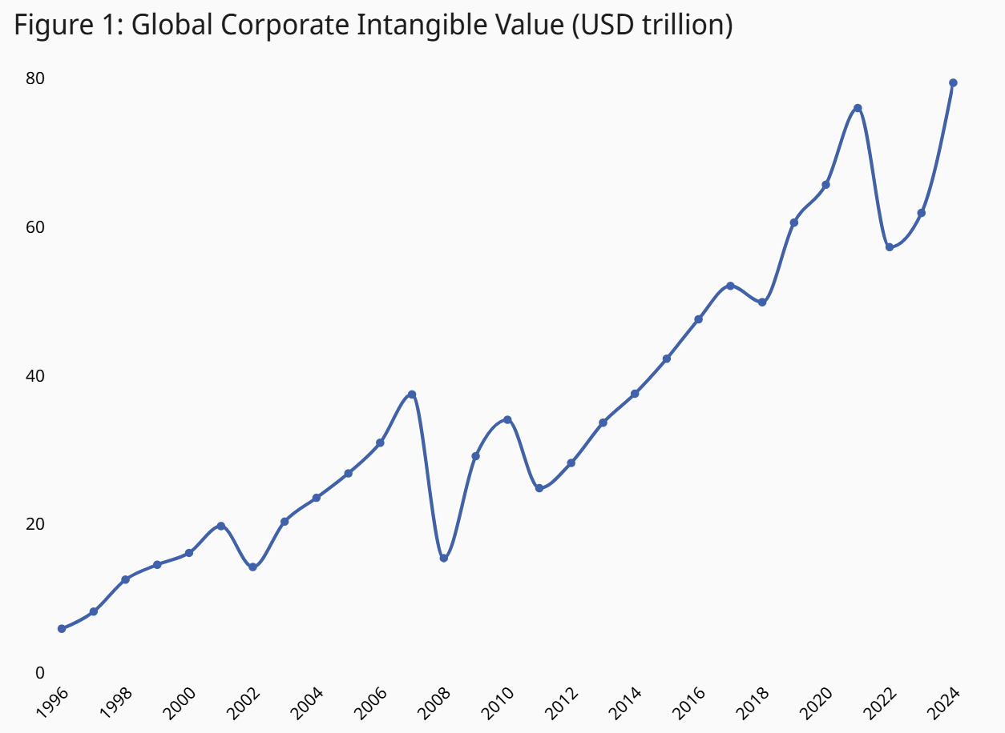
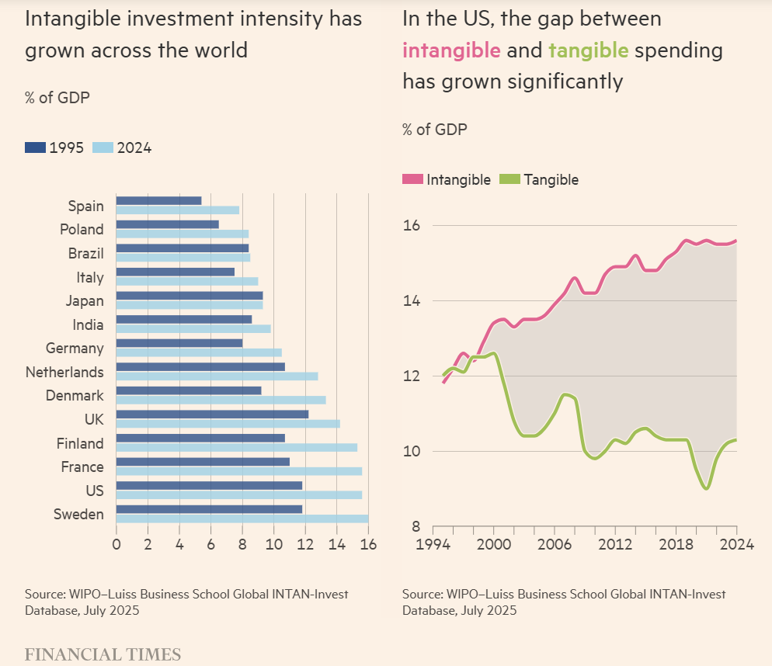
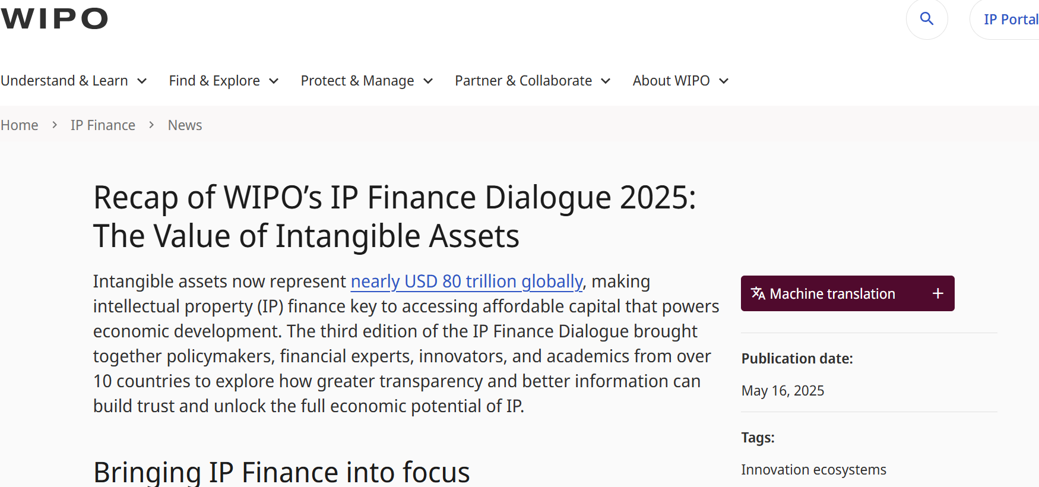
2. Setting the Scene: Why IP is Key to Deal Value?
IP Value in Companies
Over the past 40 years, the shift from tangible to intangible assets has transformed corporate value – today, ~90% of S&P 500’s and 74% of S&P Europe 350 market cap is intangible assets.
In M&A and business transfers, IP often determines the valuation multiple and can make or break the deal’s strategic rationale.
"IP" is broader than patents – includes trade secrets, proprietary algorithms, datasets, industrial designs, brands, and know-how.
Investors now actively price both traditional forms (patents, trademarks) and emerging forms (AI training data, proprietary processes).
Notes:
Marcos

Slide 7
2. Setting the Scene: Why IP is Key to Deal Value?
What is an IP valuation?
Valuation is a process of determining value or worth of an asset
Valuation often combines objective and subjective considerations
An estimation of the worth of an IP asset or a set of IP assets
Many valuation techniques, ranging from the simple to the extremely complex
The objectives of the valuation will impact the strategy as well as the type of valuation that is appropriate
The process always begin with an assessment of the purpose of the valuation
Asset + Context + Time = Value
Notes:
Marcos

Slide 8
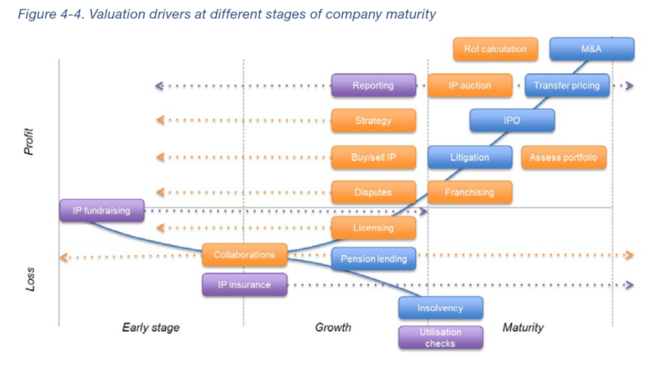
Setting the Scene: Why IP is Key to Deal Value?
Notes:
Marcos
Illustrative Case A:
Scenario: £200m buy-out of a Midlands construction technology firm.
Challenge: Initial EV/EBITDA multiple offered was 4.1x, based purely on tangible assets and financials.
Approach: Independent valuation of proprietary manufacturing processes, patented components, and trade secrets underpinning cost advantage.
Outcome: Recognised defensible IP position doubled perceived competitive moat - multiple increased to 8.4x, unlocking an extra £85m in deal value.

Slide 9
3- Valuation Playbook
The standard approach to IP Valuation
Identify the Intangible Assets and the Purpose of the Valuation
Select and Appropriate Bases of Value
Select Appropriate Valuation Approach and Method
Valuation Analysis and Reporting
IVS 210
Intangible Assets
20.06 – When valuing intangible assets, the valuer must understand what needs to be valued and the intended use of the valuation.
IVS 102
Bases of Value
When valuing intangible assets, the value must select an appropriate basis(es) of value.
e.g. Market Value, Equitable Value, Investment Value (or Worth), Synergistic Value, Liquidation Value, Fair Value (under IFRS), Fair Market Value (OECD and U.S. IRS definitions), and Forced Sale Value​​.
IVS 103
Valuation Approaches
-Income Approach​
Future income streams derived from the IP, discounted to present value.
-Market Approach​
Uses comparable market transactions to establish value.
-Cost Approach​​
Calculates the cost to recreate or replace the IP asset.
Data collection
Data analysis
Risk assessment
Valuation Calculations
Draft reports
Client reviews
Final reporting
Valuation sign-off
Notes:
Marcos
Illustrative Case B:
Scenario: Acquisition of a SaaS business with a proprietary machine-learning algorithm.
Approach: Applied Relief-from-Royalty method using sector-specific royalty benchmarks; factored in algorithm accuracy rates and switching costs for customers.
Outcome: Valuation added £3.6m to amortisation schedule - directly affected purchase price allocation and improved negotiation position for seller.

Slide 10

3- Valuation Playbook
Barker Brettell IP Valuation Offering
Rapid Scoping & Indicative Value
When you need a quick, defensible view. Short memo; typical scope 3-5 days; fixed fee after scoping.
Formal Valuation for Transactions & Reporting
Full report for licensing, fundraising, tax/accounting or fair value. Methodology agreed up front; fixed fee.
Portfolio Review & Value Maximisation
Prioritisation across multiple assets; heat-map of value, gaps, and quick wins; action plan.
Litigation Support & Expert Opinion
Valuation for disputes/royalty rate setting; independent expert report and testimony support.
Commercialisation & Licensing Support
Value-based deal modelling (rates, milestones, territory); sensitivity and scenario analysis.
Notes:
Marcos

Slide 11
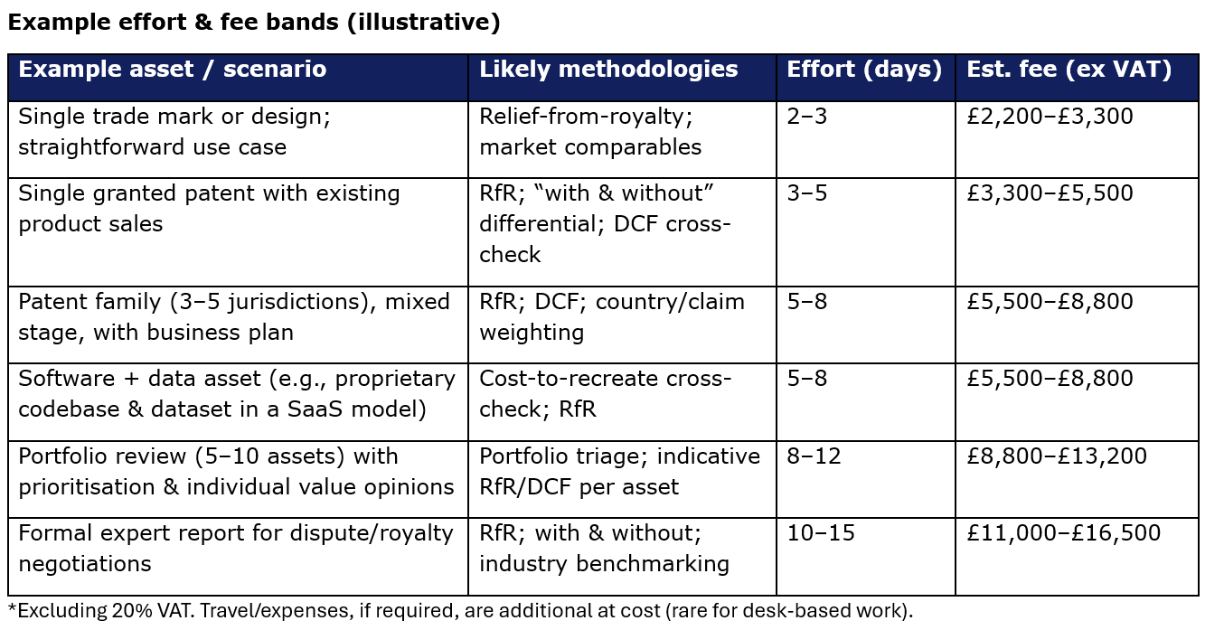
3- Valuation Playbook
Barker Brettell IP Valuation Offering
Rapid Scoping & Indicative Value
When you need a quick, defensible view. Short memo; typical scope 3-5 days; fixed fee after scoping.
Formal Valuation for Transactions & Reporting
Full report for licensing, fundraising, tax/accounting or fair value. Methodology agreed up front; fixed fee.
Portfolio Review & Value Maximisation
Prioritisation across multiple assets; heat-map of value, gaps, and quick wins; action plan.
Litigation Support & Expert Opinion
Valuation for disputes/royalty rate setting; independent expert report and testimony support.
Commercialisation & Licensing Support
Value-based deal modelling (rates, milestones, territory); sensitivity and scenario analysis.
Notes:
Marcos

Slide 12
4 - IP Due Diligence: Red Flags & Value Boosters
Its never too early to think about IP – even if a deal is not yet on the table
Having IP policy and procedures in place can reduce the pain in due diligence
Common red flags:
Capturing, evaluating and cataloguing/protecting IP as it is created
Tracking ownership, creatorship and use
Flagging and mitigating potential issues as they occur
Notes:
Oli
Examples of deals with companies I have been involved in
Company A – we only got involved around the time of the deal – lots of working in tracking down all the necessaries
Company B – we have been involved from early on – buyers came back with no questions beyond basic portfolio questions
What questions they did have, we already had recorded (e.g. protection choices etc…)

Slide 13
4 - IP Due Diligence: Red Flags
IP due diligence is not just about ticking boxes – it identifies value risk and value uplift opportunities.
Common red flags:
Freedom-to-operate issues (pending infringement claims or unassessed competitor patents).
Does the company actually own the IP they purport to?
Change-of-control clauses in licences or joint ventures (risk of losing rights post-sale).
Data ownership gaps – especially for AI/ML datasets or cloud-hosted software.
Case example with Nicholsons
Notes:
Oli
(Ox) Richard referred a case to us during the DD phase of an acquisition where he was acting for the buyer. Through this process we identified additional TMs belonging to the buyer . This ensured all of the relevant IP was captured in the agreement which ultimately resulted in a better deal. It also prevents problems down the line from there being split ownership of the identical TM by different entities.
(PTS) In another referral from Richard, we were asked to input on elements of a redrafted distribution agreement following changes in the ownership of the IP by the parent company. This identified an issue around the ownership of a domain which the client has registered but technically was in breach of the distribution agreement. Handing over the domain to the parent organisation would effectively have killed the value in the business and removed the viability of the exit strategy. We were able to help redraft the relevant clause to protect the client’s exit options.

Slide 14
4 - IP Due Diligence: Value Boosters
Value boosters:
Proactive IP audits – identify gaps in protection and fill where possible
Ensuring registrations are in the correct entity before sale.
Securing unregistered rights documentation.
Notes:
Oli (Marcos for case study)
Illustrative Case D:
Scenario: Private-equity roll-up of three manufacturing firms.
Approach: 24-month rationalisation programme + merged portfolios, abandoned low-value patents, monetised dormant IP.
Outcome: £0.5m annual saving in renewal fees and legal costs, plus one unexpected £400k licensing deal from an unused technology.

Slide 15
5- Beyond Completion: Optimising the IP Portfolio
Post-deal integration can make or break the financial return on IP-driven acquisitions.
Rapid triage of overlapping portfolios to avoid duplication in maintenance costs.
Leveraging Patent Box and R&D tax credits to accelerate post-deal ROI.
Identifying licensing opportunities for non-core IP and uses of IP outside of core business sector to create cashflow.
Notes:
Oli (Marcos for case study)
Illustrative Case D:
Scenario: Private-equity roll-up of three manufacturing firms.
Approach: 24-month rationalisation programme + merged portfolios, abandoned low-value patents, monetised dormant IP.
Outcome: £0.5m annual saving in renewal fees and legal costs, plus one unexpected £400k licensing deal from an unused technology.

Slide 16
Product Offering
Products for IP DD
IP review - £500 – review of existing UK IPO for TM, patents and designs per legal entity
Deal review for IP Red flags - £600
Input on IP clauses of commercial deals - £600-£1000
IP Audit Scheme - £3K but UK IPO will cost £2250
Products for IP protection
UK TM Registration - £990 – 1 class – 10 years protection
UK Patent - £3-5K+ depending on complexity of technology
UK Design - £500 depending on no. of designs
Notes:
Oli

Slide 17
6- Conclusion & Q&A
In summary…
We can help you unlock the full economic potential of IP by providing:
Advice on IP strategies and policies
FTO & infringement analysis de-risking launches and acquisitions.
Filing & prosecution of patents, trade marks & designs in all major jurisdictions.
IP audits & strategy support identifying non-core assets for disposal/licensing.
IP valuations.
Every business no matter the size has IP worth considering
Notes:
Oli

Slide 18




6- Conclusion & Q&A
Barker Brettell Team
Rosalyn Newsome – CFN Lead Contact
Partner, Trade Mark Attorney
+44 7989 426 806
Rosalyn.newsome@barkerbrettell.co.uk
Oliver Pooley
Partner, European & UK Patent Attorney
+44 7973 711 736
oliver.pooley@barkerbrettell.co.uk
https://www.barkerbrettell.co.uk/our-services/business-advisor-support/
Marcos Kauffman
IP Valuations Consultant
+44 7774 335 099
marcos.kauffman@barkerbrettell.co.uk

