Slide 1


Introduction to
Innovate UK Business Growth

Slide 2
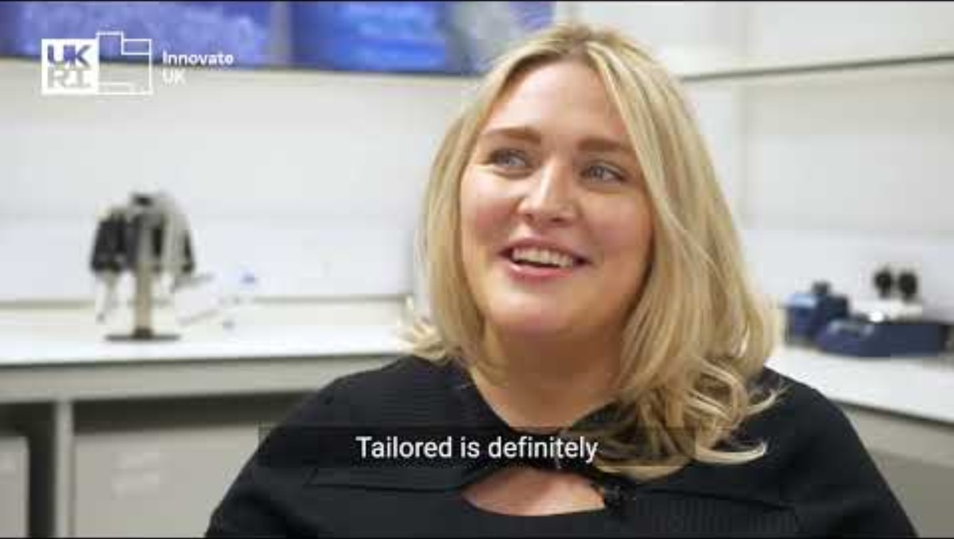
Video success story: ImmuONE
Notes:
https://youtu.be/q0UXxgsVp44?si=NULI1MN5IjtU87lM

Slide 3

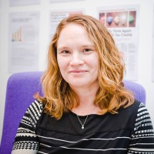
Presenter introduction
Wendy Smith Business Service Manager – External Innovate UK
LinkedIn
Over 25 years of leading business development initiatives across the Professional Service, Manufacturing and Tech sectors.
Notes:
Please replace photo of presenter with a portrait of your own. You can use your own photo in whatever shape it comes in, instead of the way this example is presented. Or to match the example of this slide 1) Send the geometric shape overlay to the back – Right-Click > Send to Back > Send to Back. 2) Replace image – use the guides provided to correctly position it. 3) Send your portrait to the back so that the geometric overlay re-appears over the portrait.

Slide 4

Innovate UK Business Growth
The indispensable partner for ambitious innovators
We equip innovation-focused businesses to make the best strategic choices and harness the right resources to accelerate their growth.
Over 6,000 innovators benefit from our intensive and tailored advisory support to achieve their ambitious goals every year.
We are in their corner – do you want us in yours? Visit iukbg.ukri.org to learn more.
97% of clients would recommend us
“Innovate UK Business Growth gave us the tools to grow with confidence”
Natali Georgieva, Co-founder at ALIANAz
94% report that our service has had a positive impact on their growth

Slide 5
Who do we support?
Ambitious, innovation-focused businesses that are growing strongly, or that have high growth potential ​
Registered at Companies House with up to 250 employees​
Management teams motivated to engage fully with us to help achieve growth milestones​
Businesses with or without Innovate UK grants

Slide 6



A service designed around your needs

Slide 7
Innovate UK Business Growth
Innovate UK provides high-quality strategic advisory support as a partner to its clients. The Innovate UK Business Growth service uniquely combines:
A comprehensive spectrum of innovation and commercial expertise
A single access point
to the most significant regional, national and international innovation resources
1:1 support that is flexible and tailored in focus and timescale to the individual needs of innovative businesses

Slide 8

Specialists with comprehensive expertise
to help you hone your strategy
Over 450 innovation and growth specialists nationwide, including 43 scaleup directors, who are also plugged into technical experts across Innovate UK and beyond.
With the commercial acumen and innovation experience to help clients hone their growth strategies and accelerate their progress in three broad areas.
Funding & finance
strategy
Innovation & commercial
strategy
International markets &
collaboration strategy
“Our specialist’s knowledge and experience…has been incredibly helpful and comforting. The…ups and downs can be tough but having that consistent sounding board has made a huge difference.”
Jason Mashinchi, Managing Director at Cambridge Kinetics
Notes:
Feature 1: It offers clients a comprehensive spectrum of innovation and commercial expertise via our specialists, the lynchpin of the service. Their professional backgrounds qualify them to help clients tackle priorities ranging from improving the innovation process and forging international business collaborations, through to becoming investment ready and structuring for growth. They can also tap an unrivalled breadth of expertise across Innovate UK, when supplementary input is required
Investment readiness
R&D collaborations
IP protection
Innovation management
Market readiness
Commercial skills
Design capabilities
Scaling production
Business models
International market entry
Build supply chains
Responsible innovation
Finance new facilities
Testing prototypes
https://www.wordclouds.co.uk/

Slide 9
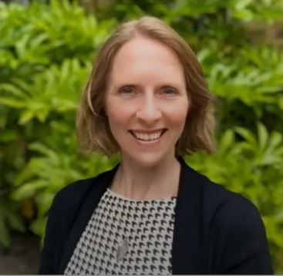
Meet Innovation & Growth Specialist
Steph Aldridge
Science degree from Cambridge University
Ten years in management consultancy – support for FTSE 250, startups and due diligence for VCs and PE
Operations director for market research business
Commercial director of biotech business – started, secured finance & scaled
Now a Senior Innovation & Growth Specialist, supporting the likes of ImmuONE: see video
Steph believes the following qualities are important for her work: A passion for coaching, lived experience and business expertise
Notes:
Steph, expanding on the important qualities:
Passion for coaching – Driven to actively support innovative businesses from startup to scaleup, in a collaborative coaching environment
Lived experience – An understanding of the challenges and rewards of entrepreneurship
Business experience – A robust understanding of business principles, essential to high quality mentorship, empowering SMEs to achieve their ambitions

Slide 10
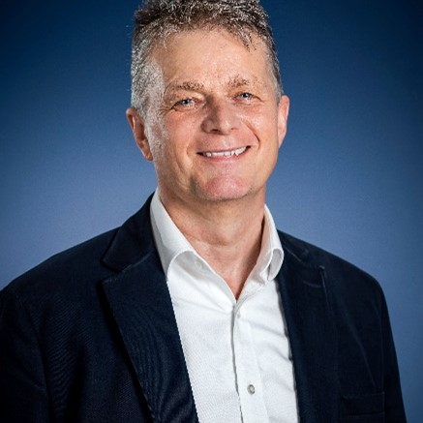
Meet Scaleup Director Mark Harrison
Space Tech Pioneer – 10 years in European space programs; NASA award for ROSAT mission.
Global Telecom Leader – Exec VP Sales & Marketing; roles in Brussels, New York, and beyond.
Entrepreneur & Innovator – Founded software ventures; scaled revenues to €15m across 35 countries.
Commercial Strategist – Led SaaS and hardware businesses; fluent in German, sharp communicator.
Mark has been a Scaleup Director since January 2022. A technologist, specialising in Commercialisation and Productization of Innovation with a focus on SaaS based businesses.

Slide 11
Providing access to local, national & international resources
Innovate UK
system
Innovate UK
Business Growth
National
Innovate UK
strategic
partnerships
Local
International
Resources in your region
Platforms for collaboration &
international growth
(R&D & commercial)
Notes:
Feature 2: The service offers a single gateway to the most significant regional, national and international innovation resources. Our specialists and the diverse consortium of delivery partners who host them have substantial connections into their local R&D and growth resources. This is combined with access to Innovate UK’s own products & services, and opportunities presented by Innovate UK’s national & international strategic partnerships. Let’s take a look at these three levels in a bit more detail.

Slide 12
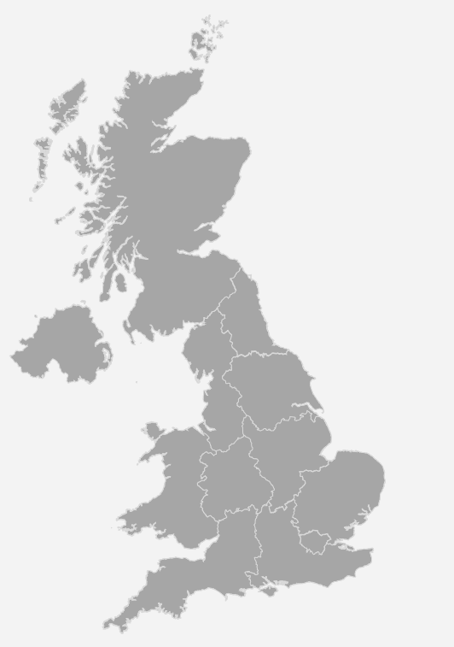
Embedded in regions & UK nations
Local
Our locally-based specialists interact with key support partners at the level of UK nations and regions, to provide clients with opportunities that help them innovate and grow.
From communicating and exchanging information, to working together and planning together, we actively collaborate with, for example:
100% of Growth Hubs
(England)
100% of Russell Group
universities & many
other research
Intensive universities
72% of Local
Authorities
Growth Hubs in England. In the other UK nations, there are different delivery bodies
Local authorities here includes city & county councils, combined authorities, LEPs and mayoral authorities
All 24 Russell Group

Slide 13
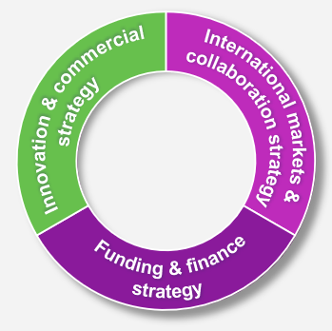
Innovate UK Business Growth support initiatives
National
Our advisory support is complemented by a range of impactful initiatives available to specialist-supported Innovate UK Business Growth clients nationally, depending on business need.
Enterprise Europe Network
Global Partnerships & Brokerage
Global Business Innovation Programme (GBIP)
Global Incubator Programme (GIP)
Global Explorers
Horizon Europe Pump Priming
Intellectual Property Audit (IPO)
Design for Growth
Standards & Compliance (BSI)
RTO/Catapult grant
Peer Networks (SUI)
Secure Innovation Security Review (NPSA)
Invest-Ability investment readiness support
Support initiatives for
Scaleup Programme clients
NED scheme
Scaleup Peer Networks
Scaleup Alumni
Scaleup Growth Fund
Notes:
The initiatives build knowledge and skills, increase connectivity and extend capacities for innovation and R&D.

Slide 14
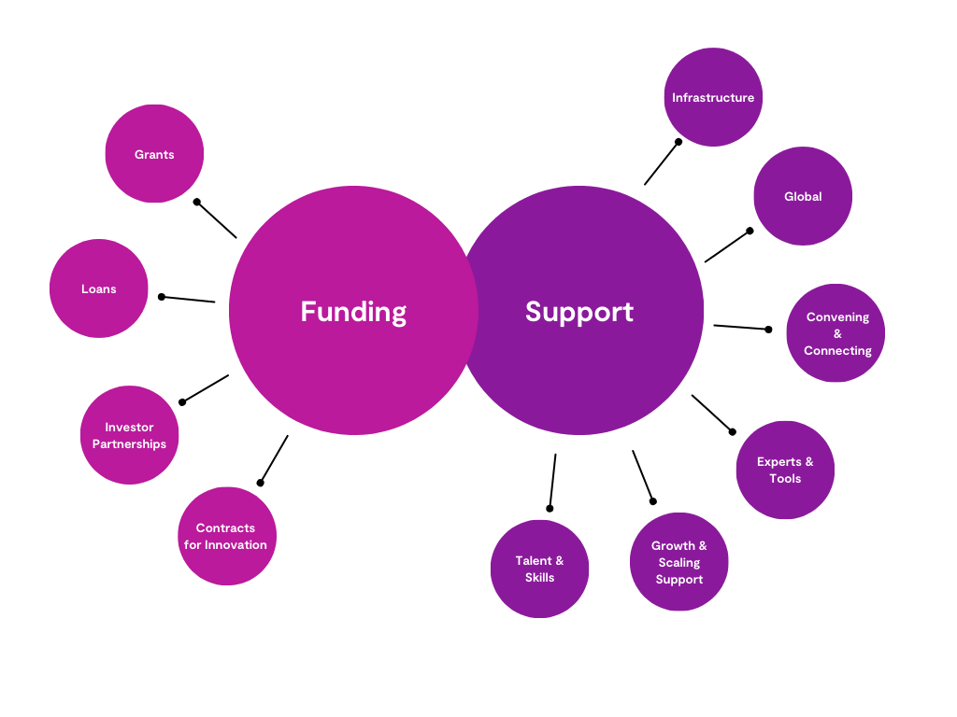









National
Innovate UK System: Product & Service Examples
National
Notes:
Please note, this is radically simplified for illustration only. Some parts of the system might span support and/or funding types.

Slide 15

















National
Innovate UK
Strategic
Partnerships
Policy &
programme partners
Initiatives
Examples of partnerships across the private and public sectors.
Referrals &
learning
National
Partners

Slide 16
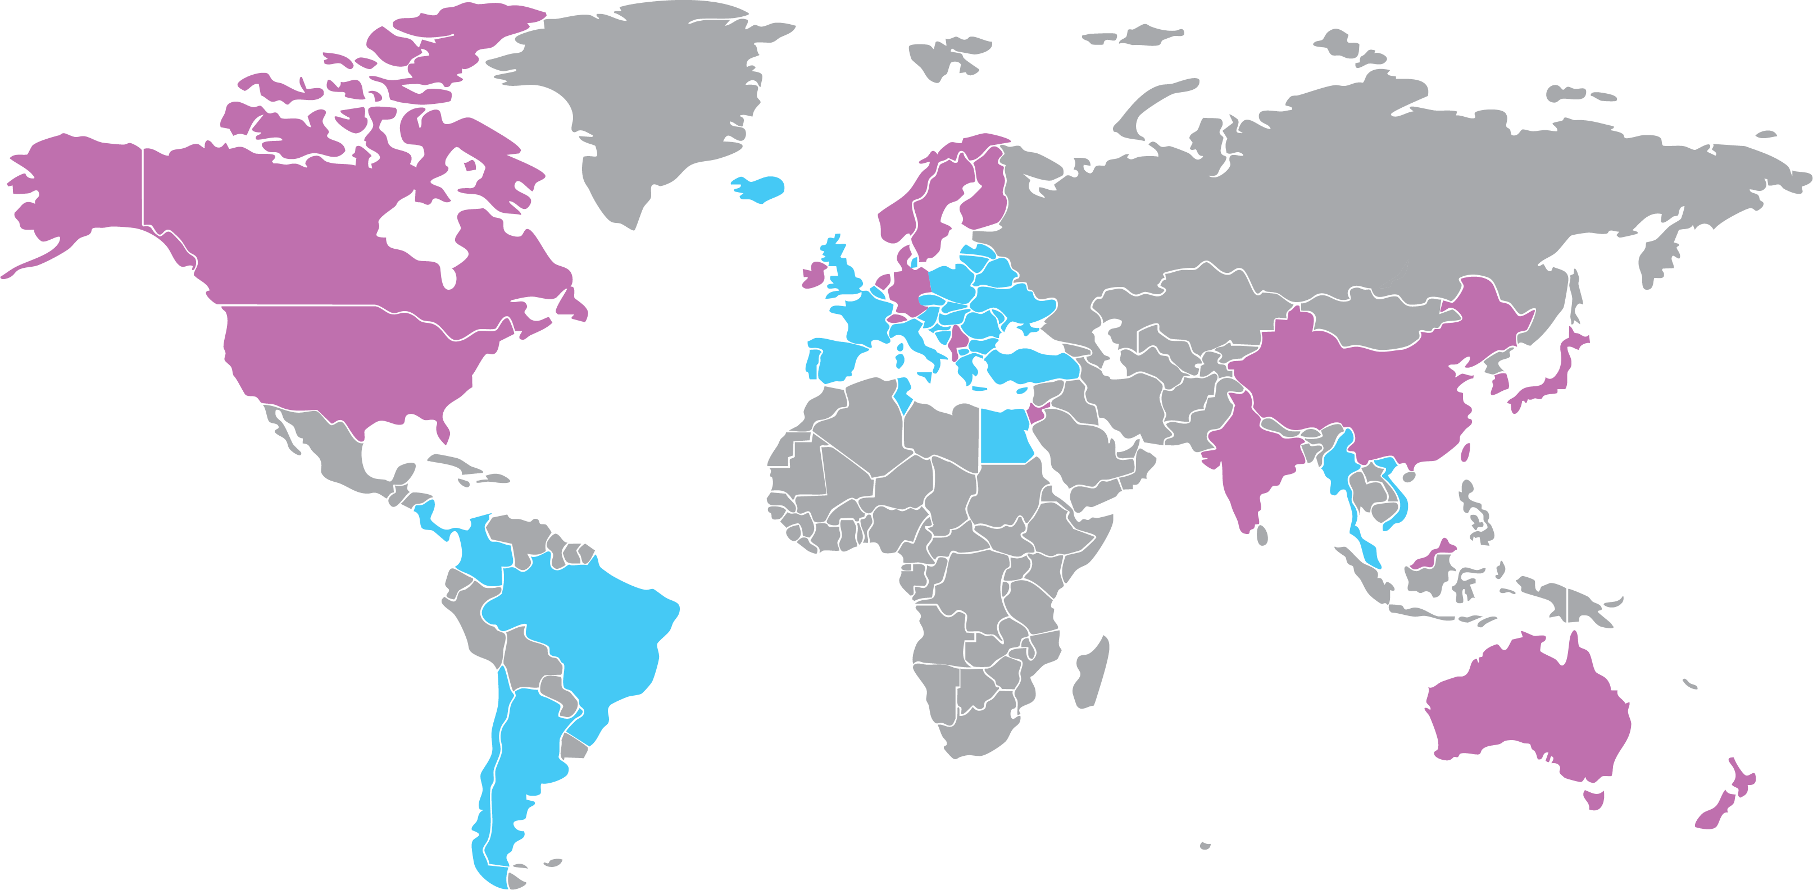
International opportunities
International
Our initiatives and partnerships extend our reach to the following countries for innovation internationalisation, whilst we link seamlessly to DBT for export support:
Innovate UK
Global
GBIP
Global Business
Innovation Programme
GIP
Global Incubator
Programme
Global
Explorers
EUREKA
Enterprise Europe Network
Partner Opportunities Database
Sector
Group
Thematic
Group
Brokerage
Events
International
funding (HEu)
Note: Colour scheme does not correspond to initiative type: opportunities in many countries flow from multiple initiative types
Notes:
Our clients can benefit from a range of initiatives from Innovate UK Global, in addition to activities related to our collaboration with the Enterprise Europe Network (EEN).
This is in the context of help we provide to clients to capitalise on international opportunities, from R&D activities and access to partnerships globally, to explorations of future target markets.
By fostering connections and collaboration, we create valuable opportunities for international growth.

Slide 17






As part of flexible advisory support through growth stages
We open the right doors and
cultivate your capabilities
We provide tailored support so that you can achieve milestones
You will be primed for game-changing investment and harnessing advanced commercial support
Start
Grow
Scale
Supporting you during key growth
episodes
We help you to articulate a
growth strategy
Note: if you require more limited and specific guidance only, we also help over 4,000 innovators per year in this way including through our National Enquiry Gateway
We take an holistic view of the business
and identify specific challenges
& needs with you

Slide 18
Success stories:
From start to scale

Slide 19
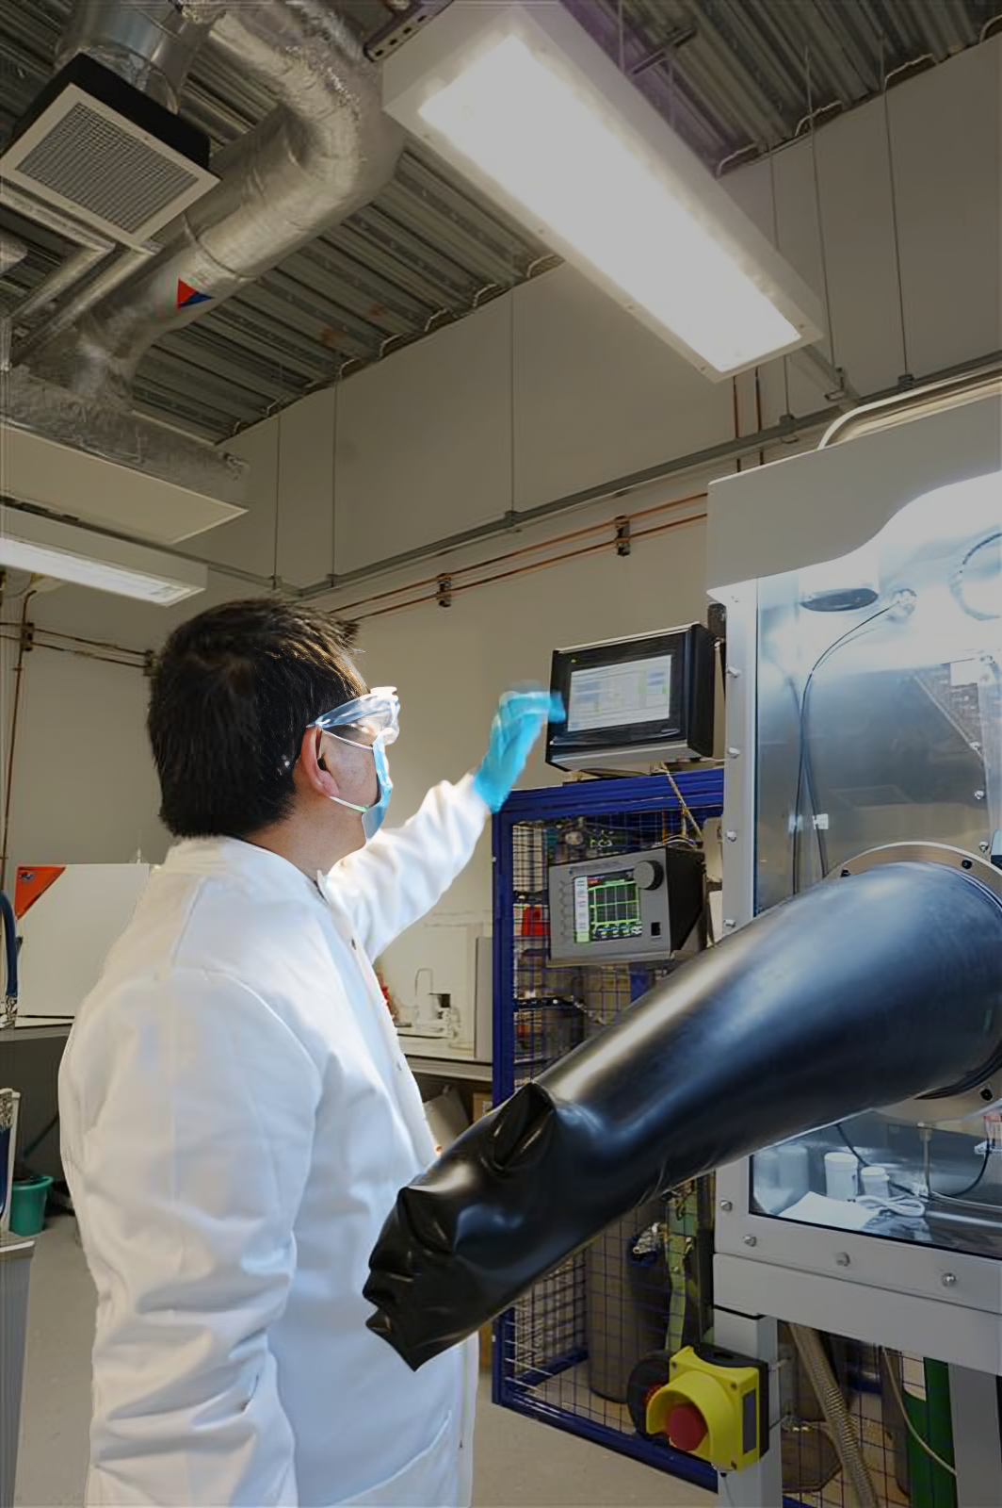

Success Story Quantum Science scales with Innovate UK
Quantum Science, a pioneering nanomaterial tech company in Cheshire, is transforming the semiconductor and electronics sectors with its innovative quantum dot technology.
We first helped it to streamline and upscale production and then welcomed it to our Scaleup Programme, which helped it to enhance its intellectual property protection, access the funds to design a new lab and expand its commercial reach.
Growth milestones:
500% year-on-year turnover increase in most recent year
Workforce growth from 12 to 27 employees 2022-2024
Eight major commercial deals closed in the past year
“The support we received equipped us with strategic tools to [ensure] we could expand efficiently and stay competitive.”
Dr Hao Pang, CEO at Quantum Science
Click here to learn more about Quantum Science’s journey with Innovate UK

Slide 20
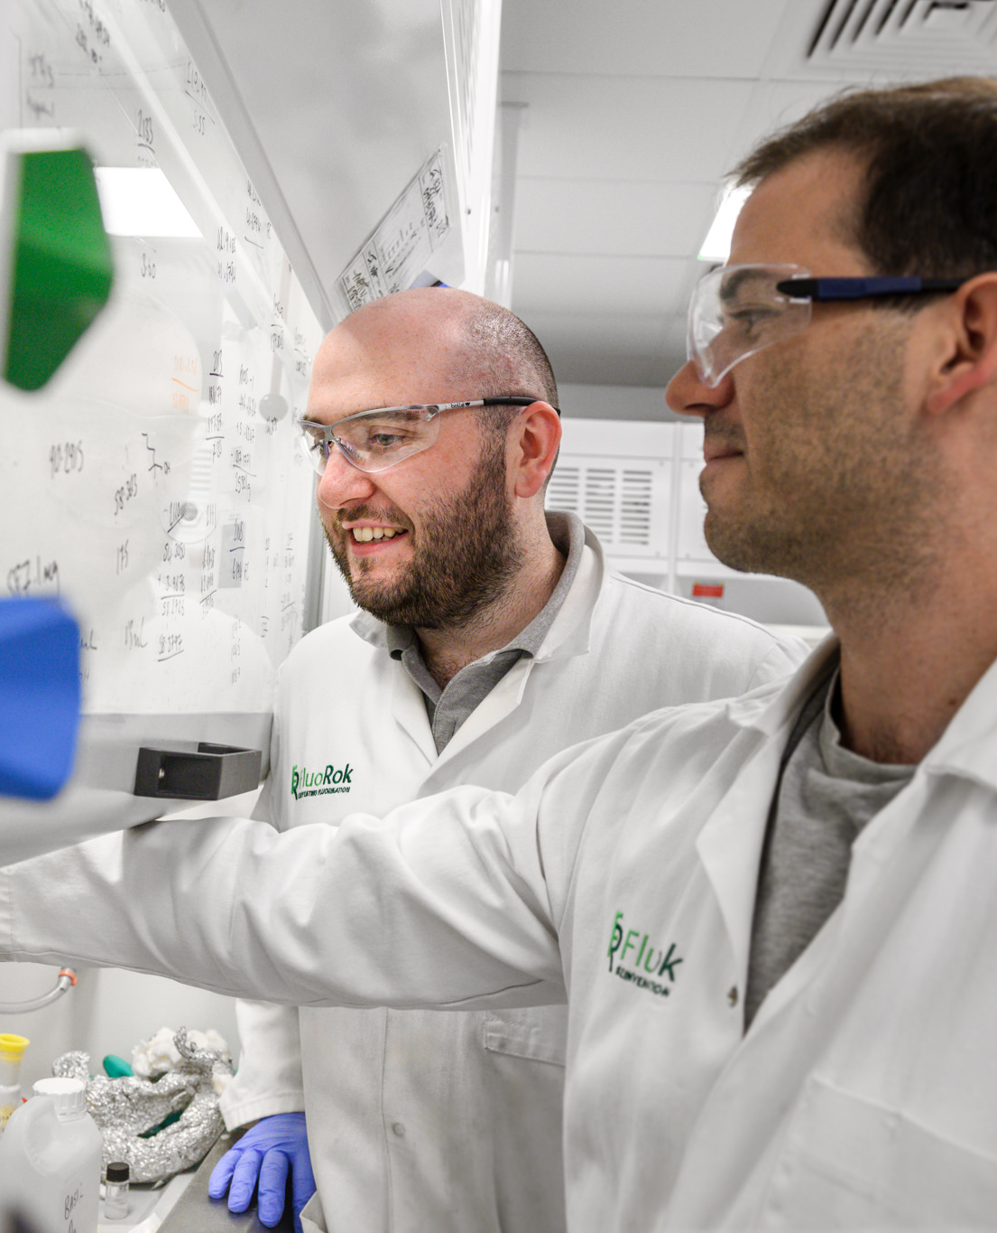
Success Story: Chemicals innovator puts right elements in place for business growth
Oxford spin-out FluoRok has developed a safer, greener and more cost-effective way to produce key materials used in batteries, electric vehicles and renewable energy technologies.
We collaboratively created an action plan with FluoRok that focused on finance, operational development, internationalisation, and investment readiness. We provided strategic advice and opened doors to collaborators and partners to help it achieve its growth goals.
Growth milestones:
Validated its processes with the High Value Manufacturing Catapult
Secured £1.5m in grants and £7.8m in private investment
Created 5 high-value jobs, expanding to 13 employees
Established partnerships with UK manufacturing specialists
"The partnership with Innovate UK Business Growth opened doors to wider opportunities, which helped advance our product and strengthen our operational framework. Their support has been pivotal in helping us scale efficiently and prepare for long-term growth.”
Andrew Schwarz, VP of Business Development at FluoRok
Click here to learn more about FluoRok’s journey with Innovate UK.

Slide 21
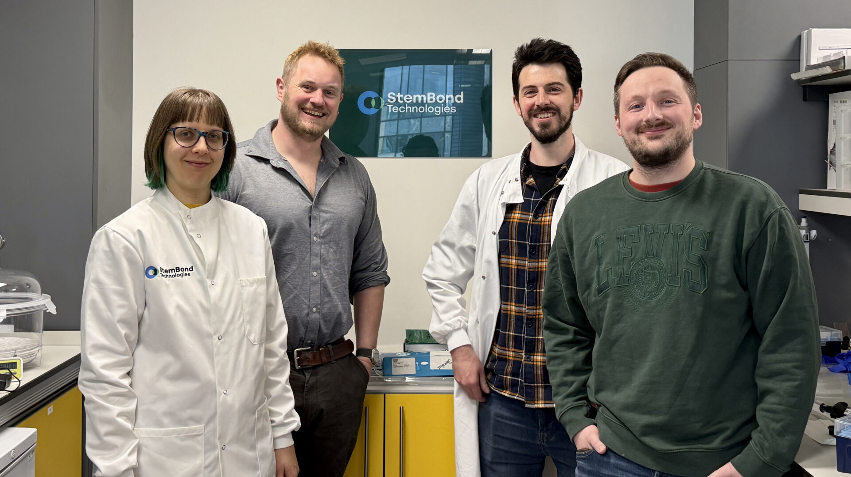
Success Story: StemBond nurtures biotech growth with Innovate UK
Cambridge-based StemBond Technologies is advancing regenerative medicine with its hydrogel platform that mimics human tissue, making it easier to grow healthy cells for developing new treatments.
We helped StemBond refine its investment strategy, build R&D partnerships, develop its IP and explore international opportunities. To complement its advisory support, it benefitted from tailored guidance on investment readiness via Invest-Ability Intensive Training, access to the Cell and Gene Therapy Catapult via a Research & Technology Organisation (RTO) and Catapult grant, and participated in the Global Business Innovation Programme (GBIP).
Growth milestones:
Raised over £1M in investment & grant funding with Innovate UK Investor Partnerships
Tripled headcount, growing from 2 to 6
Built international partnerships with global biotech stakeholders
"Innovate UK Business Growth has been hugely influential in our journey, from investment readiness support to funding access opportunities. The guidance we received helped us refine our strategy and accelerate our commercialisation.”
Andrew Hodgson, Founder and CEO of StemBond Technologies
Click here to learn more about StemBond Technologies’ journey with Innovate UK.

Slide 22

Spotlight on areas of strategic focus

Slide 23
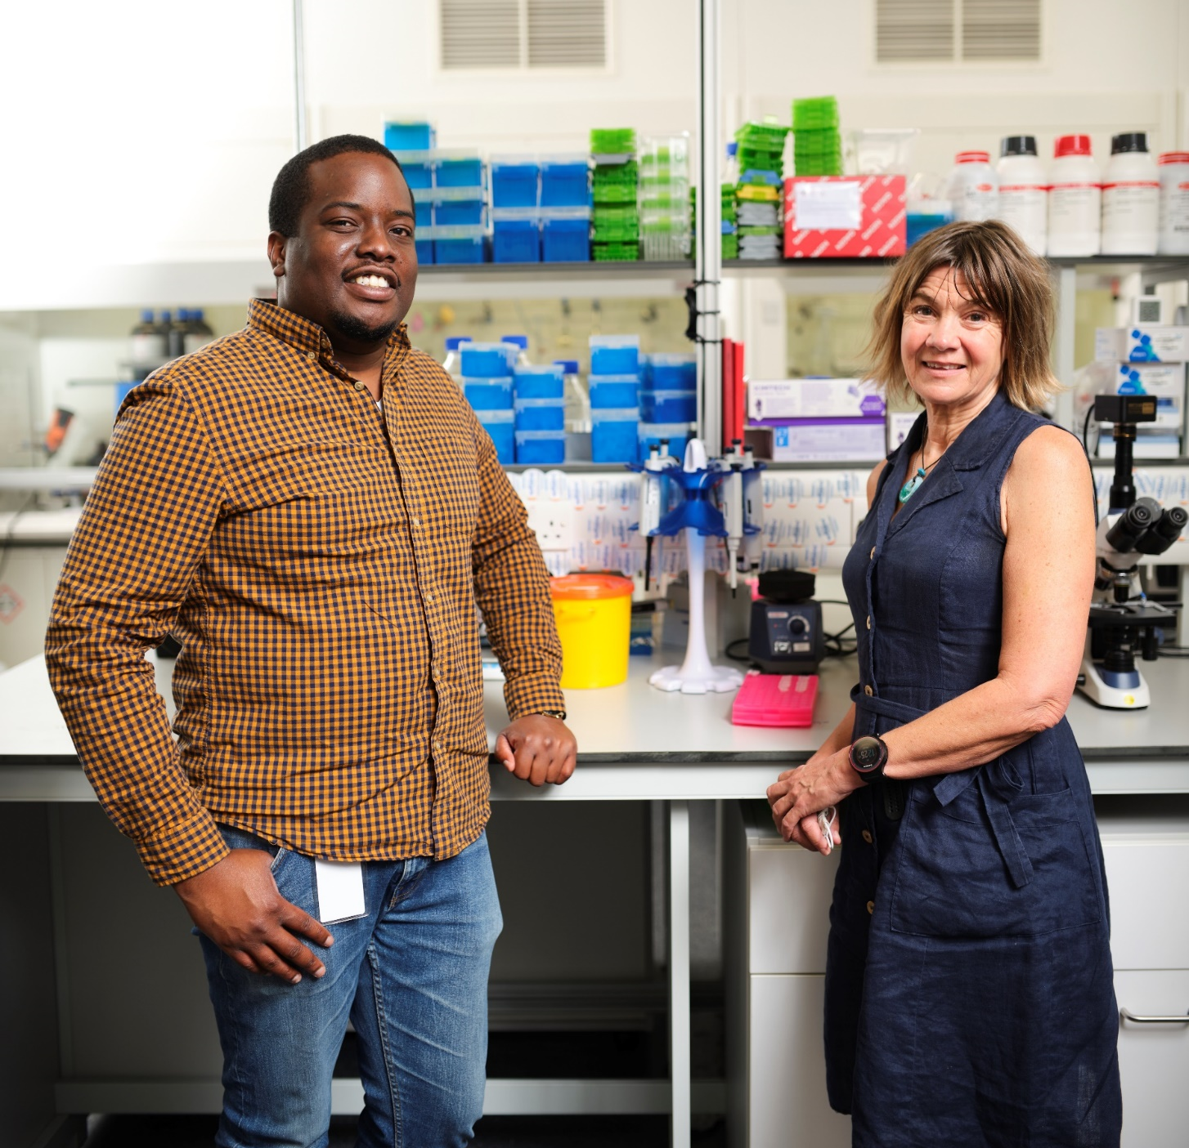
Innovation & Commercial Strategy
Strategic support to:
Manage innovation effectively
Commercialise and scale more rapidly
Access the right resources at the right time within the innovation ecosystem
Support initiatives:
Funded IP support and advice
Participation in Peer Networks
Funded access to RTOs and Catapults
The Design for Growth scheme
The BSI Standards for Growth scheme
Funded NPSA security reviews
“I recommend Innovate UK Business Growth to any innovation-driven growth business Our dedicated specialist has made a decisive contribution to our success.” Neciah Dorh, FluoretiQ

Slide 24
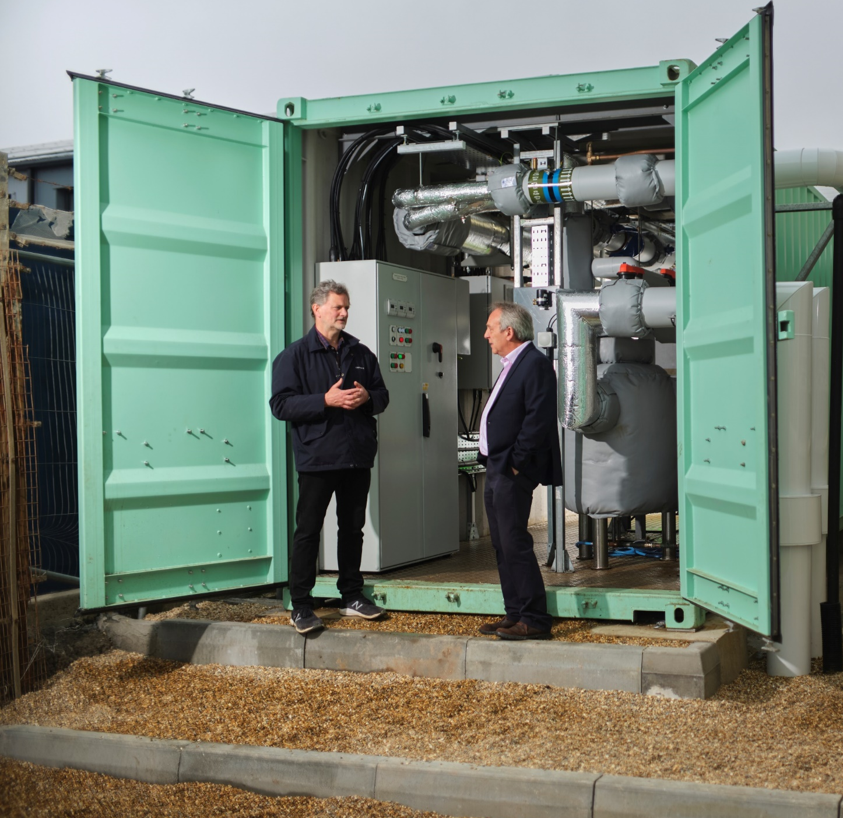
Funding & Finance Strategy
Strategic support to identify your business objectives and determine which of the grant funding options and / or capital options will get you there.
Support initiatives:
If assessed to require equity financing, access Invest-Ability, our comprehensive investment readiness support including: Invest-Ability Intensive Training and Invest-Ability Pitch Panel.
Also benefit from our connections with other Innovate UK products and services plus partners such as London Stock Exchange, that give access to knowledge and opportunities to attract investment.
“We’re thriving in a disruptive sector with Innovate UK Business Growth support. Its strategic input has been invaluable to help grow our business.” Mark Hewitt, ICAX

Slide 25
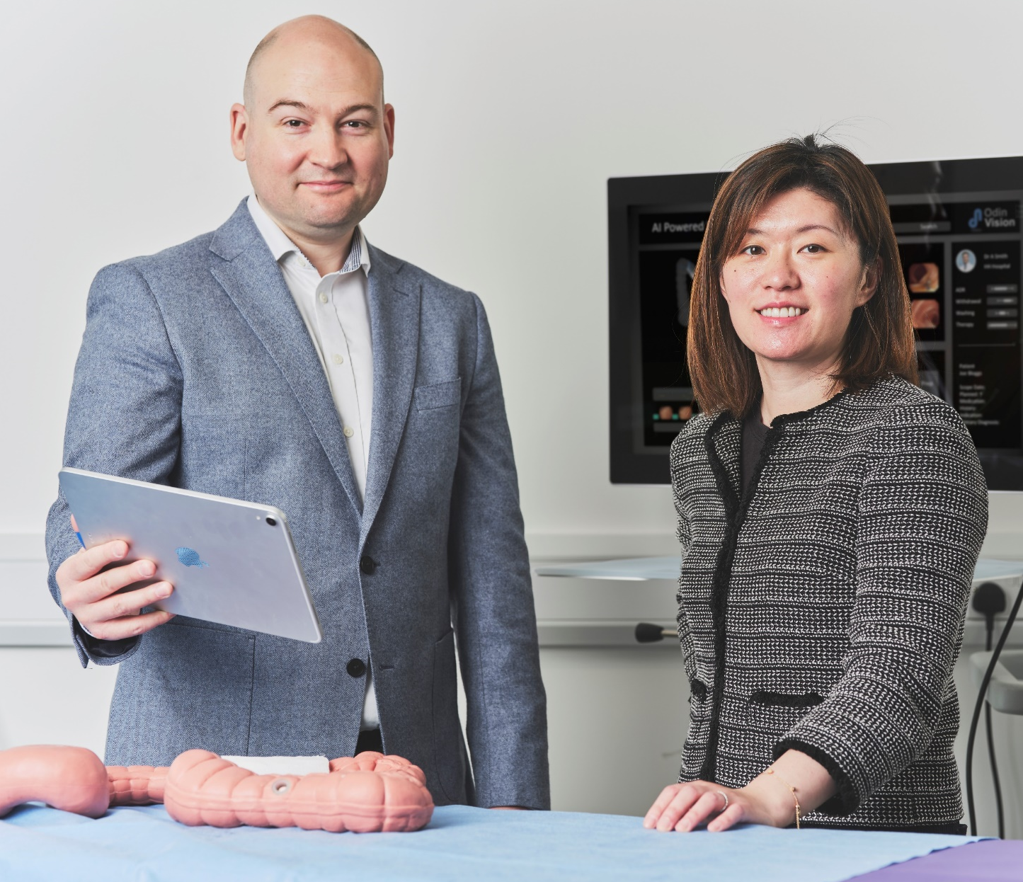
International Markets & Collaboration Strategy
Strategic support to:
Explore and enter global markets
Pursue international collaborations
Accelerate global growth and scaling
Support initiatives:
Enterprise Europe Network access: the world's largest business collaboration network
Support to develop global innovation partnerships via Innovate UK initiatives e.g. Global Business Innovation Programme
Access to focused brokerage activities
Support accessing Eureka and Horizon Europe via Innovate UK’s Horizon Europe Pump Priming Initiative
“Innovate UK Business Growth helped me grow my innovation-led business so we can create a new era of AI-enabled healthcare.” Peter Mountney, Odin Vision

Slide 26
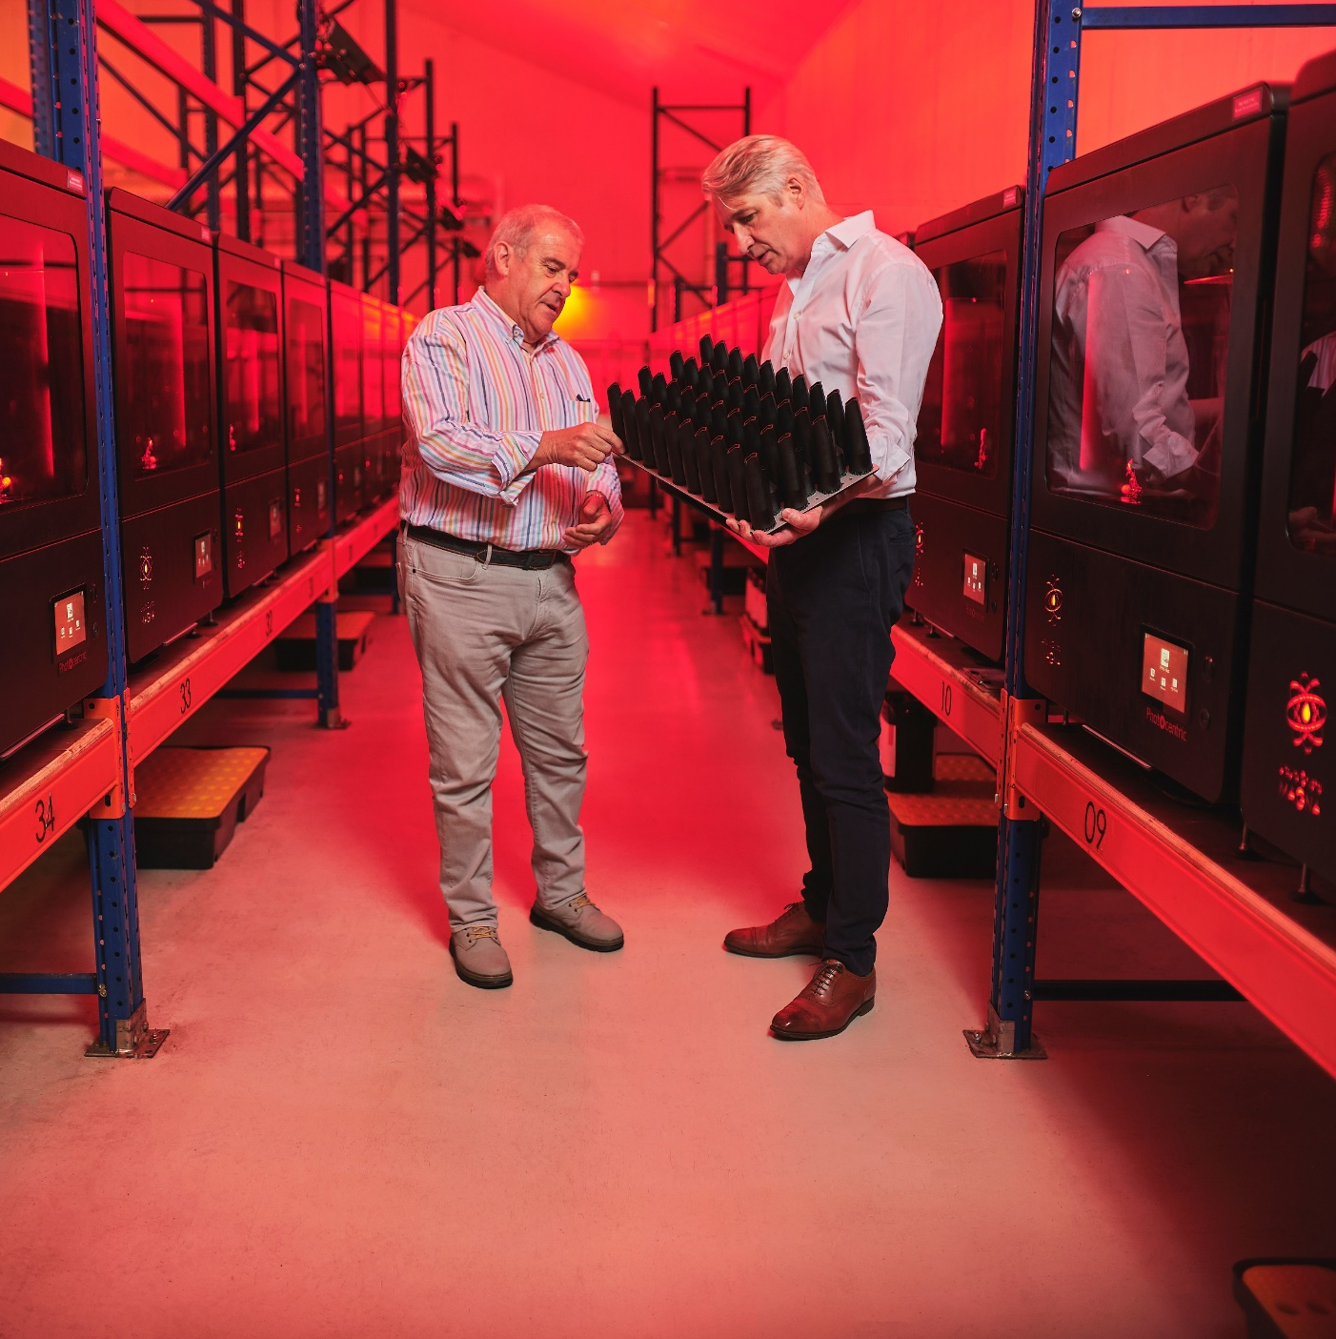
Scaleup Programme
Scaling companies have opportunities and challenges on multiple fronts as they prepare for serious fundraising and international expansion to become the next champions for British innovation on the global stage.
Innovate UK’s Scaleup Programme is for clients with the highest growth potential, offering enhanced coaching from an expert Scaleup Board and its extended connections.
“Innovate UK Business Growth has brought my R&D-intensive business huge benefits. We have doubled in size this year and its scaling support has been critical.” Paul Holt, Photocentric

Slide 27

Contact Us
Client enquiries: call our National Enquiry Gateway on:
0300 123 3066
or visit our website:
www.iukbg.ukri.org

