Slide 1
The National Conference
kirsty@TheCFN.org.uk
Chairman, The Corporate Finance Network

Slide 2
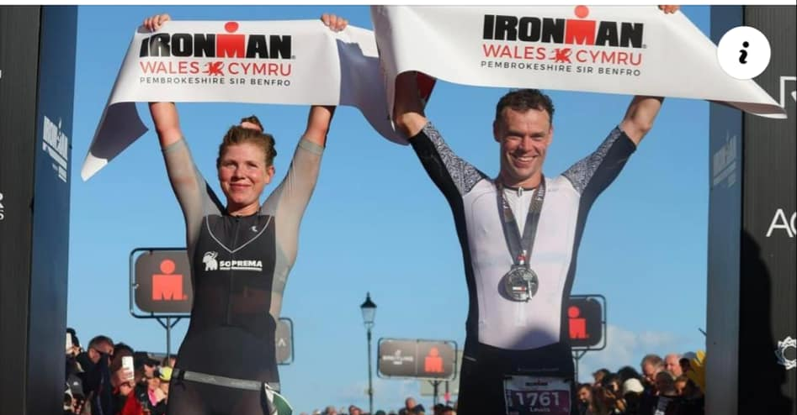
Notes:
Lewis Eccleston – 9hrs 34
Franzisca Hofmann – 9hrs 42
2.4 mile swim
112 mile bike ride
26.2 mile marathon

Slide 3
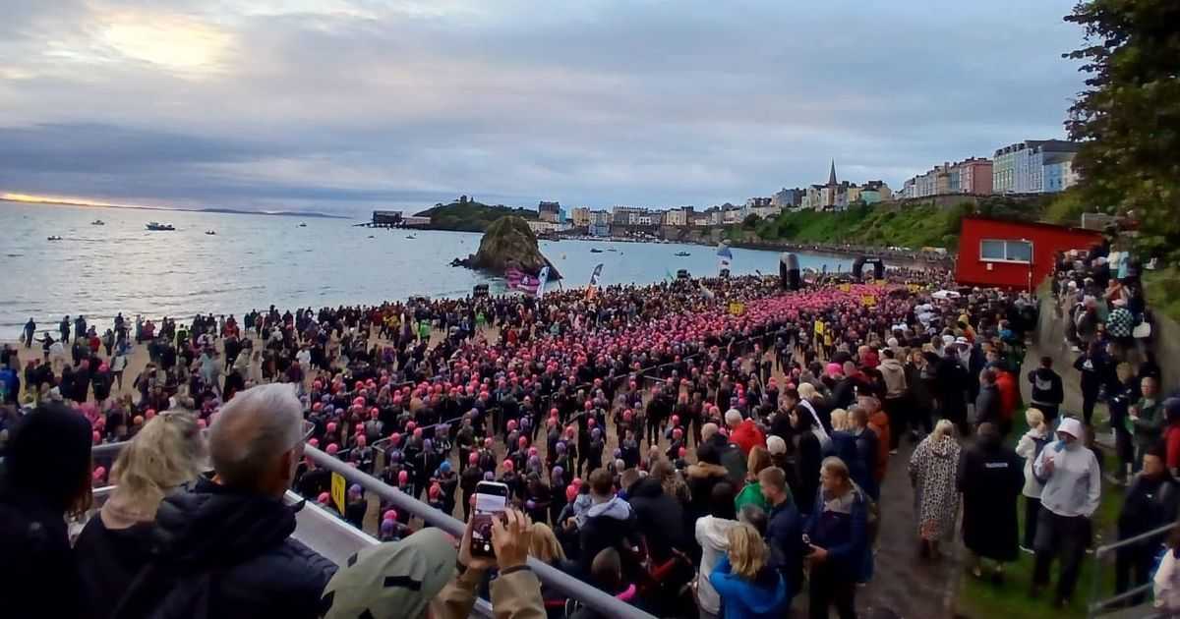

Slide 4
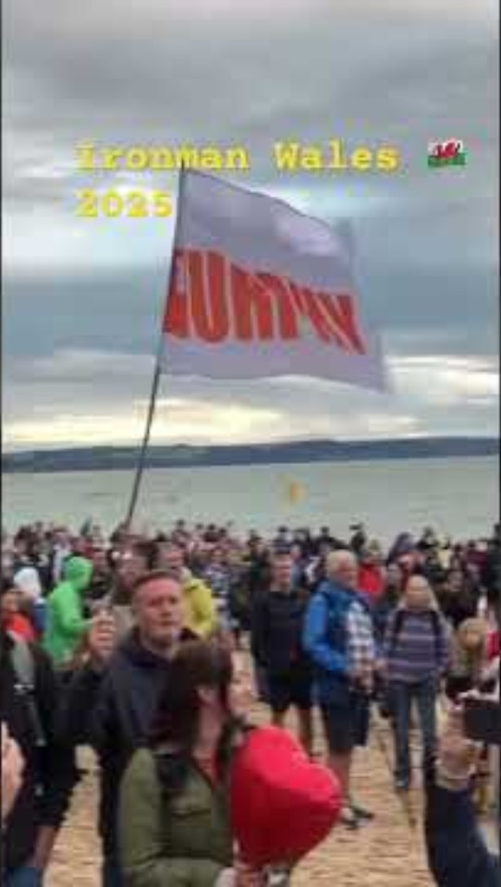
Notes:
2700 people entered
Started today with a rousing Welsh singer & we’ll end with rousing welsh singers – I tried from Cambridge!

Slide 5
The lightbulb moment - don’t just serve the current market, grow it – and do the right thing
Doing the deals is the easy part
Deal origination is harder – CF firms
True Deal Origination - CFN
Had an approach
Found a target to buy
Find the buyer
Find a target
Make it sellable
Encourage M&A
Notes:
I know this is harder than not doing it – not having those conversations with your clients, not guiding them to acquisition or exit planning
Why do they want to do something so hard?

Slide 6
Who are you? What impact can you have?
Opportunity
Influence
…the Responsibility?
Notes:
You tell me – is it your responsibility?
And what can you do to make more of these impacts?

Slide 7

Whose job is it anyway?
Notes:
William Mitchell - survived a fiery motorcycle accident in 1971 that left him with severe burns and a later plane crash in 1975 that resulted in paraplegia, he became an internationally recognized speaker and successful entrepreneur. His motto, "It's not what happens to you, it's what you do about it”

Slide 8
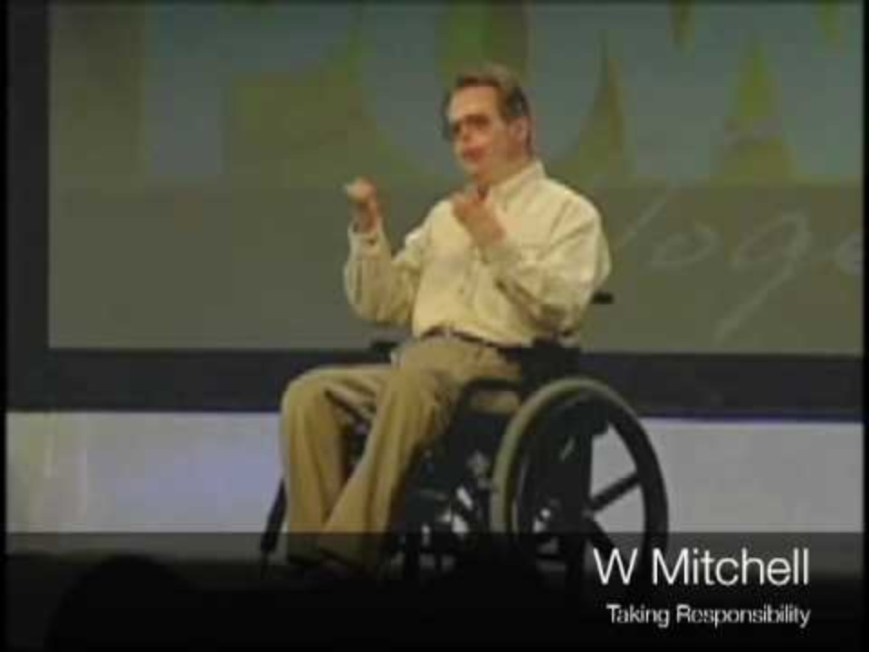
Notes:
William Mitchell - survived a fiery motorcycle accident in 1971 that left him with severe burns and a later plane crash in 1975 that resulted in paraplegia, he became an internationally recognized speaker and successful entrepreneur. His motto, "It's not what happens to you, it's what you do about it”

Slide 9
Next conference!
Location – Liverpool (definite)
Venue –Hilton Hotel (likely)
Date – Thur 5th March 2026 (likely)
Football match incl meal at Everton vs Burnley at new Hill Dickinson Stadium on evening of Wed 4th March (pencilled in)
& “The Tracks of Liverpool” on the evening of Thur 5th March (a mystery tour!)

Slide 10
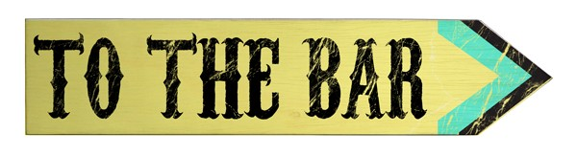
Thank you!
Leave Hotel 6pm
Pre-dinner drinks at St John’s College followed by Dinner 7pm

