Slide 1
The National Conference
kirsty@TheCFN.org.uk
Chairman, The Corporate Finance Network

Slide 2


Slide 3




What a Rousing Start!

Slide 4
Why
The Corporate Finance Network was created
Any why I (still) believe!
Notes:
Start with the Why
I saw that OMBs needed more help – with scaling & with exiting – most were winding up; demographics were changing & it was going to be more of a problem
I could look after a dozen per year in a firm
All of us together could look after hundreds, thousands and have much greater impact on our communities & the national economy

Slide 5
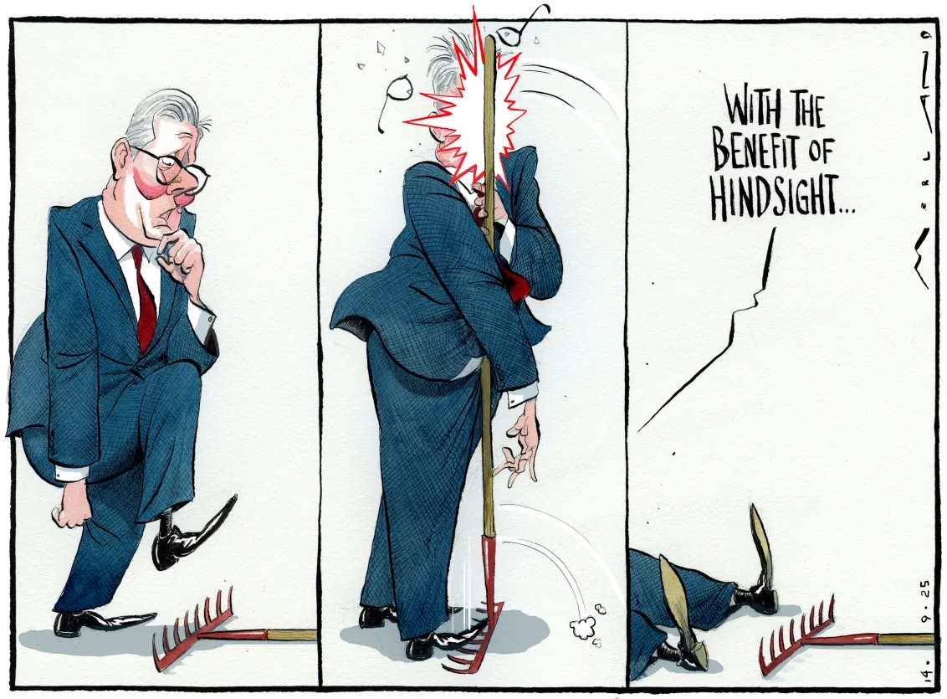
Notes:
The accounting world has moved fast in the last 18 years
There is an awful lot happening in the world – but we can only control the controllables, in our community, in our firm, with our clients
ChatGPT, an all-knowing expert – says what you need to do to keep up. Thrive or fail. It’s your gotomarket plan.
Don’t be like Keir in a couple of years & realise you’ve missed it
Now is the time, today is the time, to decide what actions you want to take

Slide 6
ACTION
POINTS
Notes:
Create your actions.
Delegate – up or down as you need to when you go back to the office
Share with your team
But above all – take action
Shift the story to a new narrative – time flies & little changes inside, but lots changes in the outside world

Slide 7
Who are you? What impact can you have?
Opportunity - clients
Influence – skills
…the Responsibility?
Notes:
You have the opportunity – access to hundreds & thousands of clients
You can influence- you’re trained & you have skills
Do you have the responsibility?
20,000 clients – from 11 firms replying, 14 acq; 2 on exit planning retainers

Slide 8


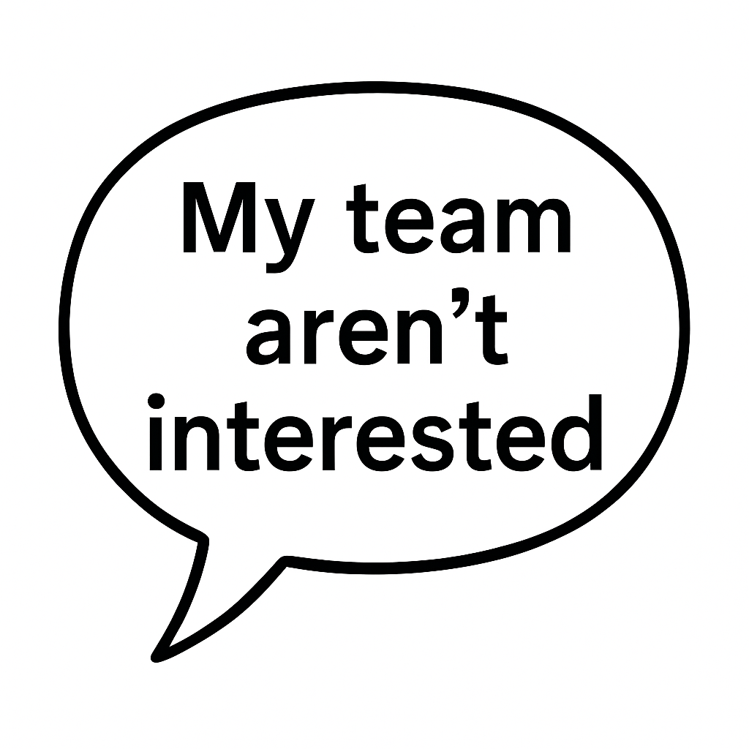

Who are you? What impact can you have?
Notes:
I don’t care who you are in your firm – you can all have impact if you want to
The youngest & least experienced
The Managing Partner/Director complaining that it’s your fellow partners who aren’t stepping up
Your team who aren’t interested
You say you’re already too busy – maybe look at what you are spending your time on

Slide 9
Business Advice – you helped a client to…
Digitalised via intro to Made Smarter & were more productive
Improved their credit score so they had access to cheaper capital
Acquired a business to plug a weakness
Got exit ready & sold for a life-changing sum
Helped an MBO or EOT get business ownership for the first time
Gave them confidence to scale, become more profitable with new business strategies, then employed more staff in your community
Created a business expansion plan, then funded it
Notes:
So now over to you. I’ll give you 45 seconds – think of when you’ve had an impact this year
On feet
Find your matching number
You have 15 seconds to say hello to each other, then 1min each to share your impact
Go!

Slide 10
How did that feel?
Do you want more of that?
Notes:
If you want to have more impact, you will make the changes.

Slide 11
Who are you? What impact can you have?
Opportunity
Influence
…the Responsibility?
Notes:
You tell me – is it your responsibility?
Is it your wish to have more of an impact?

Slide 12
The lightbulb moment - don’t just serve the current market, grow it – and do the right thing
Doing the deals is the easy part
Deal origination is harder – CF firms
True Deal Origination - CFN
Had an approach
Found a target to buy
Find the buyer
Find a target
Make it sellable
Encourage M&A
Notes:
My blueprint for the CFN. My philosophy was always this.
And I know it’s not easy
We are 15 years behind US/Canada/Australia – EP is a profession (not delivered by CPAs)
If you’re determined & want to make more of an impact, you’ll find a way

Slide 13
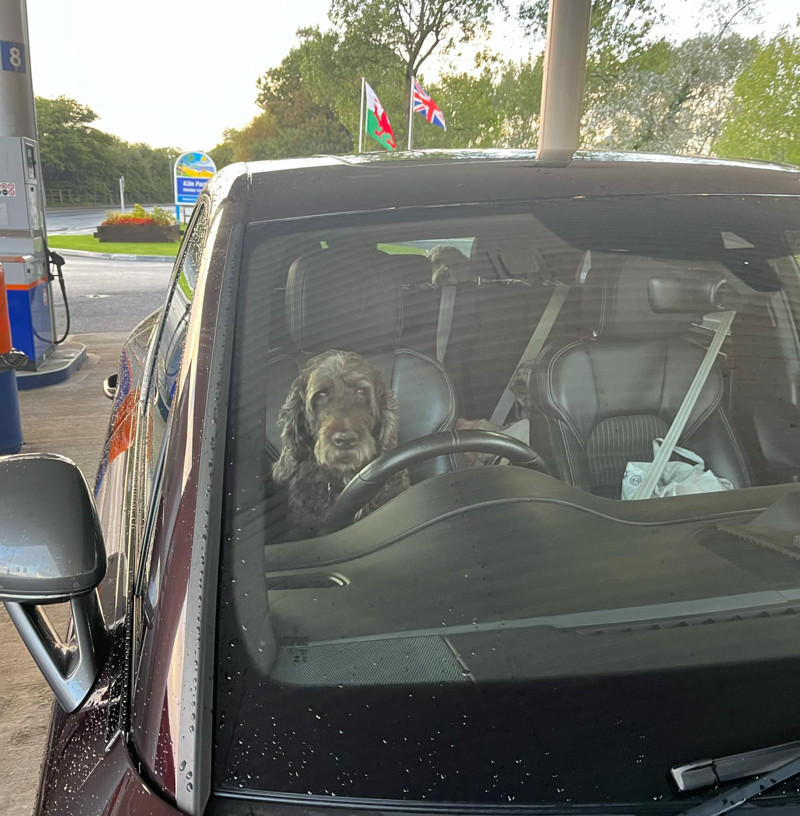
#BeMoreLola

Slide 14
ACTION
POINTS
Notes:
You decide what you can do.
What impact you can have.
Have a great day – get loads of action points.
Let’s move the needle & not be wishing in hindsight you’d done things differently
Let’s go!

