Slide 1

The CFN
Creative Library - Creative Library - All Documents
Kroll Update
24 September 2025

Slide 2
Restructuring – Market Update
  Themes
  Administration Statistics
  HMRC
Sector Insights
  Construction
  Other prominent sectors
Early Warning Signs
Case Study
Kroll x CFN

Slide 3
1. Restructuring - Market Update

Slide 4












Overview of key UK economic challenges, themes and business impact
Key UK economic challenges
Increase in cost of Government borrowing leading to tough decisions re spending and taxation
National insurance / minimum wage hikes challenge labour intensive businesses
UK international competitiveness is is being tested
Uncertain inflation outlook
Transition to a Net Zero economy
Tariffs pose challenge to UK exporters competitiveness
Higher borrowing costs and increased NI expected to weigh on investor confidence/
consumer spending
Rising UK defence spending to create new opportunities
Demographic challenges to continue
Labour market conditions to remain challenging
Labour committed to unlock housing
Geopolitical tensions to drive the need for supply chain resiliency
4

Slide 5
Administration Statistics
YTD 2025
Total administrations increased to ‌​​105​‌ in ‌​​‌August​‌ 2025 (from ‌​​​95​‌ in ‌​​‌‌July​‌).
August administrations (105) are below pre-pandemic levels (116).

Slide 6
Administration Statistics
Total administrations - Rolling last 12 months
Total administrations (last 12 months) are beginning to level out again.

Slide 7
Administration Statistics
By Sector
‌​​Retail​‌ (‌​​‌98​‌), Manufacturing (‌​​​96​‌), and Construction (90) top YTD 2025 industries.
Increased insolvency activity in the Real Estate and Professional Practice sectors in recent months.

Slide 8
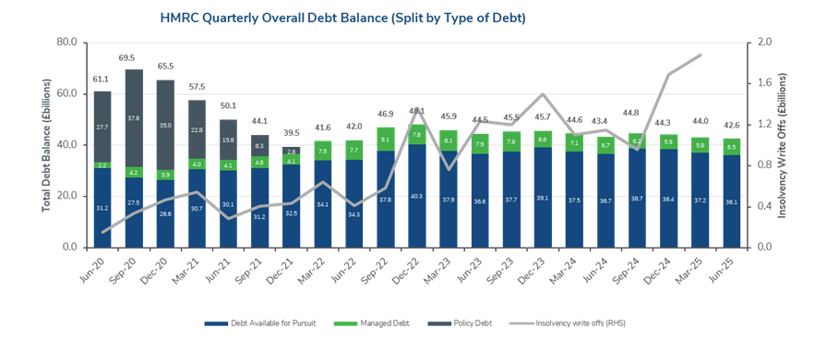
Market Outlook: HMRC
Overdue debts
Debt position of HMRC, as of Jun-25, was £42.6bn - decrease of £1.4bn from March 2025.
Small reduction in Managed Debt of £0.2bn between June 2024 and June 2025 - representative of HMRC’s stricter approach in agreeing TTPs
Debt Available for Pursuit on a downward trend in the year to June 2025. Currently at £36.1bn (£0.6bn reduction in past 12m). Demonstrates clear signs of distress persist amongst UK businesses - driven by record levels of insolvency write offs.

Slide 9
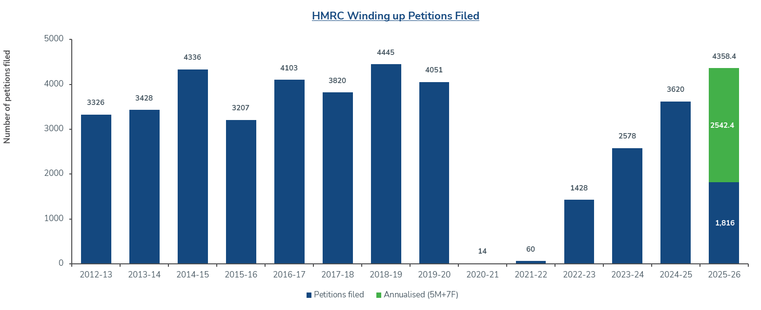
Market Outlook: HMRC - Enforcement
Winding up petitions
HMRC continue support where there is merit, but under pressure to collect record levels of debt.
Gradual increase in number of HMRC winding up petitions since 2022/23
3,620 petitions in 2024/25. Trend is continuing. In first five months of 2025/26, 1,816 petitions were filed by HMRC (4,358 annualised). Back to pre-pandemic levels
Seeing more Field Force Officer visit and a stricter approach on TTPs from Debt Management teams (both Large and SME).
HMRC’s debtors should avoid being passed to Enforcement and Insolvency (“EIS”), however, in certain circumstances we have secured longer tail TTPs with the EIS team, which demonstrates willingness to support and give businesses every chance to repay (subject to compliance record).

Slide 10
2. Sector Insights

Slide 11
Performance of the construction sector
Industry statistics
3.3%
3.1%
4.3%
Total construction new orders grew 3.3% (£1,305 million) in H1 2025, compared to H1 2024.
Annual rate of construction output price growth was 3.1% for the 12 months to June 2025.
CAGR of 4.3% is projected between 2025 and 2030.
16.3%
10.9%
Construction firms accounted for 16.3% of all insolvencies in England and Wales in 2Q 2025, with 1,037 construction businesses becoming insolvent.
10.9% less construction firm insolvencies in 2Q 2025 compared with 2Q 2024 (1,164).

Slide 12





Performance of the construction sector
Sub-sector outlook
Infrastructure
Residential
Institutional
Commercial
Industrial
Infrastructure remains the strongest sub-sector.
Government’s 10-year strategy of “at least £725 billion of government funding”.
But there are barriers to delivery.
The UK remains below its target of 300,000 new homes each year.
Mortgage rates set to remain above pre-pandemic levels, and house prices at risk of slipping.
Government promises increased spending on schools and hospitals which may support growth.
National Service Transformation Authority (NISTA)
Slight increase in new orders in 1Q 2025.
Rising labour and material costs have led to investor caution.
Strong demand for premium office space.
Demand from AI increasing data centre construction.
Government investment in clean energy.
Nuclear generation – government’s commitment to Sizewell C.

Slide 13




Performance of the construction sector
High profile recent insolvencies
Breyer Group PLC
Marbank Construction
H.E. Simm & Son
Ardmore Construction
Turnover: c.£89m
No. of employees: 255
Unsecured creditors (per SOA): £17.5m
Dozens of subcontractors face six-figure losses
Turnover: c.£67m
No. of employees: 21
Unsecured creditors (per SOA): £9.8m
Administration left many halted projects and legal claims
Turnover: c.£118m
No. of employees: 184
Unsecured creditors (per FY23 accounts*): £28.4m
Administration followed a period of sustained market pressure
Turnover: c.£313m
No. of employees: 244
Unsecured creditors (per FY23 accounts*): £55.4m
Accumulation of losses from remedial work led to the Administration
*Administrators’ proposals are not yet available.

Slide 14
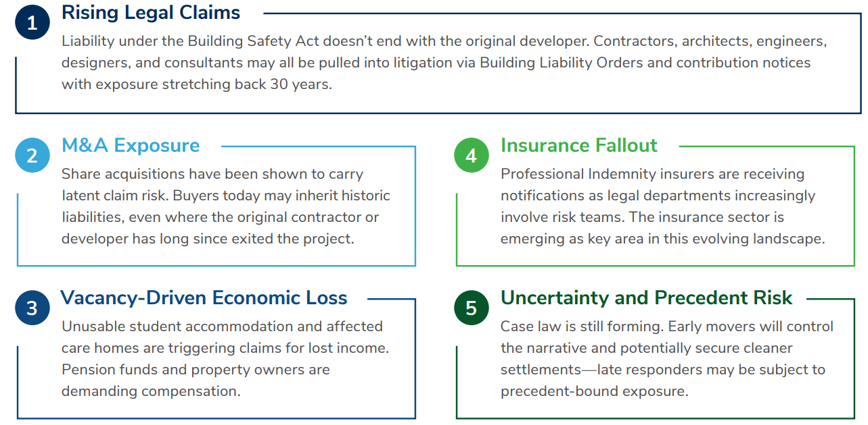
The Building Safety Act (“BSA”)
What’s happening in the market

Slide 15
The Building Safety Act (“BSA”)
Building Safety Levy
The Building Safety Levy (“BSL”) to be introduced in autumn 2026.
Purpose – to support ongoing remedial works for buildings at risk.
Revenue target of the BSL is £3.4 billion over the next decade.
Levy will apply to residential buildings (10 units and over) regardless of height.
Levy calculation is based on the gross internal floor area of floorspace, including communal areas.
Rates range from £12.70/m2 in County Durham, to £100.35/m2 in Kensington and Chelsea; 50% rate reduction for previously developed land.
Enforced by local authorities – building control completion certificate or final certificate will not be issued until the levy is paid.
How will developers fund the cost of the levy or recoup the cost? Subcontractors and the wider supply chain, homeowners.

Slide 16



Key challenges facing subcontractors
Options if payments are still being made
Adjudication
Most common form of dispute resolution.
Aim is to resolve disputes quickly, fairly & cost effectively.
Typical duration - 28 days to reach decision.
Decision binding between parties but can be overturned later by court or arbitration.
Mediation
Mediator appointed to help resolve dispute.
Cost effective and flexible.
Outcome dependent on cooperation of the parties and not guaranteed.
Expert determination
Independent technical expert carries out own assessment.
Commonly used when dispute focuses on technical rather than legal issue.
Quicker and cheaper than court proceedings.
Arbitration
Independent panel listen to evidence and decide.
Can be quicker and cheaper than court proceedings.
Arbitrator’s award is final and legally binding.
Like court proceedings, but private and confidential.

Slide 17
Getting paid!
Best Practice
Payment terms
Push for payment terms as close to the standard 14 days as possible.
Watch out for amendments to standard forms of contract.
Bespoke or heavily amended contracts – if unsure, seek advice.
Notice periods
Follow the contract.
Understand responsibilities for serving and / or responding to notices under the contract.
Payment applications and claims
Follow the payment schedules incorporated into the contract.
Ensure all payment applications and claims are properly substantiated first time around to avoid delays to payment.
Record keeping
Maintain detailed and accurate site records, meeting minutes etc.
Accurate records required for substantiation of claims and potential disputes (e.g. diaries, photos, progress reports etc).
File key emails/letters with client on disputed issues.
Retention
1.5% or 2.5% of subcontract value - ensure you claim the retention monies. A main contractor will not remind you.
Understand any defect issues and resolve promptly in accordance with the contract.
Collateral warranties
Provide a legal link between employer and subcontractor.
In the event of main contractor insolvency, the Employer (end-user, funder) may have 'step-in' rights to continue the project and payment of supply chain.
Relationships
Open and transparent relationships between the parties will help speed up payments.
Remember: If parties are not getting paid what is owed in a timely manner, then the dispute resolution options set out in the contract are there to help.

Slide 18









Distressed Sectors 2025 – Kroll Overview
Challenges facing all sectors – sectors in focus
Haulage
2024 saw cost pressures in haulage. Increased fuel costs, debt service costs, driver shortages and wage costs place pressure on margins.
Construction
Higher debt service, wages and input
costs to continue to challenge construction. Also, Building Safety Act 2022
Automotive
Landmark ruling may cause trouble for
vehicle financiers. Car dealers are now required to disclose commissions from lenders to customers.
Healthcare
NHS funding pressure and rising drug
costs to challenge the pharmacy and
healthcare sectors.
Consumer markets
Rising business rates, NI and minimum
wage to pressure hospitality and retail. Consumer confidence a concern.
Education
Higher education and private schools to come under financial pressure. Increases in VAT and lack of experienced professionals drive concern.
Manufacturing
Wage inflation expected to place significant financial strain on labour intensive manufacturing, as well as consumer uncertainty surrounding global unrest.
Film and Television
Film and television sectors to remain challenged. Production costs have soared with inflation and the rise of Netflix and use of AI places significant strain on the industry.
Recruitment
Recruitment industry to come under pressure due to NI and minimum wage increases.

Slide 19
3. Triggers and Indicators

Slide 20








Early warning indicators
Early identification means early actions can be taken to reduce future risk for our clients.
Reduced margins
HMRC arrears
Insufficient accounting information
Increasing debt (leverage)
Early Warning Indicators
Management
Deterioration in working capital profiles
Sector considerations
Profitable but cash absorptive

Slide 21
Distress curve
Early action preserves value - delay limits options
Advisory & turnaround services – earlier the better!
Healthy
Discomfort / Denial
Restructuring & insolvency advice / planning – earlier the better!
Stress
P&L and KPI Underperformance
Limited sales growth/ declining sales
Declining margin
Increase in COS, overheads, exceptionals
Potential impairments
Distress
Balance Sheet Deterioration / Covenant Breaches
Asset erosion
Covenant stretch
Movements in debt and declining security values
Cash Shortfall / Funding Requirement
Working capital crisis
Creditor stretch
Inability to meet covenants or debt service costs
CCJ, statutory demands, winding up petitions
Crisis
CORPORATE HEALTH
Restructuring &
Insolvency
Debt restructure or refinance
Accelerated M&A
CVA
Restructuring Plans
Administration (pre-pack or trading)
Liquidation
Unhealthy
Available Options
TIME

Slide 22
4. Recent case study

Slide 23

Case study: PaintWell
Challenge
Rapid Post-Pandemic Expansion - PaintWell expanded rapidly after the pandemic, straining resources and operational capacity
Financial Strains - Growth funded by private equity and debt increased financial pressure on the company.
Market and Economic Challenges – Post-pandemic correction, housing slowdown, and rising living costs negatively impacted trading.
Immature Branches Impact - Newly opened branches needed capital investment and time to establish market presence.
.

Slide 24

Case study: PaintWell
Approach
Cash Flow Forecast Review - the advisory team reviewed short-term cash flow forecasts revealing ongoing trading losses.
Exploration of Restructuring Options - formal restructuring options like CVA and RP were explored to compromise arrears and close underperforming branches.
Feasibility and Stakeholder Support - assessment showed additional stakeholder support was needed; however, private equity sponsor declined further support.
Accelerated M&A Process - due to limited support, an Accelerated M&A process was initiated as the most viable alternative for the company.

Slide 25

Case study: PaintWell
Outcome
Strategic Acquisition - Brewers acquired 39 of 45 branches, leveraging an existing network of over 200 stores to expand operations effectively.
Operational Integration- PaintWell’s profitable branches were integrated into Brewers’ operations, eliminating overhead by excluding the head office.
Seamless Transition - A Transitional Services Agreement enabled smooth transition and recovery of ABL debts, protecting over 200 jobs.
Successful Restructuring - the restructuring preserved business value and ensured operational continuity for the future

Slide 26

Kroll x CFN
Our value-add to CFN
Trusted advisers for you and your clients
Immediate access to our restructuring situational expertise
Access to wider Kroll expertise for you and your clients – Cyber Risk, Valuations, Investigations and Disputes, Regulatory Consulting
Common goal of securing optimal outcome for your clients
Reciprocity– we need assistance on our engagements (tax compliance/ reviews, terminal loss relief, VAT bad debt relief)
Show you and your clients distressed deals as strategic opportunities –opportunity to acquire high-potential assets

Slide 27
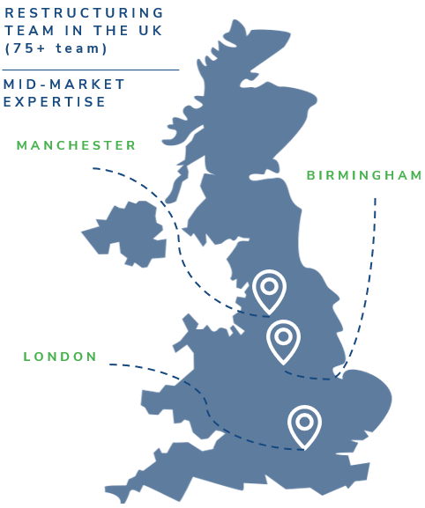


Robert Goodhew
Managing Director
Restructuring Advisory
Robert.Goodhew@Kroll.com
T: +44 2070894736
M:+44 7989343093
Eddie Bines
Managing Director
Restructuring Advisory
Eddie.Bines@kroll.com
T: +44 2070890806
M: +44 7810528828
Alex Howden
Director
Expert Services – Construction Disputes
Alex.Howden@kroll.com
T: +44 2070295488
M: +44 7721487070
27

