Slide 1
National Conference 2025
The Corporate Finance Network
Trends & Predictions of M&A Activity
24th September 2025

Slide 2
UK M&A Activity Last 5 Years
October ‘24 Budget
‘20 UK National Lockdown
Source: MarktoMarket
Notes:
Please add Bar/Line graph with monthly deal volumes from Jan 2019 (so we show –re-COVID, COVID and post-COVID period)
Norm is 400ish deals per month (M&A) with same again (Fundraising)

Slide 3
Who buys UK SMEs – by Type
PEs: Traditional LP Funds; Deal by Deal; Family Office; Search Funds; Buy & Hold Forever
12%
9%
9%
8%
PE = 11%
10%
12%
Source: MarktoMarket
Notes:
PE platforms – not including venture/growth new money deals ie proper PE M&A – more and more SME focused PEs:
Amongst our customer base:
Traditional – Bestport, Alcuin
Deal by deal – Pelican, Ethos
Family office – Souter Investments, Turner & Co
Search funds – Continuum, Vericor

Slide 4
Who buys UK SMEs – by Type
(September 2025)
Source: MarktoMarket
Notes:
Then what do PE firms do when they get a platform?
Buy and build used to be niche strategy – now it’s normal
Misconception that PE money is only interested in larger companies – true for platforms BUT PE-backed buyers account for 18% of deals

Slide 5
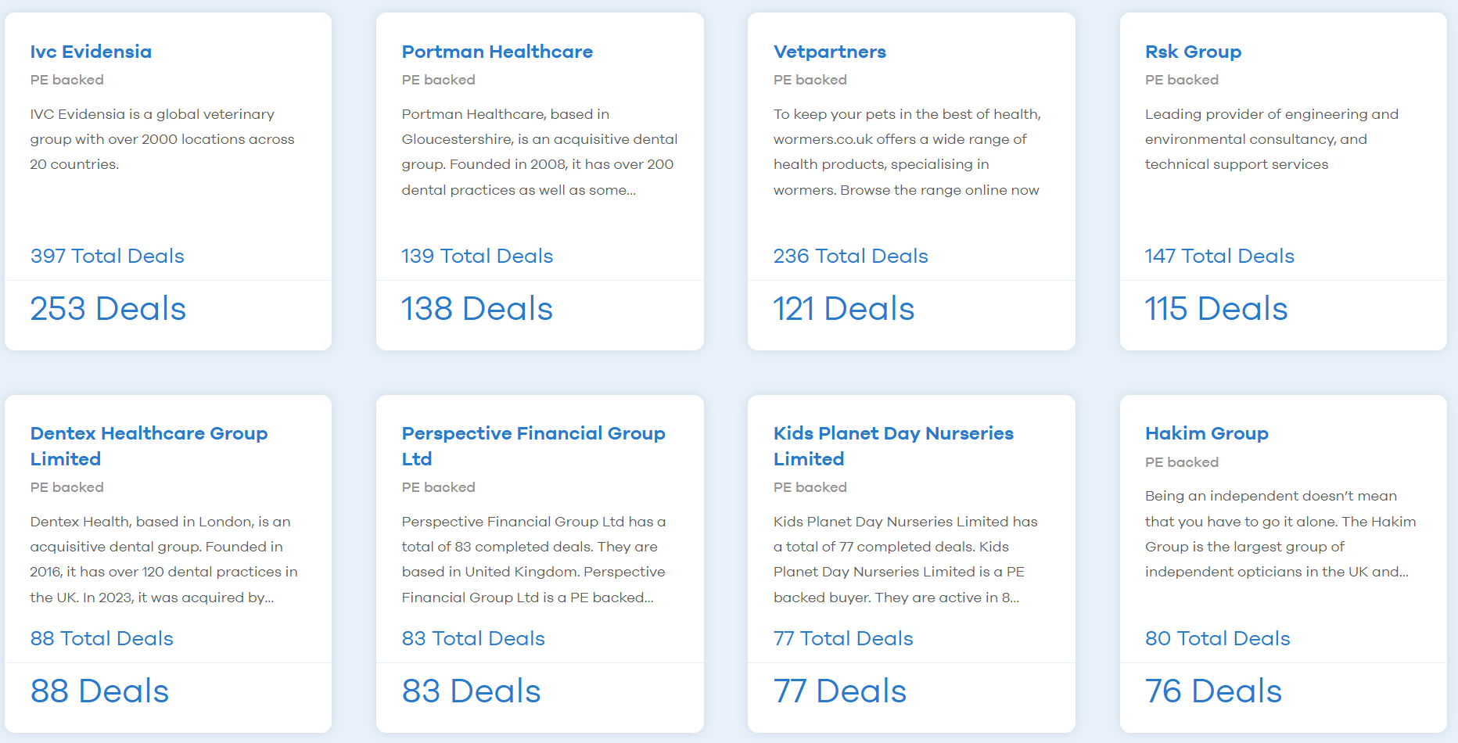
Top 10 PE-backed buyers
Revenue growth (cross-sell; operational improvements)
Margin improvement (centralised central costs)
Multiple Expansion
Source: MarktoMarket
Notes:
Healthcare Services roll-ups very popular – fragmented markets (although maybe not anymore), multiple arbitrage opportunity, buying power therefore margin improvement, upsell (vet example)….so triple whammy of sales growth, margin gain, multiple expansion
2 x vets
2 x dentals
Opticians
Then:
RSK – Engineering Consultancy
Wealth Management
Nursery

Slide 6
Who buys UK SMEs – UK vs USA vs RoW
Source: MarktoMarket
Notes:
Who acquires UK SMEs………..other UK SMEs
What is next most important market – US – 10-12%?
GET SOME SME US TO UK EXAMPLES
Just signed a US PE firm called Alpine Investors – using us because they think UK lower mid-market is an attractive asset class

Slide 7
Question
Excluding the UK and US, which country acquires the most UK SMEs?
Source: MarktoMarket

Slide 8
Who buys UK SMEs – Top 8 after UK and US
Source: MarktoMarket
Notes:
Swedish dominance…..2.5x its acquisitions of UK cos since 2019

Slide 9










Most active Swedish buyers
29 UK Target Deals
Wealth Management
27 UK Target Deals
Industrial and Technology
21 UK Target Deals
Dental, Demolition & Tools and System Solutions
19 UK Target Deals
Technology and Infrastructure
18 UK Target Deals
Manufacturing
16 UK Target Deals
Industrials
14 UK Target Deals
PE - Agnostic
11 UK Target Deals
Industrials
10 UK Target Deals
Pet Nutrition
8 UK Target Deals
Property Management
Notes:
Speaking to Internal M&A team at Odevo and they see UK as very attractive market with great fundamentals – fragmented, nation of entreppreneurs
Mostly industrials, specifically Engineering, but also Prop Maangement, Pet food, Wealth and a very big PE firm
Quasi-PE – most leave brand and have little integration – long-term home for your company

Slide 10
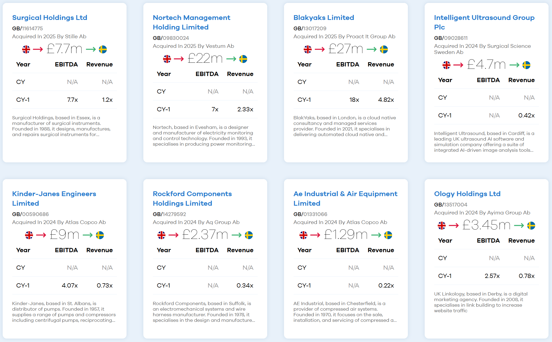
Recent Deals UK-SE
Notes:
Some recent deals and multiples from Sweden – some we have EBITDA and Revenue, some just revenue.
Some big multiples eg Blakyaks – but MSP so nice recurring revenue

Slide 11
UK Super-Sectors
Source: MarktoMarket
Notes:
TMT – trending down
Industrials – flat
BSS – flat
Consumer – recovering
Healthcare – flat
FS – flat
Energy – trending down

Slide 12
UK Hot Sub-Sectors
Source: MarktoMarket
Notes:
Annual volumes over last 5 years versus plus year to date chart of following sub-sectors (UK only):
Wealth & IFA – flat
Accountancy – trending up
Legal – trending-up
Fire – trending down
Cyber – trending up
Care homes – trending up

Slide 13
Drivers: Business Services & Tech-enabled Services Private Equity Strategies (Number of Platforms)
Source: MarktoMarket
Notes:
Number of PE-backed platforms in each sector covered in previous slide.
(includes non-Accountancy platforms backed by PE that have acquired at least 1 accountancy firm)

Slide 14
Deep Dive: Legal
Source: MarktoMarket
Notes:
PE money in Legal Services (PE & PE Backed deals)
LOTS MORE PLATFORMS BEING CREATED

Slide 15





Deep Dive: Legal
Source: MarktoMarket
Notes:
Most active PE back consolidators
Find it quite hard to see the logic here – lack of visibility
Also Gateley, which has shifted from acquiring just solicitors to law firms, management consultants, surveyors

Slide 16

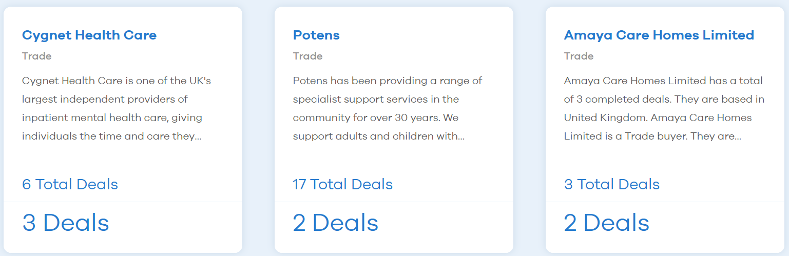
Deep Dive: Care Homes
Source: MarktoMarket
Notes:
99 buyers to 107 deals in 2025 (1/1/25 – 31/8/25)
Not one / two buyers doing loads of deals
Top 3 active acquirers Trade buyers
Why so much activity?
UK gaining population drives demand for care home services
Need for specialised elderly care (dementia etc) increases – investors attracted to long-term potential growth
Fragmented sector – large care home groups expected to pursue acquisition to consolidate the market, achieve economies of scale and enhance market presence – trend likely to accelerate as operators seek to mitigate rising costs and regulator pressures
Regulation – increasing regulatory scrutiny, & the need to meet high quality standards are pushing smaller, financially weaker operators to consider selling or merging – larger, more compliant operators are well-positioned to acquire these businesses and integrate them into their portfolios
Staffing Staff shortages, rising labour costs, remain significant risk for the sector – acquirers may use these challenges as leverage to negotiate lower prices

Slide 17
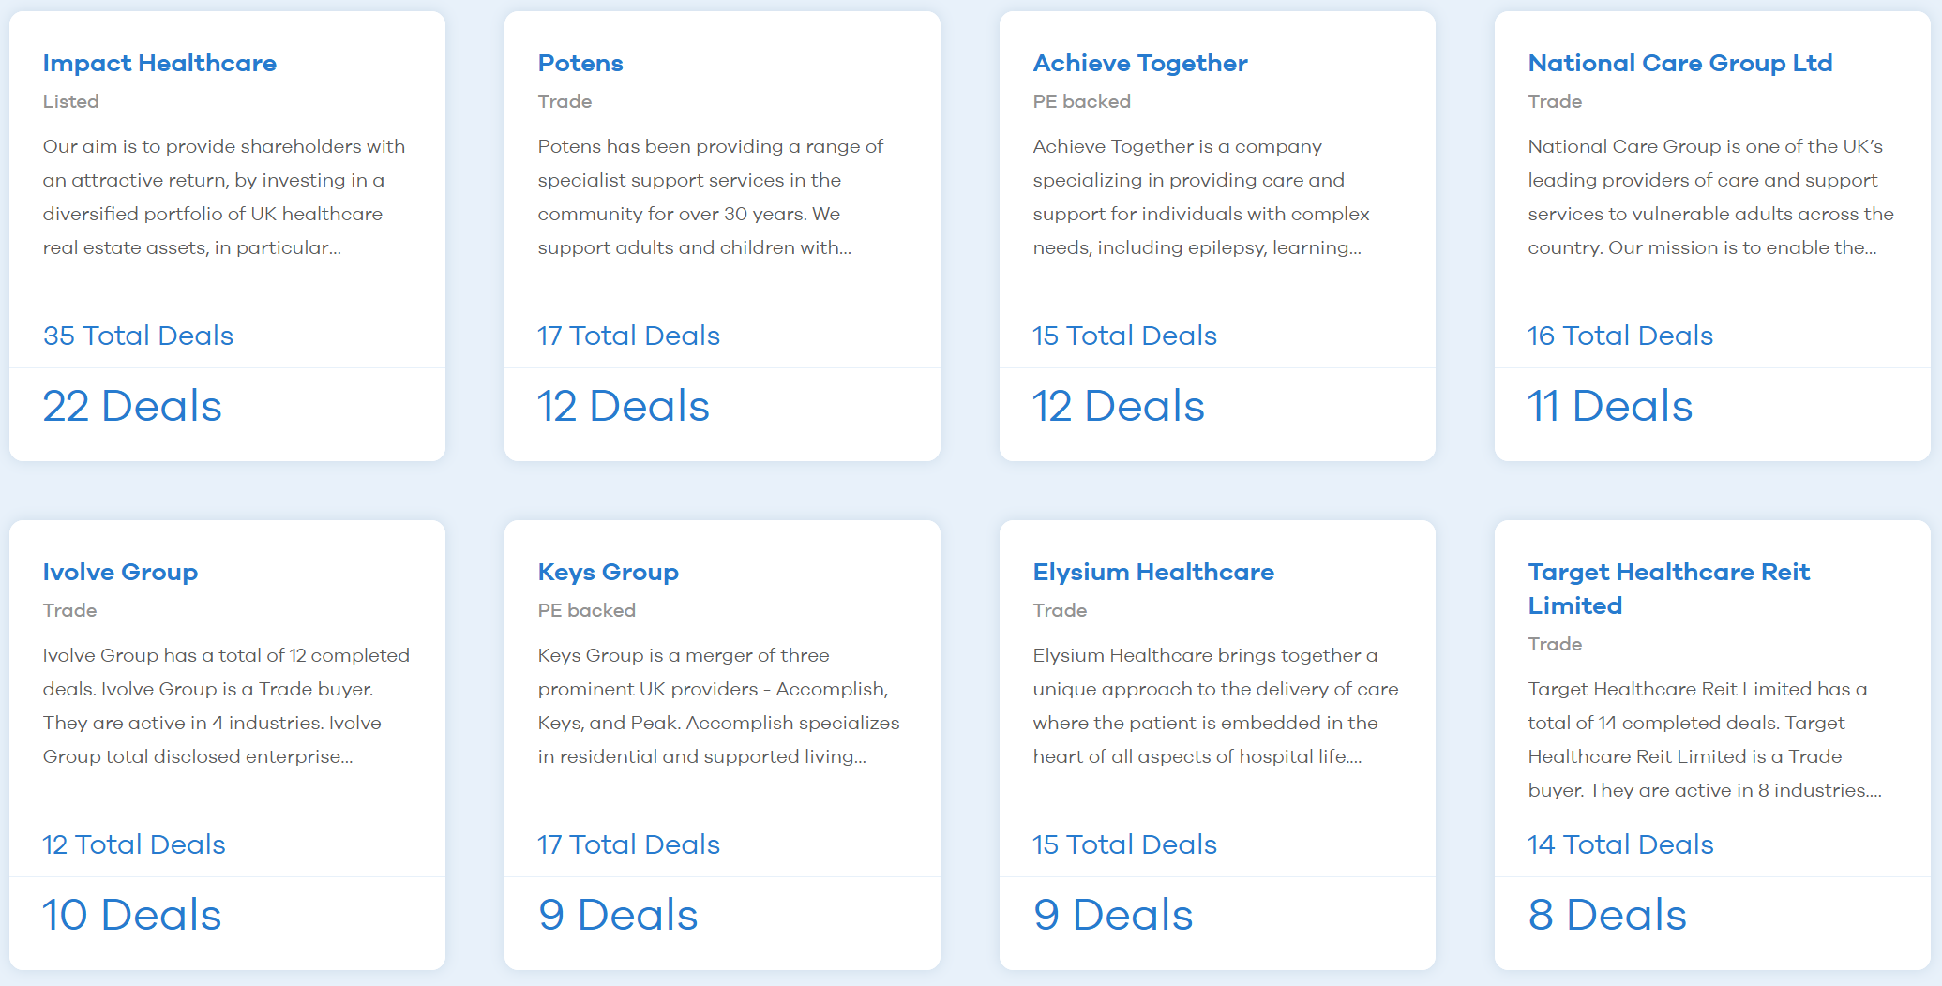
Deep Dive: Care Homes
Source: MarktoMarket
Notes:
Consolidators in the market

Slide 18





Deep Dive: Care Homes
G Square Capital
Apposite Capital
InfraBridge
Safanad
BGF
Source: MarktoMarket
Notes:
PE platforms in the sector

Slide 19




Drivers: SME Liquidity
Source: MarktoMarket;
Notes:
PE-backed Roll-ups / Search Fund / EOT / Buy & hold

Slide 20
Leading Indicators: New Business Creations
Source: MarktoMarket

Slide 21
2026 Predictions
Use PE platform creations to predict SME activity by sector….tells you professional services will remain a hot sector
Law firm deal volumes to overtake accountancy firms
Secondary deals in accountancy
Consolidation of search funds (wheat from chaff)
Tech valuation ‘recovery’ (if lower interest rates = higher present values)
The CFN conference will be in Edinburgh
Source: MarktoMarket

Slide 22

www.marktomarket.io
doug@marktomarket.io

