Slide 1
Valuation learning & reflections CFN 24/9

Slide 2
The best way to start anything is with a quick overview of the journey

Slide 3
Pre 2020
Knee jerk valuation work undertaken by all Directors.
Led to suspect and varied results.
Lack of consistency over method and calculation basis. Different pricing and engagement terms.
No system or process for the team to follow.

Slide 4
2020
Asked to do an independent expert valuation for family court. Said yes then realised I could have my day in court.
Was happy with end result but had a page of learnings.
Needed a more robust multiple that I could stand by but not something that took a week to calculate!
Needed to be fair and reasonable.

Slide 5
2021
Involved in two acquisitions (buying) and needed to support offer with robust valuation. Benefited from time to think clearly during lockdown.
Brought real clarity to understanding of Enterprise Value (EV) and Equity Value (EqV) various completion mechanisms and how we needed to apply these into valuations.

Slide 6
2022
Instructed on another family court valuation. Created a standard small business multiple guide based on the BDO quarterly multiple guide. Stress tested it against UK 200 and other valuation commentary and reports to ensure was robust. Layered in a review of the company using a business plan model to identify SW that could be backed up.

Slide 7
2023 onwards
Created two templates for valuations. Lite version for vanity valuations and full version for others.
Started to refresh the multiple guide each quarter and we built a set of processes that ensured we could undertake the valuations more efficiently.
We attach the multiple guide to the valuation providing the starting point for our multiple which we then adjust for strengths and weaknesses in the business model, size and lack of marketability.

Slide 8

2024/5
Instructed on 6 family court valuations as an independent expert and 2 instructions acting for one side. In one case we gave advice to the solicitor which helped reduce the valuation by £1.5m. Created an online assessment tool to gather information which makes it easy to collate and record info.
Content Snare

Slide 9
The future
Attended a four day valuation course in early 2025. This validated our model and thinking.
Looking to build out a cash flow based model and integrate IP valuations.
Undertaking training for family solicitors to build pipeline and relationships.

Slide 10
Six learnings from our journey

Slide 11
#1
It’s really important to spend time on the financial analysis to arrive at a robust adjusted EBITDA.
Average out one off items such as large repairs, bad debts etc.
Think about impact of global shocks on items such as energy costs and foreign exchange adjustments.
Average out exceptional periods of trading that generated super profit (covid)
Adjust for known changes (NIC)

Slide 12
#2
Understand clearly the mechanism for owners to draw income from the business and what their roles are.
Unless at market value adjust out all salary, pension, expenses and benefit costs etc.
Replace with market values.
Use data from sources like Indeed and other salary data to back up roles and ensure regional bias is adjusted.

Slide 13
#3
For businesses with substantial plant and machinery assets consider making an adjustment for economic depreciation or replacement cost.
Lots of research on why this is important (McKinsey and Damodaran) promote the concept of adjusting for cap X.
Adjustment done after EBITDA in calculation.
Replacement cost less residual value / UEL. (depreciation!)

Slide 14
#4
Consider the trading cycle of the company and whether the point of valuation requires an adjustment to working capital.
Twelve month analysis of working capital to arrive at average.
Look for trends that mean average might change.
Be clear about what is being included in calculation.
Map all items on the balance sheet to working capital – debt/ cash etc.

Slide 15
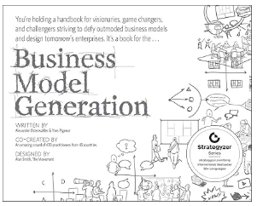
#5
Ensure you have substantial back up for the multiple you use.
Specific sector multiples
Consider the strength of the business.

Slide 16
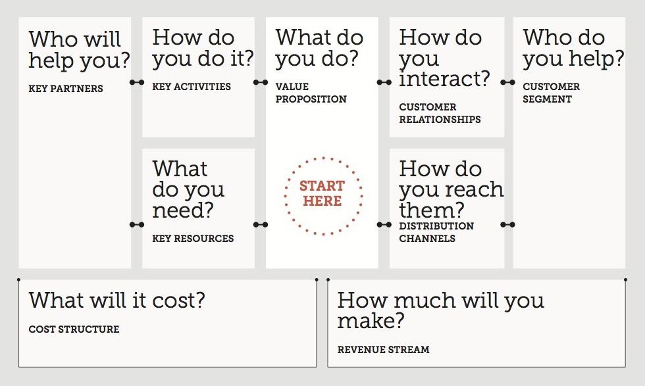

Slide 17
#5
Ensure you have substantial back up for the multiple you use.
Specific sector multiples
Consider the strength of the business.
Various discounts
GPRS (Growth, Performance, Risk and Size) – all evidence based.
DLOM – Discount lack of marketability
DLOC – Discount lack of control
DLOL – Discount lack of liquidity (payback)
CCMD – Closed Company Minority Discount.

Slide 18
#5
Also consider whether there should be n acquisition premium added?
CP – Control Premium
SP – Strategic Premium
Will be more likely in larger company that is more marketable.

Slide 19
#6
Review balance sheet for “excepted assets” those that have a value outside of the multiple approach valuation.
Properties for example can be excluded and included as a separate asset in the valuation (i.e. added in at the end).
If doing so consider making a deemed rent adjustment in the EBITDA adjustment.
If formal valuation use RICS value from an independent expert or instruct them to.

Slide 20
#6
Consider if the value of the business is in the Intellectual Property. – life cycle

Slide 21
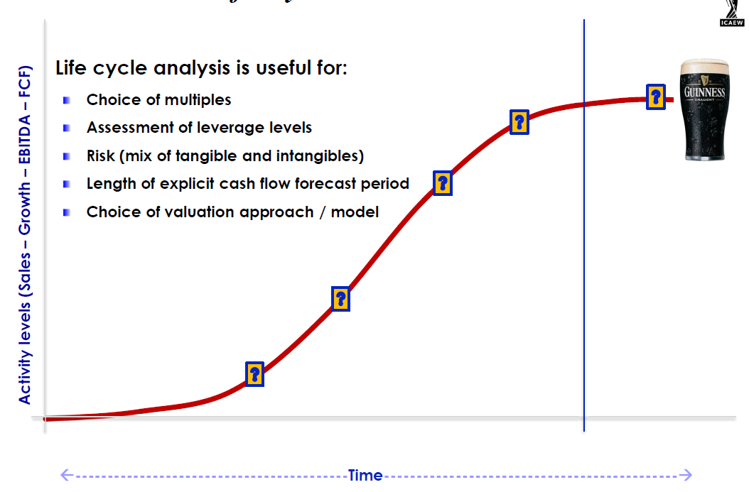
Difficult to value in this phase due to Growth, Performance, Risk and Size
More predictable cash flow and performance.
As performance becomes more predictable growth in value is driven by intangibles

Slide 22
#6
Consider if the value of the business is in the Intellectual Property
Early start up with technology evidenced by patents, design rights, licenses.
Established businesses with strong recognised and protected brands.
If there is substantial IP consider whether an independent IP valuation is needed...

Slide 23
Questions (No Answers)
Thank You

