Slide 1
The CFN - The World of ETA
Simon Webster

Slide 2
Simon Webster
MBA 1989 -1991 @ LBS
Wanted to be an entrepreneur but… I did not have the ‘big’ idea
Heard about - and decided to do - a (T)SF
First outside the USA
5th person Worldwide
© 2025 Proprietary & confidential

Slide 3
What did I do?
My search – 6 months fundraising, 3.5 year search
Bought a prosthetics and orthotics company
 | Year 1 | Year 10
Sales | £3.5m | £30m
EBITDA | £0.4m | £2.5m
Market: Prosthetics | 8% 16 players | 30% Largest
Orthotics | 0% 1 Clinician | 12% Largest
Employees | 50 | 450
Sold to PE and stayed as CEO for 2 years
© 2025 Proprietary & confidential

Slide 4
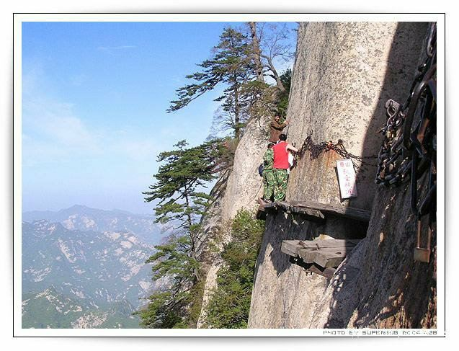
© 2025 Proprietary & confidential

Slide 5
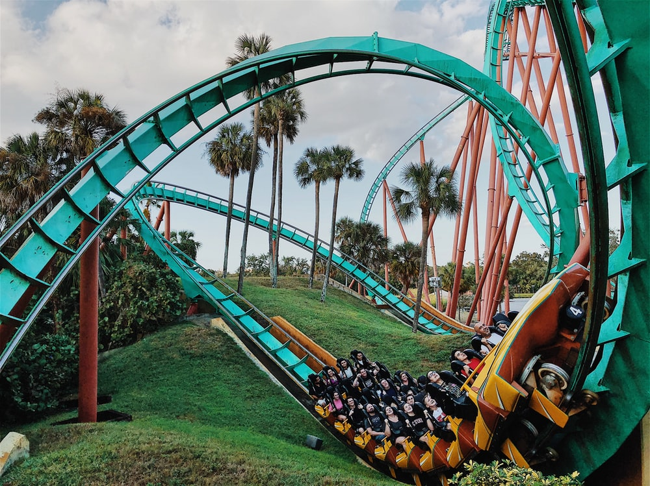
© 2025 Proprietary & confidential

Slide 6
What have I done since selling the company?
Spreading the word / teaching
Informal sessions at LBS, INSEAD, and IESE
Chair of Advisory Board of SF Centre IESE
Conference / events at Stanford & IESE
Lecture at LBS and Judge Business School
Contributor to search fund textbook and papers
Mentor and sit on various search fund company boards
Shareholder and director at two major turnarounds (one losing £3m p.a. and the other losing £1.3m p.a.; both are now profitable)
© 2025 Proprietary & confidential

Slide 7
ETA alternatives
 | Traditional Search Fund
Stages | Fundraising Searching Acquisition and fundraising Operating Exit
Number of Investors | c. 15
Largest single investor | Searcher
Searcher remuneration | c. 2/3rds of post-MBA average salary
Searcher equity | 25% (solo), 30% (partnerships) based on hurdles
Step-up of search capital | 50%
Target business criteria? | Searcher / investor
© 2025 Proprietary & confidential

Slide 8
ETA alternatives
 | Traditional | Self-Funded Search
Stages | Fundraising Searching Acquisition and fundraising Operating Exit | Searching Acquisition FUNDRAISING Operating Exit
Number of Investors | c. 15 | c. 4
Largest single investor | Searcher | Searcher
Searcher remuneration | c. 2/3rds of post-MBA average salary | None
Searcher equity | 25% (solo), 30% (partnerships) based on hurdles | More flexible, often between 50% and 70%
Step-up of search capital | 50% | No
Target business criteria? | Searcher / investor | Searcher / size
© 2025 Proprietary & confidential

Slide 9
ETA alternatives
 | Traditional SF | Self-Funded Search | Sponsor-backed Search
Stages | Fundraising Searching Acquisition and fundraising Operating Exit | Searching Acquisition FUNDRAISING Operating Exit | Finding sponsor & terms Searching Acquisition and fundraising Operating Exit
Number of Investors | c. 15 | c. 4 | 1
Largest single investor | Searcher | Searcher | Sponsor
Searcher remuneration | c. 2/3rds of post-MBA average salary | None | Yes, agreed with sponsor
Searcher equity | 25% (solo), 30% (partnerships) based on hurdles | More flexible, often between 50% and 70% | Yes, agreed with sponsor
Step-up of search capital | 50% | No | Maybe
Target business criteria? | Searcher / investor | Searcher / size | Sponsor dependent
© 2025 Proprietary & confidential

Slide 10
© 2025 Proprietary & confidential

Slide 11
Growth…

Slide 12
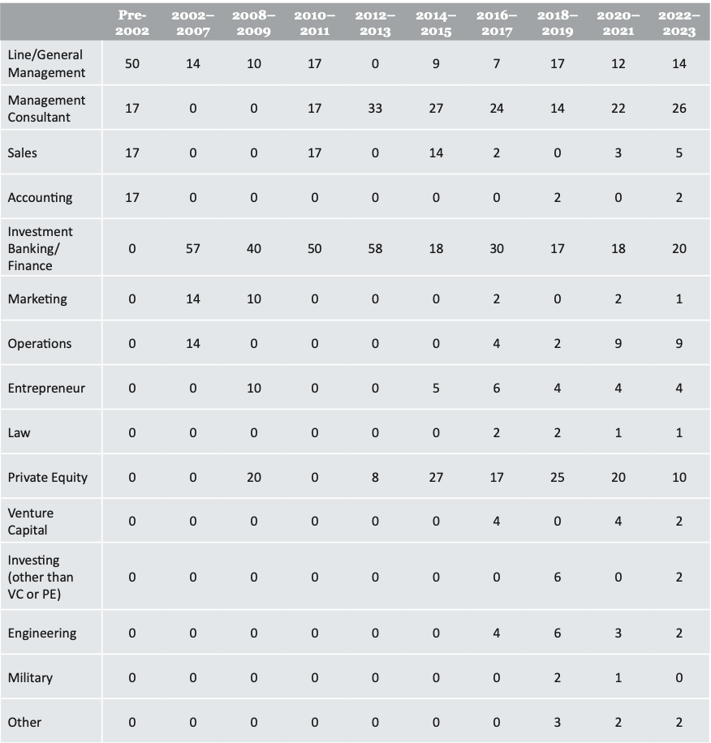
Searcher backgrounds
© 2025 Proprietary & confidential

Slide 13
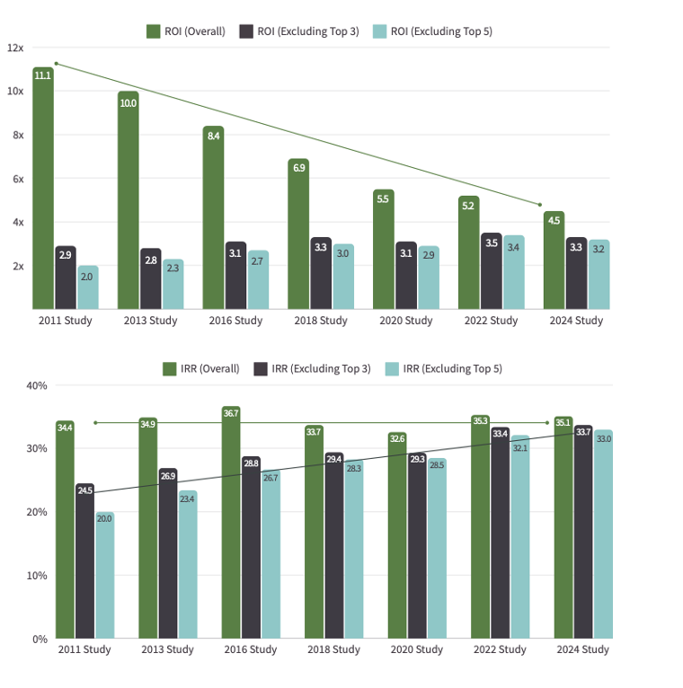
Returns

